Slide 1
From Child Welfare to Children Well-being:
What can we learn from children?
The 2014 Hokenstad International Lecture
60th CSWE 2014 Annual Program Meeting (APM);
October 23–26, 2014
Tampa Florida
Asher Ben-Arieh
Paul Baerwald School of Social Work, Hebrew University of Jerusalem
The Haruv Institute, Jerusalem
benarieh@mail.huji.ac.il

Slide 2
What do I want to talk about?
The changing context of child welfare
Recent changes and shifts in our understanding of children’s well being
The special role of social work
What can we learn from children

Slide 3
Changing Contexts
The way we understand well-being today is different than what we thought in the past
The changes are universal but they occur at different paces in different places.
Child Welfare
Child Well-Being
Child-Saving
Child Development

Slide 4
Changing Contexts
The children themselves are “pushing” toward a new concept.
In fact I would argue that the changes can be summarized by a number of shifts.
Studies have found that these shifts are indeed happening all over the globe, even if at different paces.

Slide 5
The First Shift - From Survival and Basic Needs to Development and Well-Being
Much attention has been paid to children’s physical survival and basic needs – and for good reasons. The result was the focus on saving children.
Infant and child mortality, school enrollment and dropout, immunizations, and childhood disease are all examples of measures of well being in regard to basic needs.
But now the definition of well being moved from supplying minimums, as in saving a life, to a focus on quality of life.

Slide 6
The Second shift - From Negative to Positive
The absence of problems or failures does not necessarily indicate proper growth and success.
Understanding well being as absence of risk factors or negative behaviors is not the same as focusing on protective factors or positive behaviors.
Thus, the challenge is to develop a concept that holds societies accountable for more than the safe warehousing of children and youth.

Slide 7
The Third Shift - From Well-Becoming to Well-Being
In contrast to the immediacy of well-being, well-becoming describes a future focus (i.e., preparing children to be productive and happy adults).
The conventional preoccupation with the next generation is a preoccupation of adults. Although not a necessarily harmful view, anyone interested in children and childhood should also be interested in the present as well as future childhood.
Focusing on preparing children to become citizens suggests that they are not citizens during childhood.
Both perspectives are legitimate and necessary. However, the emergence of the child-centered perspective, introduced new ideas and energy to the child well being concept.

Slide 8
The Fourth Shift - Incorporating children rights and beyond
Although inspired and to some extent guided by the child rights movement, the new concept of well being goes beyond the concept of rights.
Perhaps the most crucial difference is the standard used to measure children’s status. Children’s well-being is normally focused on what is desired, but rights monitoring addresses legally established minimums.
Monitoring rights and monitoring well-being also share a focus on child-centered indicators, ones that can be measured at the level of the child.
Such indicators draw attention to the actual situation of children.

Slide 9
The Fifth Shift - From an adult to a child perspective
When these changes were taken into account, efforts to study children’s well-being had to ask the following questions:
  What are children doing?
  What do children need?
  What do children have?
  What do children think and feel?
  To whom or what are children connected and related?
  What do children contribute?
  Answering such questions demanded a better picture of children as human beings in their present life including the positive aspects of it.
To better answer such questions, the field had to focus on children’s daily lives, which is something that children know the most about.

Slide 10
But why did it happen?
I would argue that this change in context is the consequence of two major sources:
  new normative and theoretical advancements.
  changes in the technical and methodological ability to study children’s well-being.
  I will now turn to discuss these sources of change.

Slide 11
“New” Normative and Theoretical Approaches
Theories and normative approaches to children welfare abound. Many have contributed to the changing context and many more continue to do so.
Yet, I single out three such approaches that influenced the changing child welfare context, these include:
  the ecological theories of child development;
  the normative concept of children’s rights; and
  the new sociology of childhood as a stage in and of itself.

Slide 12
New Methodological and Technical developments
Just as new theories contributed to the new context of children's well being, I would argue that three methodological perspectives have done the same:
  the call for using the child as the unit of observation;
  the emerging importance of subjective perspectives; and
  the expanded use of administrative data and the growing variety of data sources.

Slide 13
But how do all of these relate to social work and its role?

Slide 14
Our code of ethics calls us to be advocates for children’s well being
Social workers pursue social change, particularly with and on behalf of vulnerable and oppressed individuals and groups of people.
Social workers strive to ensure equality of opportunity and meaningful participation in decision making for all people.
Source: The Code of Ethics, the National Association of Social Workers

Slide 15
Children’s rights calls us to be advocates for children’s well being
States Parties shall assure to the child who is capable of forming his or her own views the right to express those views freely in all matters affecting the child.
For this purpose, the child shall in particular be provided the opportunity to be heard in any judicial and administrative proceedings affecting the child, either directly, or through a representative or an appropriate body.
Source: Convention on the Rights of the Child, Article 12

Slide 16
The best interest of the child calls us to be advocates for children’s well being
Children’s participation leads to better decision and services for children.
Children’s participation enhances children’s skills and self esteem.
Children’s participation better protects children.
Source: Landsdowm, 2001 ; Sinclair and Franklin, 2000 in : Brady 2007

Slide 17
But - if it’s our obligation to represent children then we need to know what are they saying.
There is no way we can know what children need or want without asking them.

Slide 18
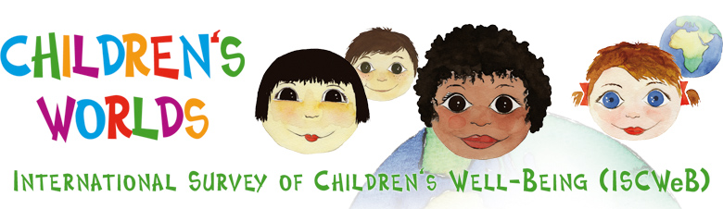

So what can we learn from children?
www.isciweb.org

Slide 19


Background
Children’s Worlds is a world-wide research survey on children’s subjective well-being and daily activities.
The purpose is to improve children's well-being by creating awareness among children, their parents and their communities, but also among opinion leaders, decision makers, professionals and the general public.
The study aims to collect solid and representative data on children’s lives and daily activities, their time use, and in particular on their own perception of their well-being.
By determining the degree of children’s well-being in as many countries as possible, we hope to raise awareness to children’s well-being and their life situations and to influence government policies and services.

Slide 20
Extended Pilot 2011-2012
~ 35,000 children
Ages 8, 10 & 12
14 countries.
Goal was 1,000 kids per age group per country
Convenience sample
Included countries with less children
Not all countries had the 3 age groups

Slide 21
Extended pilot 2011-2012 : Non-representative samples. # of participants
Country | 8 y.o | 10 y.o | 12 y.o | total
Algeria | 594 | 435 | 428 | 1457
Brazil | 1173 | 1293 | 1005 | 3471
Canada | 261 | 144 | - | 405
Chile | 1052 | 693 | 827 | 2572
England | - | - | 1141 | 1141
Israel | 1034 | 992 | 998 | 3024
South Korea | 2746 | 2652 | 2602 | 8000
Nepal | - | 295 | - | 295
Romania | 1041 | 927 | 1354 | 3322
Rwanda | - | 295 | - | 295
South Africa | - | - | 1002 | 1002
Spain | - | - | 5727 | 5727
Uganda | - | 1000 | 1035 | 2035
USA (South Dakota) | 522 | 502 | 784 | 1808
Total | 8423 | 9228 | 16903 | 34554

Slide 22
Full Survey 2013-2104
54,000 children. ~ 18,000 per age group
15 countries from different continents, varied cultures, diverse religions, distinct development and different types of welfare states.
A representative sample of the entire country or federal region.
  The entire country: England, Estonia, Ethiopia, Israel, Nepal, Norway, Romania, South Korea.
  Federal region: Algeria (El Bayedh , Tlemcen and Oran), Colombia (Antioquia), Germany (Thuringia, Hesse, Baden-Wurttemberg and North Rhine-Westphalia) Poland (Wielkopolska), South Africa (Western Cape), Spain (Catalonia), Turkey (Istanbul).

Slide 23
Full Survey 2013-2104
Sample was based on mainstream schools, and therefore did not include special education schools and etc.
Sampling strategy varied from country to country, subject to the characteristics of each.
To ensure the quality of the sample each sample plan, prepared by the local teams, was reviewed and approved in advance by a 'sample committee' comprised of four experts.

Slide 24
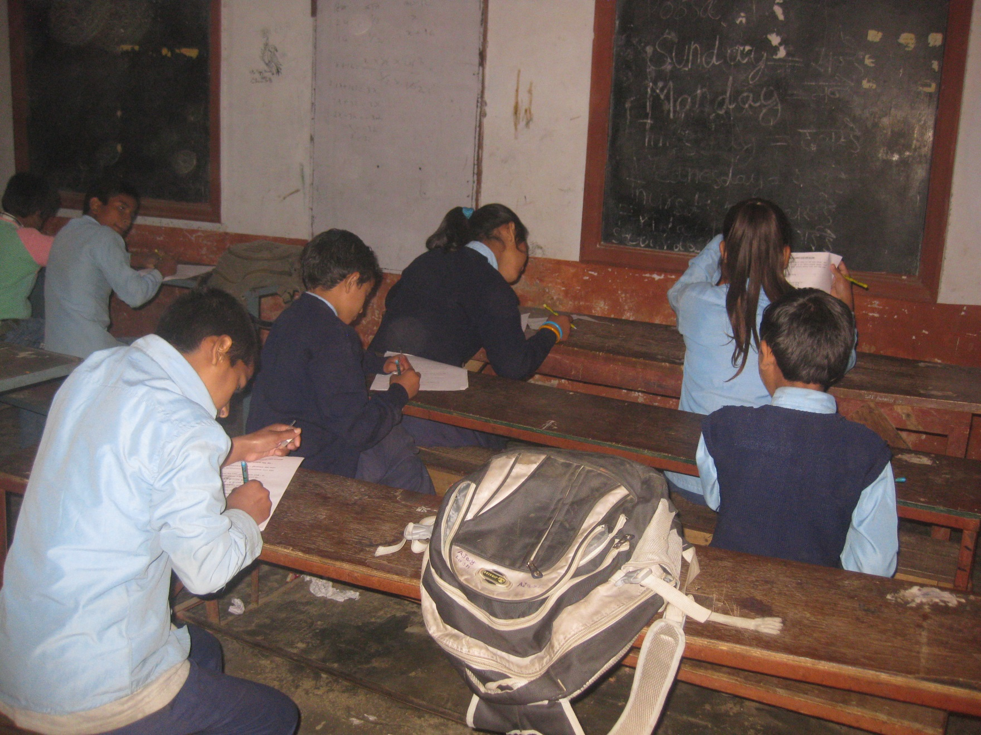
Data collection in Nepal

Slide 25
Full survey 2013-2014 – representative samples. # of participants
Country | 8 Y.O | 10 Y.O | 12 Y.O | Total
Algeria | 1385 | 1216 | 1359 | 3960
Colombia | 1003 | 1071 | 1007 | 3081
England | 990 | 989 | 1319 | 3298
Estonia | 1131 | 1034 | 1033 | 3198
Ethiopia | 1000 | 1000 | 1000 | 3000
Germany | 1069 | 1143 | 851 | 3063
Israel | 1004 | 1030 | 954 | 2988
Nepal | 1073 | 1073 | 1073 | 3219
Norway | 977 | 1033 | 1000 | 3010
Poland | 1078 | 1156 | 1038 | 3272
Romania | 1422 | 1424 | 1561 | 4407
South Africa | 1032 | 1109 | 1143 | 3283
South Korea | 2323 | 2323 | 2607 | 7253
Spain | 1066 | 1082 | 1717 | 3865
Turkey | 1045 | 1079 | 1029 | 3153
Total | 17598 | 17762 | 18691 | 54051

Slide 26
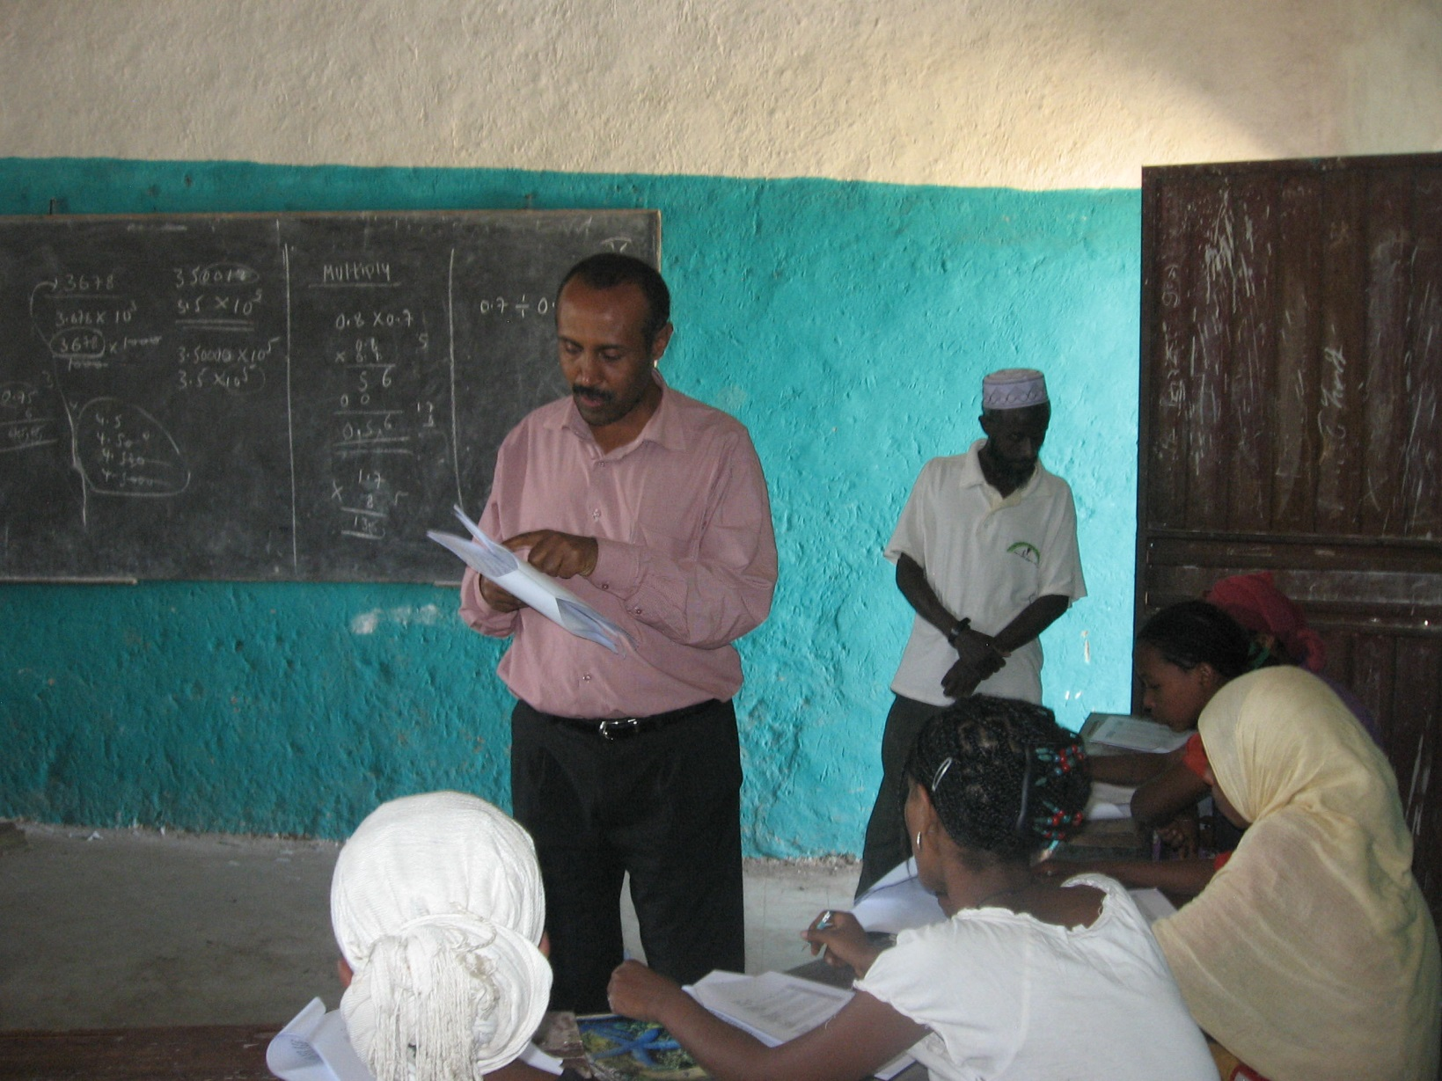
Data collection in Ethiopia

Slide 27
What did we ask?
Questions about frequency of activities
Satisfaction scales of life in large and specific domains or factors
Agreement scales with status and events.
Socio-demographic characteristics

Slide 28
How did we ask it?
Three versions of the questionnaire were created, one for each age group.
Questionnaires differ in length; the questionnaire for age 12 is the longest while the questionnaire for age 8 is the shortest.
Three types of scales – agreement, satisfaction, and frequency – were used to measure each of the aspects of children’s lives.
In the 8-years-old version, a scale of emoticons was used for the satisfaction items and these items were phrased in term of happiness (‘How happy you feel with...’).

Slide 29
How did we ask it?
Frequency: of activities in last week, month and year
Agreement scales: five-point unipolar agreement scale was used. Children could also choose to answer 'Don't know' which was then coded as missing data.
Satisfaction scales: 11-point scale, with 0 denoting ‘not at all satisfied‘ and 10 ‘totally satisfied'.
Response scale for the satisfaction items in the 8 year-olds questionnaire consisted of five emoticons (from a sad face to a happy face), for the data coding the scale was converted to a 0-4 scale.

Slide 30
Which topics did we cover?
You – age, gender, place of living
Your home and the people you live with
Money and things you have
Your friends and other people
The area where you live
School
How you use your time
More about you
How you feel about yourself
Your life and your future
In addition, several well-known SWB psychometric scales are used in the questionnaire, both context-free and domain-specific

Slide 31
Some initial thoughts
Almost 90,000 kids ages 8, 10 & 12 from 21 countries, various religions, cultures and languages were comfortable with 95% of the questions we asked.
The only problematic domain was family formation. For example you can not ask an Arab child if his mother lives with a boy friend…

Slide 32
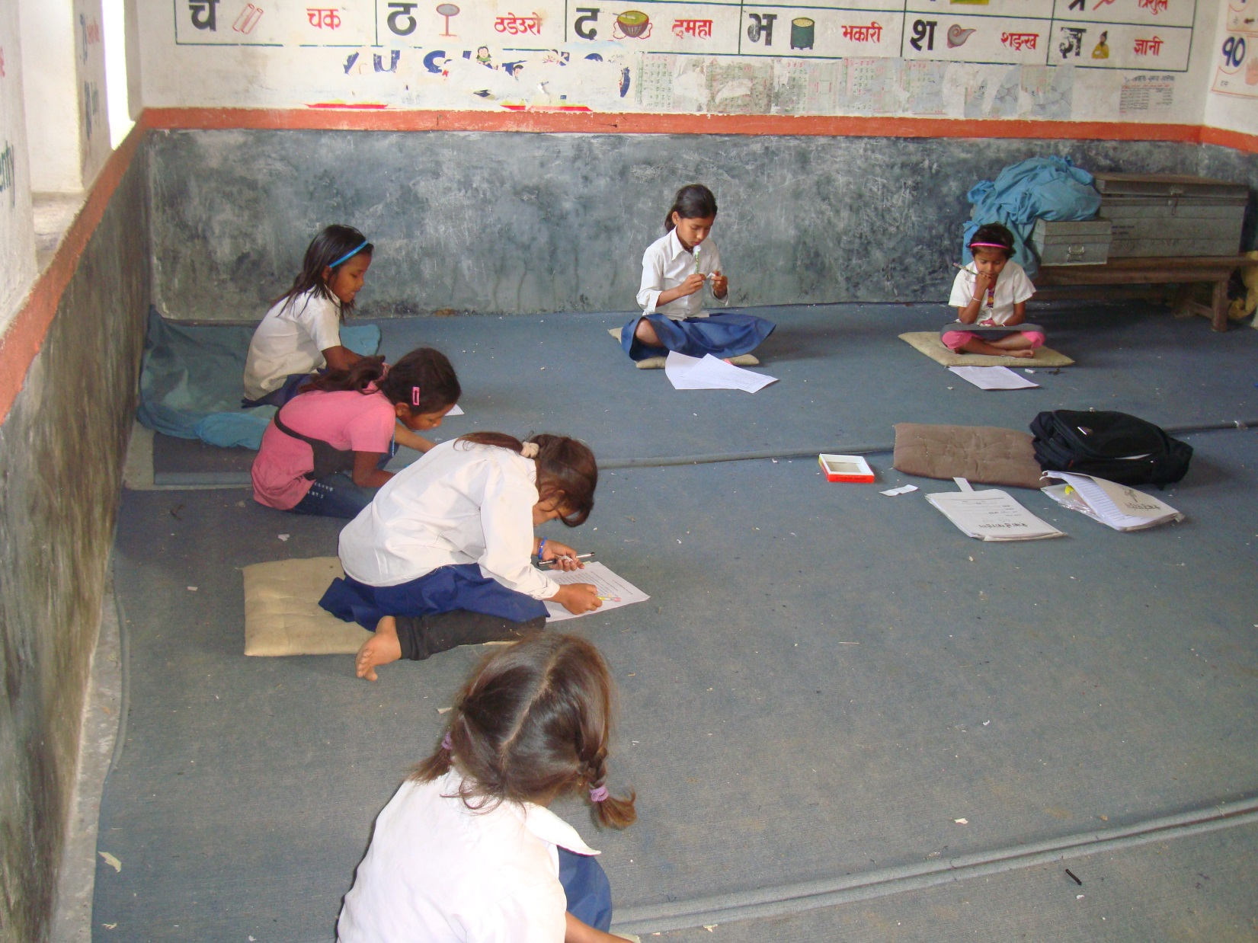
Data collection in Nepal

Slide 33
Overall subjective well-being
The survey included 29 questions about children’s satisfaction with different aspects of their life
A question about satisfaction with life as a whole (0-10)
Six questions about positive affect in the last two weeks (0-10)
Short version of Huebner’s Student Life Satisfaction Scale (SLSS) (5 items, 0-10)
Cummins and Lau’s Personal Well-Being Index-School Children (PWI-SC) (7 items, 0-10)
Huebner’s Brief Multidimensional Student Life Satisfaction Scale (BMSLSS) (5 items, 0-10)
All multi-item scales have been converted to 0 to 100 for comparison purposes

Slide 34
How satisfied are you with…
12 year-old

Slide 35
How satisfied are you with…
12 year-old

Slide 36
How satisfied are you with…
12 year-old

Slide 37
12 year-old
Life as a whole
Comparison with the average of the total sample
Notes:
The average is calculated as each country sample weights to 100

Slide 38
Your home and the people you live with

Slide 39
I feel safe at home
12 year-olds

Slide 40
My parents listen to me and take what I say into account
12 year-olds

Slide 41
How satisfied are you with…
12 year-old
The house or flat The people who All the other people Your family
where you live live with you in your family life

Slide 42
Money and things you have

Slide 43
How satisfied are you with all the things you have?
12 year-old

Slide 44
How often worry about how much money family has
12 year-old

Slide 45
Your friends and other people

Slide 46
My friends are usually nice to me
12 year-old

Slide 47
How satisfied are you with…
12 year-old
Your friends The people who live Your relationships with
in your area people in general

Slide 48
The area you live in

Slide 49
I feel safe when I walk around in the area I live in
12 year-old

Slide 50
How satisfied are you with…
12 year-old
The local police The outdoor areas children The area where you
in your area can use in your area live, in general

Slide 51
School

Slide 52
My teachers treat me fairly
12 year-old

Slide 53
I feel safe at school
12 year-old

Slide 54
How often hit by other children in school
12 year-old

Slide 55
How often left out by other children in your class
12 year-old

Slide 56
Your activities and satisfaction

Slide 57
Taking care of family members
12 year-old
Rarely or Less than once Once or twice Everyday or
never a week a week almost everyday

Slide 58
How satisfied are you with…
12 year-old
Your health The way that you look Your self-confidence

Slide 59
10 and 12 years old
Questionnaires were very similar
Responses were similar
The age phenomenon in regard to children's subjective well being is worth noticing
When children grow up they are less satisfied with life - on all scales!

Slide 60
Is it about age?
Student Life Satisfaction Scale (SLSS)

Slide 61





8 year-old
The version for children aged 8 was shorter
Satisfaction items were phrased in term of happiness (‘How happy you feel with...’)
A scale of emoticons was used for the these items
Notes:
Cases with more than 20 missing values were excluded

Slide 62
I feel safe at home
8 year-old

Slide 63
My parents treat me fairly
8 year-old

Slide 64
How happy you feel with…
8 year-old
The house or flat The people who All the other people
where you live live with you in your family

Slide 65
I have enough friends
8 year-old

Slide 66
I like going to school
8 year-old

Slide 67
I feel safe at school
8 year-old

Slide 68
So what does it all means?
Children know how to reliably describe their life.
Their perspective is different than ours.
Children know what they need.
We as social workers are obliged to promote their well being
In order to do it we need more data and we need to talk with children

Slide 69
What do we need to do?
If children’s well being is our goal – we need to discover what promotes or harms it.
Our data set enabled us to explore the variance in children’s well being and what is associated with it.
Finding were surprising

Slide 70
The characteristics of children’s well being
The variance in children’s SWB is barely explained by socio-demographic variables.
It is better explained by variables that measure children’s relations and perceptions.
This is a new and growing area of research.
Initial studies found three strong predictors of children’s SWB:
  Bullying
  Perception of safety
  Respect for children and inclusion of their voice

Slide 71
The characteristics of children’s well being
All three are well within the realm and goals of the social work profession
To fulfill our mission as social workers we need to promote children’s well being.
The children tell us that to do so we need to focus on ensuring their safety, reducing violence and fostering better family and social relations.

Slide 72
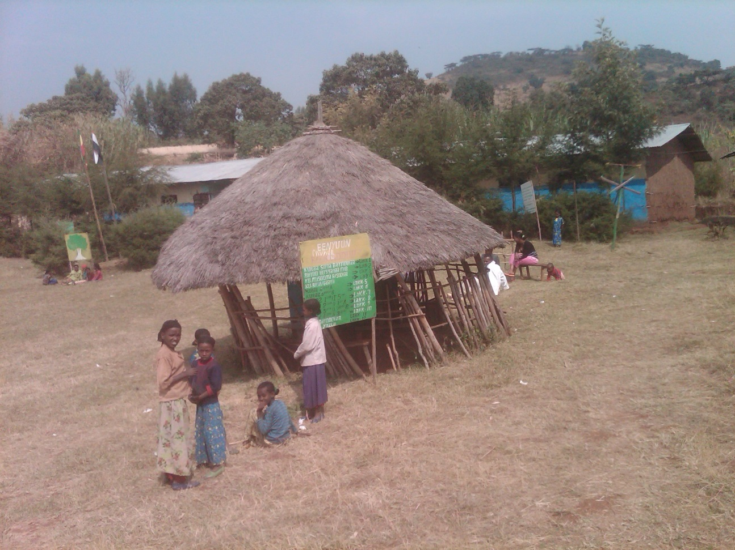
Thank you very much!
Asher Ben-Arieh
Paul Baerwald School of Social Work and Social Welfare, The Hebrew University of Jerusalem
www.isciweb.org

