Slide 1

Summit on Field Education 2014
October 23, 2014
Name of Presentation

Slide 2
Virna Little, PsyD, LCSW-R, SAP
Senior Vice President, Psychosocial Services and
Community Affairs
The Institute for Family Health, New York, NY
The Value of Social Work in Integrated Care

Slide 3
Pack your Bags!
For the next few years…

Slide 4
Health Reform in the Works
Health Reform
Medical Homes/ BH Homes
ACOs

Slide 5

Triple AIM
Improve patient experience
Decrease costs
Improve quality

Slide 6
“We should not maintain state systems if the alternative is being part of the mainstream….we must lead to achieve integration of care everywhere….
I believe that a few entrepreneurial leaders will embrace the challenge of true integration…
from policy to plan to practice.
These entrepreneurs will also succeed in business because the game will come to them”
-M. Hogan, Commissioner, NYS OMH

Slide 7
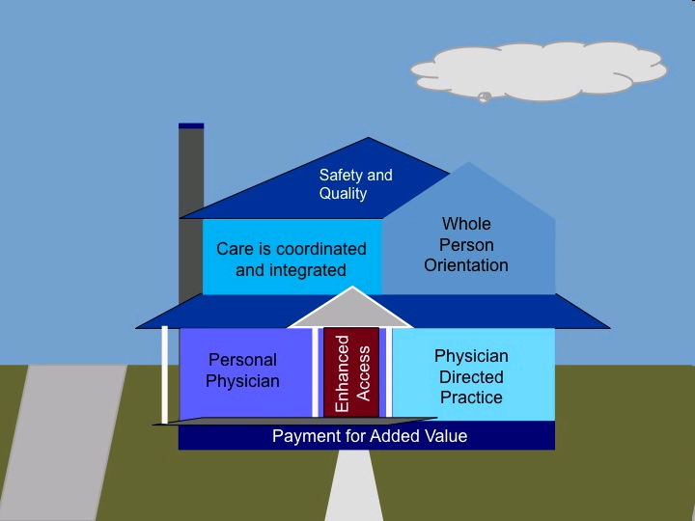

Slide 8
Are You Thinking About Care Management?
Care manager for all!!!
Excellent opportunities
Models with social workers
Training

Slide 9

Key Elements
Clearly identified care team
Care management
  Coordinate care between providers
  Identify and address barriers to care
  Implement single integrated care plan
Longitudinal care plans
  Comprehensive single document
  Transdisciplinary
  Part of routine care for all providers
Notes:
Health Homes are defined by a few elements
Patient should be able to identify members of their care team. Similar to PCMH
Care Management largely carried out by dedicated care managers
All providers will be transitioning to a single, integrated care plan. Supports principles of integrated care

Slide 10

PCMH Framework
9 Core Measures
Critical Elements
Behavioral Health
Vulnerable Population
Patient
Tracking
Access
Performance
Improvement
PCMH
Communication
Care Management

Slide 11

Around We Go
Integrated Care
Multidisciplinary
Care
Collaborative
Care
Co-located
Interdisciplinary
Care
Transdisciplinary
Care

Slide 12
The Common Thread
ALL need social workers!

Slide 13
Social Workers
Need to be flexible
  It’s okay interrupt my session!
Need to be open
  Yes, open access to my schedule
    What schedule?
Extended hours
  Sure, I’ll work this weekend!
Documentation
  Yes, I will share my notes!

Slide 14
What We Need You To Teach
Population Management
Tools
Technology
Episodic Care
Chronic Care Models
Care Management/Coordination
Care for Suicide Risk
Behavioral Activation
Longitudinal Care Planning
Terminology-ACO, FQHC, etc.

Slide 15
Federally Qualified Health Center (FQHC) Expansion
Health Care Reform Mandate to double patients served by 2015
  Largest employer of social workers
  2/3 of the mental health services in the United States

Slide 16
Accountable Care Organizations
Accountable care management needs
Annual wellness-depression care
Share in some of the cost savings
Population management

Slide 17
If Social Workers Are
Not at the Table
Nursing and psychology
Care management will go on
Population management models
Networks will develop

Slide 18

Looking to the Future

