Slide 1
Patient Protection and
Affordable Care Act
Module 4
Victoria Stanhope, PhD
New York University

Slide 2
Module Objectives
To provide an understanding of the context for health care reform in the United States
To provide an update on the legislative and legal status of the PPACA
To describe the major provisions of the law related to primary and behavioral healthcare integration
To provide an overview of legislation related to PPACA

Slide 3
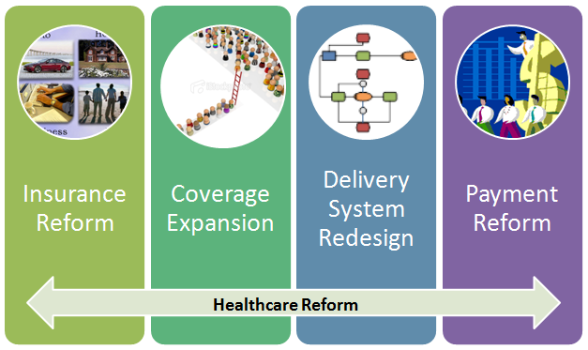
National Healthcare Reform
Four Key Strategies

Slide 4
Overview
How is healthcare reform going to work?
What is it going to do?
  Expand coverage
  Contain costs
  Improve quality and system performance
  Promote prevention & wellness
Who benefits?
When is it going to happen?

Slide 5
Expanding Coverage
The Individual Mandate
  The requirement to buy coverage
Employer subsidies
  Play or pay provisions
  50 or more employers
State Health Insurance Exchange
  Individual and small businesses can purchase insurance through exchanges
  No public option
Medicaid expansion
  To all non Medicare eligibles with incomes under 133% FPL

Slide 6
Dual Eligibles
Dual eligibles are people who quality for both Medicare (due to age or disability) and Medicaid (due to income)
CMS created a Federal Coordinated Health Care Office to improve integration of benefits for dual eligibles
  Provides states, providers, and other relevant entities or individuals with the information and tools needed to develop programs that coordinate benefits for dual eligibles
  Supports state efforts to coordinate acute and long-term care services for dual eligibles with other benefits provided under Medicare
  Supports coordination of contracting and oversight by states

Slide 7
Supreme Court Case
The Oran Arguments
Supreme Court Decision (5-4 vote)
  The individual mandate is a constitutional exercise of Congress’ power to tax (therefore mandate IS a tax)
  Medicaid expansion violates Congress’ spending clause power as unconstitutionally coercive of states because all existing Medicaid funds are at risk and states not given adequate notice to voluntarily consent
  Remedy is to limit HHS Secretary’s power to withhold existing federal Medicaid funds for state non-compliance with Medicaid expansion

Slide 8
What Stays the Same
The following provisions remain:
  Funding for primary care and behavioral healthcare integration efforts to help improve deplorable mortality rates among Americans with behavioral health disorders and other chronic conditions
  Access to preventive services that ward off higher healthcare costs and unnecessary suffering
  Health exchanges
  Plans will have essential health benefits
    Newly insured individuals will have coverage that includes mental health and substance use treatment at parity with medical/surgical benefits

Slide 9
What May Not Stay the Same
Plan to expand Medicaid to cover up to 16 million people may be undermined
States no longer have to lose Medicaid funds if they chose not to participate in expansion of Medicaid under ACA
  What will be the impact?
May threaten universal coverage promise of ACA

Slide 10
Get ready... it’s going to Happen

Slide 11
Federal Support for Integration
Establish The Center for Medicare and Medicaid Innovation that will
  Awards $1 billion in grants to improve care coordination
  The Center has a Comprehensive Primary Care Initiative that offers primary care physicians incentives for improving care coordination with their Medicare consumers
SAMHSA and HRSA jointly sponsor the Center for Integrated Health Solutions
Notes:
These are just a sample of government response to developing integrated behavioral healthcare – all stem from enacted health policies

Slide 12
  Financial Incentives for Integration
Medicare Shared Savings Program
  Provides financial incentives for networks (Accountable Care Organizations) of providers for reducing costs and improving quality
Medicaid State Plan
  Permits Medicaid enrollees with at least two chronic conditions, one condition and risk of developing another, or at least one serious and persistent mental health condition to designate a provider as a Health Home

Slide 13
Accountable Care Organizations
A network of providers receives financial incentives to take risk for the health care costs and needs of a defined population of Medicare recipients.
ACOs would serve as both the “insurance” and provider for a group of people
  Similar to Kaiser Permanente, Intermountain Health
ACOs organize care utilizing the Primary Care Medical Home model

Slide 14
Primary Care Medical Homes
What is a PCMH?
Defining a PCMH
Emerged as a model to address complex health needs of children
PCMH is a major framework for improving healthcare of adults with chronic conditions – based on Chronic Care Model
PCMH organize primary care to meet physical health, behavioral health and prevention needs
The model has been funded by Medicaid, Medicare, and Private Pay and is now a key part of the ACA

Slide 15
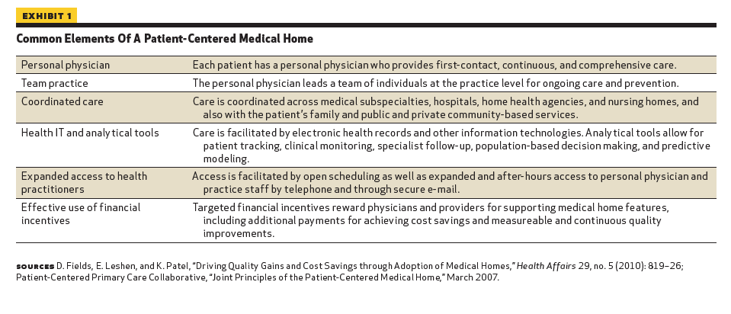
“Health Policy Brief: Patient-Centered Medical Homes,” Health Affairs, September 14, 2010
http://www.healthaffairs.org/healthpolicybriefs/

Slide 16
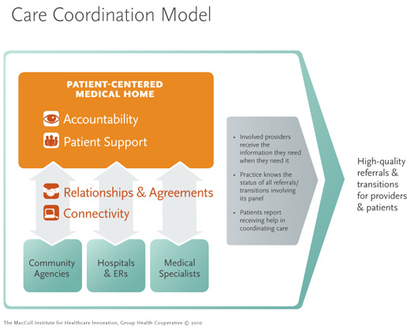
The MacColl Institute for Healthcare Innovation, Group Health Cooperative (2010)

Slide 17
Joint Principles for PCMH
Each patient has an ongoing relationship with a personal physician trained to provide first contact, continuous and comprehensive care
The personal physician leads a team of individuals at the practice level who collectively take responsibility for the ongoing care of patients
Whole person orientation—the personal physician is responsible for providing for all the patient’s health care

Slide 18
Joint Principles for PCMH (cont.)
Care is coordinated and/or integrated across all elements of the complex health care system
Quality and safety are hallmarks of the medical home
Enhanced access to care is available through systems such as open scheduling, expanded hours and new options for communication between patients, their personal physician, and practice staff.
Aligned payment methods

Slide 19
The PCMH Model
A designated primary care provider leads a team to coordinate care for client
PCMH utilizes the following strategies:
  Team approach
  Collaboration with other providers
  Care Coordination
  Self-Management
  Health Information Technology

Slide 20
Care Planning in PCMH Model
Care Plan
Created and managed by patients and their families and their health care team
Person centered focusing patient’s current and long-term needs and goals for care
Care Manager
Functions are client activation and education, care coordination, monitoring participation response to treatment
Social Workers have the skills to be care managers but some PCMH plans have restricted these positions to nurses

Slide 21
FQHCs Become PCMHs
Federally Qualified Health Centers are community-based organizations that provide comprehensive primary care and preventive care, including health, oral, and mental health/substance abuse services to persons of all ages, regardless of their ability to pay or health insurance status
Federally Qualified Health Center Advanced Primary Care Practice demonstration project
  FQHCs who adopt care coordination practices set by the National Committee for Quality Assurance (NCQA) can achieve patient-centered medical home recognition
BHOs can also partner with FQHCs and then receive the designation FQHC Look Alike giving them access to federal funds for integration

Slide 22
Health Homes
Similar to PCMH but focuses on low-income and people with chronic conditions
Network of Providers who receive payment to provide care management services to high cost Medicaid enrollees
Eligible enrollees must have 2 chronic medical conditions or a serious mental illness or HIV
Entities receiving grants from SAMHSA’s Primary and Behavioral Health Care Integration Program started in 2009 will now be required to be Health Homes

Slide 23
Health Home Providers
States have flexibility, providers can be:
  A designated provider: May be physician, clinical/group practice, rural health clinic, community health center, community mental health center, home health agency, pediatrician, OB/GYN, other.
  A team of health professionals: May include physician, nurse care coordinator, nutritionist, social worker, behavioral health professional, and can be free standing, virtual, hospital-based, community mental health centers, etc.
  A health team: Must include medical specialists, nurses, pharmacists, nutritionists, dieticians, social workers, behavioral health providers, chiropractics, licensed complementary and alternative medical practitioners, physician assistants
  Or a mix of the above (Center for Health Care Strategies, 2011)

Slide 24
Health Homes Principles of Care
Person-Centered Care
  Based on individual’s preferences, needs & values
  Self-management support
  Shared Decision Making
Population Based Care
  Optimizing health on a specific population
  Care management
Data Driven Care
Evidence Based Care

Slide 25
Health Homes Services
Comprehensive care management
Care coordination and health promotion
Comprehensive transitional care/follow-up
Patient and family support
Referral to community and social support services
Use of health information technology (HIT)

Slide 26
Health Home Structure
In House Model
  Behavioral Health Agency provides and owns all PC and BH services in one location
Co-Located Partner Model
  BH agencies arranges for PC to be delivered onsite
Facilitated Referral Model
  BH agency has processes that will coordinate care offsite (Druss, 2012)

Slide 27
Examples
ACOs
  Community Care of North Carolina
  Minnesota Senior Health Options
Primary Care Medical Homes
  Pilots and demonstrations
Health Homes
  New York State Health Home Program
  Mental Health Integration Program

Slide 28
The Future
Source: The National Council for Community Behavioral Healthcare

Slide 29
Current Legislation
Excellence in Mental Health Act (H.R. 5989) — Companion to S. 2257, this legislation will establish national standards and oversight for Federally Qualified Community Behavioral Health Centers (FQCBHCs)
Behavioral Health Information Technology Act (H.R. 6043) — Like its counterpart in the Senate (S.539), this bill will add community mental health centers, psychiatric hospitals, mental health treatment facilities, and substance abuse treatment facilities to the list of organizations eligible for federal incentive payments. Currently, you can receive incentive payments for the adoption of health information technology if you have a psychiatrist or nurse practitioner on staff. Both bills would extend incentive payments for electronic health records to certain types of behavioral health organizations that are not currently eligible.

Slide 30
References
Alcoholics Anonymous World Services, Inc., Questions and Answer on Sponsorship, copyright 1976, 1983. Retrieved from http://www.aa.org/pdf/products/p-15_Q&AonSpon.pdf
Centers for Disease Control and Prevention. (2011, May). Community Health Workers/Promotores de Salud: Critical Connections in Communities. Retrieved from http://www.cdc.gov/diabetes/projects/comm.htm
Center for Substance Abuse Treatment. (2009). What are peer recovery supports? HHS Publication (number (SMA) 09-4454), Rockville MD: Substance Abuse Mental Health Services Administration.
Hill MN, Bone LR, Butz AM. (1996). Enhancing the role of community-health workers in research. Image 28, 221-226.
Lenninger, M. and McFarland, M. 2006. Culture care diversity and universality: A worldwide nursing theory, Sudbury, MA, Jones and Bartlett Publishers.
Integrated Care Resource Center. (2012, June). Low cost, low administrative burden ways to better integrate care for Medicare-Medicaid enrollees. Technical Assistance Brief. Retrieved from http://www.chcs.org/usr_doc/ICRC_-_Low_Cost_Approaches_to_Integration_FINAL.pdf
Klein, S., McCarthy, D. (2010, July). Case study: Organized healthcare delivery system. The Commonwealth Fund.
Leninger MM. (1991). Culture Care Diversity and Universality: A Theory of Nursing. New York: National League of Nursing.
McLellan, A.T., Hagan, T.A., Levine, M., Gould, F., Meyers, K. and Bencivengo, M., et al. (1998). Research report: Supplemental social services improve outcomes in public addiction treatment. Addiction, 93(10), 1489-1499.
SAMHSA. (2011, June). News Release. Retrieved from http://www.samhsa.gov/newsroom/advisories/1112223420.aspx

Slide 31
References
Sheedy C. K., and Whitter M. Guiding principles and elements of recovery-oriented systems of care: What do we know from the research? HHS Publication No. (SMA) 09-4439. Rockville, MD. Retrieved from http://partnersforrecovery.samhsa.gov/docs/Guiding_Principles_Whitepaper.pdf
United States Department of Health and Human Services, Agency for Healthcare Research and Quality (AHRQ). (2010, June). Health navigators, support self-management with primary care patients, leading to improved behaviors and lower utilization. Retrieved from http://www.innovations.ahrq.gov/content.aspx?id=2905
United States Department of Health and Human Services, Substance Abuse Mental Health Services Administration. (2004). National consensus statement on mental health recovery. Retrieved from http://store.samhsa.gov/shin/content//SMA05-4129/SMA05-4129.pdf
University of Arizona & Annie E.Casey Foundation (1998). The national community health: Advisor study: weaving the future. Tucson, Arizona: University of Arizona Press (410-223-2890). Retrieved from http://www.aecf.org.
White, W.L. (2006). Sponsor, recovery coach, addiction counselor: The importance of role clarity and role integrity. Philadelphia Department of Mental Health and Mental Retardation Services, Philadelphia, PA.
White, W.L., Kurtz, E., and Sanders, M. (2006). Recovery management. Great Lakes Addiction Technology Transfer Center, Chicago, IL.
White, W.L. (2009). Peer-based addiction recovery support: History, theory, practice, and scientific evaluation. Great Lakes Addiction Technology Transfer Center, Chicago, IL.

