Slide 1
The Need for Integrated Behavioral Health Care in the US
Module 1
Shirley Porterfield, PhD
School of Social Work
University of Missouri - St. Louis

Slide 2
Overview
Integrated Behavioral Health, including models and origins, is defined
There is a high prevalence of mental health and substance abuse disorders that are comorbid with physical health conditions.
Health care costs are high and expected to continue to rise over the foreseeable future
Studies suggest that many patients served in integrated behavioral health systems receive more effective treatment at a lower cost

Slide 3
What is Integrated Behavioral Health?
Integrated behavioral health (IBH) care occurs when primary medical care and mental and/or substance use disorders treatment coexist in the same health services setting
Primary care and mental health practitioners work together to provide care, and to coordinate care from other medical specialists
The integrated behavioral health model reflects the ecological framework and strengths perspective inherent in social work practice

Slide 4
IBH Models
Integrated behavioral health occurs when
Behavioral health services are added into the primary care setting, or
Primary health care services are added into the behavioral health setting
Most patients with serious mental illness (SMI) or addictions are treated by behavioral health specialists in a psychiatric or community setting so adding primary care services to this setting makes sense for these patients
Most patients with less serious mental illness or substance use disorders are treated by generalist physicians in a primary care setting so adding behavioral health services to this setting makes sense for these patients

Slide 5
IBH Origins
The concept of the Patient-Centered Medical Home (PCMH) originated with the American Academy of Pediatrics in 1967
Defined as care that is accessible, family-centered, coordinated, comprehensive, continuous, compassionate, and culturally effective¹
Research on the PCMH finds the care coordination piece is critical for better health outcomes, lower overall and out-of pocket costs, and reduced family impacts²³⁴
Notes:
In practical terms this means the individual has a primary care team whose members are readily accessible, even after regular office hours, who coordinate specialist care, and who explain this care and results of any tests in an understandable way and in the individual’s native language. Many patient-centered medical homes have adopted electronic medical records and electronic prescribing, use e-mail to enhance patient-physician communication, and employ a nurse or medical social worker as case manager for patients. An excellent discussion of the forms this model may take is included in Graf, T.R., Bloom, F.J., Tomcavage, J., & Davis, D.E. 2012. Value-based reengineering: Twenty-first century chronic care models. Prim Care Clin Office Pract 39: 221-240. A description of the role of social workers within this care model can be found in Collins, S. 2011. The medical home model: What is it and how do social workers fit in? Practice Perspectives, issue 10, April, NASW, SocialWorkers.org.

Slide 6
Why Integrated Behavioral Health Services?
Prevalence of mental disorders and substance use disorders
Incidence of co-morbid conditions
Costs associated with these two conditions in particular
Costs of treatment
Improved outcomes and cost savings with integrated health services

Slide 7
Mental Disorders
How prevalent are mental disorders?
How are mental health issues
typically treated?

Slide 8
Defining Mental Illness
Mental illness (MI) is “characterized by sustained, abnormal alterations in thinking, mood, or behavior associated with distress and impaired functioning”^{5,6}
Mental disorders are more disabling than any other group of illnesses, including cancer and heart disease (MI is the 3rd or 4th most costly condition)
Many mental and physical health disorders co-exist (called co-morbidity)

Slide 9
Prevalence of Mental Disorders⁷
46.4% of Americans will experience some form of mental illness in their lifetime⁸
20% of women and 13% of men are affected by major depressive disorder each year;
6% of women and 3% of men are diagnosed with panic disorder;
9.7% of women and 3.6% of men are diagnosed with PTSD
Men have higher rates of impulse-control disorders, substance use disorders, and suicide completion than women

Slide 10
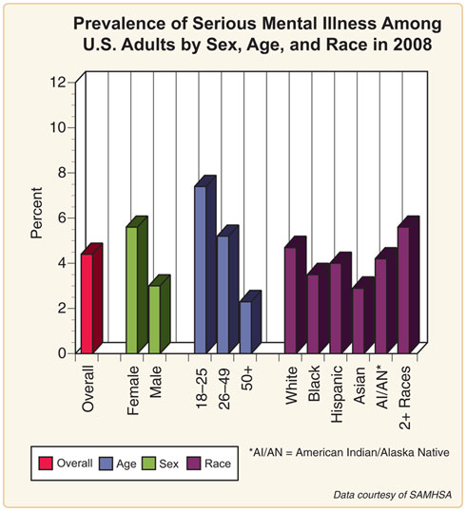
Serious Mental Illness (SMI)⁹
The National Survey on Drug Use and Health (NSDUH) defines SMI as:
A mental, behavioral, or emotional disorder (excluding developmental and substance use disorders)
Diagnosable currently or within the past year
Of sufficient duration to meet diagnostic criteria specified within the 4th edition of the Diagnostic and Statistical Manual of Mental Disorders (DSM-IV)
Resulting in serious functional impairment, which substantially interferes with or limits one or more major life activities.
Notes:
Source: http://www.nimh.nih.gov/statistics/SMI_AASR.shtml

Slide 11
Impact¹⁰
Mental disorders are disabling and can affect all aspects of life:
Physical health
Parenting
Work
Finances
Care giving
Relationships with family and friends
Common daily activities

Slide 12
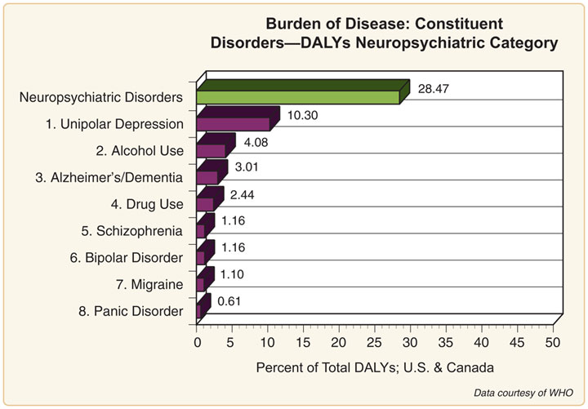
Burden of Disease:
Disability-Adjusted Life Years (DALYs)¹¹
DALYs represent the total number of years lost to illness, disability, or premature death within a given population.
They are calculated by adding the number of years of life lost to the number of years lived with disability for a certain disease or disorder.
Neuropsychiatric disorders are the leading contributor to DALYs in the US & Canada, and they contribute nearly twice as many DALYS as cardiovascular diseases and cancers.
Notes:
Source: http://www.nimh.nih.gov/statistics/2CDNC.shtml

Slide 13
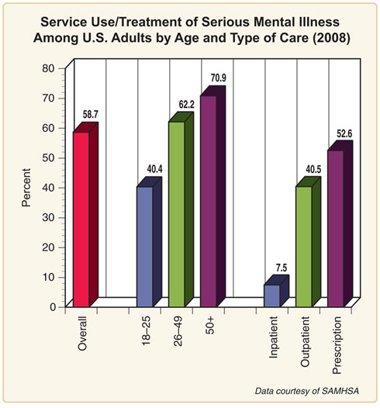
Treatment
In 2008,13.4 percent of adults in the United States received treatment for a mental health problem.
Just over half (58.7 percent) of adults in the United States with a serious mental illness (SMI) received treatment for a mental health problem.
Treatment rates for SMI differed across age groups, and the most common types of treatment were outpatient services and prescription medication.

Slide 14
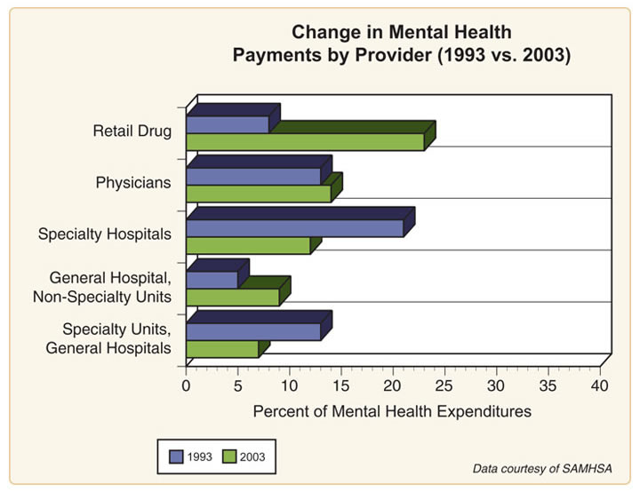
Changing Service Patterns¹²
More drugs prescribed
Shorter hospital stays
Notes:
http://www.nimh.nih.gov/statistics/4CHANGE_PROV9303.shtml

Slide 15
substance Use and co-occurring disorders
How prevalent are substance abuse
disorders?
What are comorbid conditions and how
prevalent are they?
In what setting are mental health and/or
addiction issues typically treated?

Slide 16
Substance Use/Abuse
Defined as the “use of a substance (drugs and/or alcohol) for a purpose not consistent with legal or medical guidelines”^{13, 14}
Labeled “addiction” when “the user (referred to as an addict) is periodically or chronically intoxicated, shows a compulsion to take the preferred substance (or substances), has great difficulty in voluntarily ceasing or modifying substance use, and exhibits determination to obtain psychoactive substances by almost any means”
Approximately 10% of the general population are addicted to alcohol, while another 5% are addicted to drugs
Substance abuse prevalence rates are higher among persons with mental illness, traumatic brain injuries, spinal cord injuries, and many chronic health conditions (see slide 19).
Notes:
Sources: http://www.who.int/substance_abuse/terminology/who_lexicon/en/; http://www.hhs.gov/od/about/fact_sheets/substanceabuse.html

Slide 17
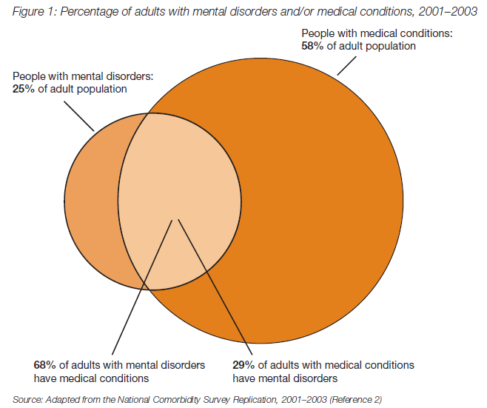
Epidemiology of Co-morbidity^{15, 16}
16.8% of the US adult population has both a mental disorder and a medical condition
30% of adults with a chronic medical condition have a co-morbid mental health condition
Source: http://www.rwjf.org

Slide 18
Epidemiology of Co-morbidity¹⁷
Odds ratio of alcohol/ drug disorders is 2.7 times more if any mental disorder exists
This is 10-20 times greater than expected for schizophrenia, mania, antisocial personality disorder
Notes:
[Slide 8] An important statistic related to comorbidity is the “odds ratio” which shows the extent to which a given factor increases the risk of developing an illness or disorder. The odds ratio is derived from a comparison of rates of the illness among individuals who do and do not also exhibit the factor of interest. A statistically significant odds ratio (significantly different from 1.00 at the .05 level) indicates an appreciable risk associated with a particular factor. For example, an odds ratio of 2.00 indicates a doubled risk of the illness/disorder appearing; an odds ratio of 1.30 indicates a 30% increase in risk.
The odds ratio of lifetime alcohol or drug disorders increases to 2.7 times the normal risk when any mental disorder is present. This jumps to 10-20 times greater than expected when the disorders are schizophrenia, mania, or an antisocial personality disorder. For example, the co-occurrence of schizophrenia and substance abuse or dependence appears to be substantial affecting approximately 50% of individuals with schizophrenia (Swofford, Scheller-Gilkey, Miller, Woolwine, & Mance, 2000). Still more dramatic are the proportions of comorbid disorders observed among individuals seeking treatment (as opposed to the rates above that are based on the general population).

Slide 19
Co-morbidity & Chronic Health Conditions¹⁸
Prior Diagnostic History
Patients with Risk Scores 50+*
NYC Residents
Percent of Patients with Co-Occurring Condition
CVD
AMI
Ischemic
CHF
Hyper-
Diabetes
Asthma
COPD
Renal
Sickle
Alc/Subst
Mental
HIV/AIDS
Heart Dis
tension
Disease
Cell
Abuse
Illness
Cereb Vasc Dis
5.0%
100.0%
15.0%
49.5%
36.2%
81.6%
51.7%
35.3%
24.8%
13.7%
2.9%
56.4%
62.7%
13.7%
AMI
6.0%
12.5%
100.0%
80.9%
53.3%
90.1%
56.6%
40.4%
31.5%
17.4%
2.1%
55.2%
56.2%
13.5%
Ischemic Heart Dis
22.4%
11.1%
21.7%
100.0%
45.3%
86.9%
54.0%
42.0%
30.2%
13.2%
2.1%
53.5%
58.4%
14.0%
CHF
16.2%
11.2%
19.8%
62.8%
100.0%
89.5%
56.9%
42.7%
34.9%
20.7%
2.7%
48.4%
48.0%
13.4%
Hypertension
50.9%
8.0%
10.6%
38.3%
28.4%
100.0%
46.2%
41.0%
25.4%
11.6%
1.8%
63.1%
62.9%
20.0%
Diabetes
29.0%
8.9%
11.7%
41.8%
31.7%
81.3%
100.0%
41.2%
23.9%
13.0%
1.4%
55.4%
62.7%
15.6%
Asthma
36.3%
4.9%
6.7%
25.9%
19.0%
57.5%
32.9%
100.0%
32.5%
4.3%
2.3%
72.9%
70.0%
29.6%
COPD
20.8%
6.0%
9.1%
32.5%
27.2%
62.2%
33.3%
56.7%
100.0%
6.0%
1.7%
74.2%
65.6%
29.9%
Renal Disease
6.3%
10.8%
16.5%
46.7%
52.8%
93.3%
59.6%
24.3%
19.8%
100.0%
2.2%
36.6%
37.4%
18.0%
Sickle Cell
2.9%
5.0%
4.2%
15.7%
14.9%
31.3%
14.0%
28.2%
12.3%
4.7%
100.0%
48.9%
50.7%
15.0%
Alc/Subst Abuse
72.8%
3.9%
4.5%
16.5%
10.7%
44.1%
22.0%
36.4%
21.2%
3.2%
2.0%
100.0%
70.9%
33.4%
Mental Illness
66.2%
4.7%
5.1%
19.7%
11.7%
48.3%
27.4%
38.4%
20.6%
3.6%
* High Risk of Future Inpatient Admission
Source: NYU Wagner School, NYS OHIP, 2009.

Slide 20
Treatment¹⁹
Two thirds of adults with mental disorders and/or addictive disorders are treated for these conditions in a general medical setting
Nearly 70% receive no mental health treatment
Adults with co-morbid conditions whose mental health conditions are untreated incur higher medical costs
Less likely to undertake beneficial self care activities
Less likely to adhere to treatment regime
Notes:
These average $505 per month per person with comorbid medical condition and untreated depression and $651 per month per person with comorbid medical condition and untreated anxiety (search for keyword ‘comorbid’)

Slide 21
health CARE COSTS
Why do we spend so much on health care?
What role does government play in this system?
If government reduces its reimbursement rates,
who wins and who loses?
Can you think of policy changes that might lead to
lower costs without lowering reimbursement
rates?

Slide 22
Costs of MI
Mental illness cost the United States an estimated $300 billion annually (2002-2003)²⁰
Direct costs
Health care, care giving, and specialized equipment
Indirect costs
Decreased productivity
Absenteeism
Lost jobs and wages
Pain and suffering
Unraveling of families and friendships
Suicide
Notes:
Approximately 5% of ambulatory care visits in 2007-2008 involved patients with a diagnosis of a mental health disorder

Slide 23
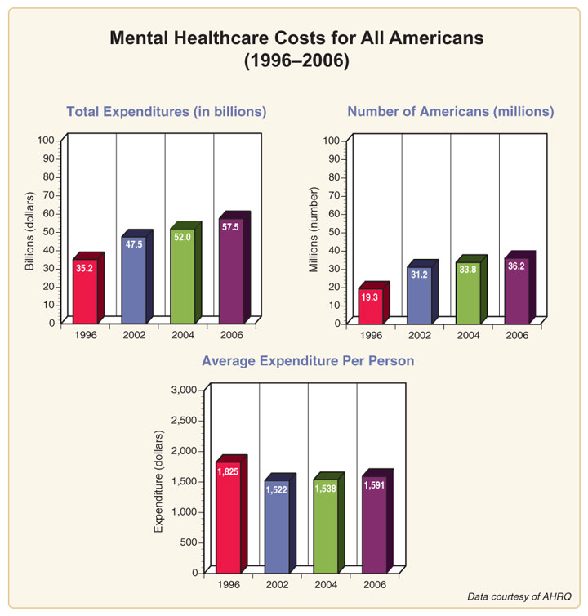
Costs Over Time
Over the 1996-2006 decade, Americans paying for mental health services increased 87.6 percent and total expenditures increased 63.4 percent.
The average cost per person for mental health services slightly decreased during this period.
Notes:
Note: The year over year estimates do not take inflation into account.

Slide 24
Costs of SA
An average physician office visit in 2008 cost $199, compared to $922 for an Emergency Department visit (median was $89 for doctor's visit, vs. $422 for ED)²²
Estimates of the total overall costs of addiction in the United States, including productivity and health- and crime-related costs, exceed $600 billion annually. This includes approximately $181 billion for illicit drugs (2002), $193 billion for tobacco (2007), and $235 billion for alcohol (2003)²³

Slide 25
Why Do We Spend So Much on Medical Care?^{24, 25}
Because we can
Price increases are a small part of the story
Quantity and quality increases are a large part
Example: Changes in Medical Care for People with Depression
1950 Standard
Mental institutions for very ill; little for others
Lobotomy, ECT, Insulin therapy
Today’s Standard
SSRIs; various types of therapy
Notes:
Costs have doubled in the past 20 years mostly because we treat more people. The percent of adults with SMI receiving treatment increased from 24% in 1990-92 to 41% in 2001-03. The percent with any mental disorder receiving treatment grew from 12% to 20% (same time periods). Source: Kessler, et al. 2005. Prevalence and treatment of mental disorders, 1990 to 2003. New England Journal of Medicine 352, 24, 2515-23, as cited in Mark, T., et al. 2011. Changes in US spending on mental health and substance abuse treatment, 1986-2005, and implications for policy. Health Affairs 30, 2, 284-291.

Slide 26
Who Pays for Treatment?²⁶
4.9 million uninsured with SMI
5.5 million uninsured with addiction and/or substance use disorders
* Figures do not add to 100% as some payer categories are not included in this chart.

Slide 27
Uncompensated Care²⁷
In 2008 doctors, hospitals, and other providers incurred $42.7 billion for patients who did not pay their bills
The uninsured pay on average 37%
of their costs
Gov’t programs and charities pay
another 26%

Slide 28
Hidden Health Tax²⁷
Providers must recoup the costs of caring for the uninsured from their paying customers in the form of higher insurance premiums and taxes
Premium increases make it harder for businesses to initiate or continue health insurance, as a result adding to the number of uninsured
In 2008, insured persons paid a "hidden health tax" for family and individual coverage of $1,017 and $368 respectively

Slide 29
THE RATIONALE FOR INTEGRATED BEHAVIORAL HEALTH
Why might it be cost effective to treat all
health conditions in the same setting
and with the same team of health
professionals?
Is this model cost effective for everyone,
or only for people with certain
conditions?

Slide 30
Health Care is Important To Americans²⁸
Percent reporting importance of having one place/doctor responsible for primary care and coordinating care
93
93
93
92
93
94
89
94
U.S. region
Political affiliation
NE=Northeast; NC=North–Central; Dem=Democrat; Rep=Republican; Ind=Independent.

Slide 31
The Model Matters^{29, 30}
Outcomes are poor if behavioral health care is provided solely by a primary care clinician
Problems with diagnosis, dosage, duration of treatment, lack of follow-up treatment
Outcomes worse for minority and lower-income patients
The model has to include a team approach, incorporating a variety of medical professionals
Must include systematic screening and coordination of care by a care manager with a specific mental health background
Must include frequent follow up for chronic conditions
Must include education to empower patients to aid in medical decision making and self care
Notes:
Source: Williams, J.W. 2012. NCMJ 73, 3, 205-206; Bower et al., 2006. British Journal of Psychiatry 189, 6, 484-493.

Slide 32
Outcomes in an Integrated Care Model^{31, 32}
Outcomes are significantly better if care is provided by a team of health professionals that includes a mental health/addictive disorders professional (integrated care)
Medication adherence significantly improved
Outcomes for minority and lower-income patients the same or better than those for white, higher-income patients
For patients with co-morbid chronic health conditions and depression, overall health improves when both conditions are treated in an integrated care environment
Patient satisfaction with care is higher

Slide 33
Cost Evidence is Mixed^{33, 34, 35, 36, 37}
Most studies examine co-morbid depression/anxiety (rather than SMI or addiction) with chronic health conditions
Screening for mental health disorders, such as depression, increases the duration (and cost) of primary care physician visits
Care management is expensive, but costs are offset by reduced hospitalizations and emergency department visits
Cost savings tend to accrue to payers rather than primary care providers (clinics and physicians)
Important to pay attention to incentives inherent in this system of care

Slide 34
Case Study: Intermountain Health
Is this a model that could easily be
replicated elsewhere? Why or why not?
What are the main elements of the
medical home model in this case study?
Notes:
I’ve provided one case study here, with reference to a few others. There are good websites that should be incorporated as well, including:
National Committee for Quality Assurance (NCQA – this organization provides a certification process for the patient-centered medical home) http://www.ncqa.org/tabid/631/default.aspx
Patient Centered Primary Care Collaborative http://www.pcpcc.net/content/examples-successful-integrated-models
Commonwealth Fund http://www.commonwealthfund.org/From-the-President/2009/Can-Patient-Centered-Medical-Homes-Transform-Health-Care-Delivery.aspx
One exercise might be to assign teams of 2-3 students to find a good example of a Behavioral Health Home and report back to the class. Another might be to assign students to find the NCQA certified medical home practices in their community and to research whether or not there are behavioral health specialists as part of each practice.

Slide 35
Case Study:
Intermountain Healthcare^{37, 38, 39}
Nonprofit, integrated health system with 22 hospital facilities and 130 ambulatory clinics, operating in both rural and urban areas within Utah and Idaho, with a mix of commercial, Medicare, Medicaid and uninsured/self-pay patients
Mental Health Integration (MHI) program implemented in 69 clinics, and in 4 uninsured school-based clinics
Team-based approach including primary care physicians and their staff, mental health professionals, care management, community resources, and the patient and his/her family
Notes:
Results found in this study mimic those found in several other studies.

Slide 36
Case Study:
Intermountain Healthcare⁴⁰
Study design
Compare outcomes in MHI (n=5) vs matched non-MHI (n=8) clinics, adults with depression only, no Medicare patients
Follow patients and compare costs from 12 months pre to 12 months post diagnosis with depression

Slide 37
Case Study: Intermountain Healthcare⁴¹
Results
Patients in MHI treatment group had overall average annual per-patient charges in 2005 that were $667 lower than those in the usual care group
Largest cost savings were reductions in inpatient, emergency department, and office visits for treatment of medical conditions
Patients with depression treated in an MHI clinic were 54% less likely to have an ED visit and half as likely to use inpatient psychiatry than similar patients treated in non-MHI clinics
Lower rate of growth in costs of all service lines except outpatient psychiatry/counseling and antidepressant prescriptions
Largest savings seen among those with depression and one or more co-morbid conditions

Slide 38
Need For More Evidence
Few studies examine the impact of integrated behavioral health services on those with serious mental illness or substance abuse disorders
Examples of programs that have adopted this model and have been subjects of study include
Pathways to Housing, Inc (New York & Philadelphia)
Paxton House (Chicago)
Still need to know which payment structures for physicians and clinics are supportive of this care model
Important to consider incentives for all participants

Slide 39
Conclusions
Mental health issues represent a significant problem in the US, affecting more than a quarter of adults
Substance use disorders affect at least 15% of the population of adults in the US
Quality of care, medical and mental health outcomes, and patient satisfaction are improved in an integrated behavioral health system
Many studies also show lower costs with this care model
Successful integrated behavioral health care includes patient education, follow-up, and coordination of care by a care manager with a specific mental health and/or addictions background

Slide 40
Reference
Backer. (2007). The medical home: An idea whose time has come again. Family Practice Management. American Academy of Family Physicians. Retrieved from http://www.aafp.org/fpm/2007/0900/p38.html
Porterfield, SL and DeRigne L. (2011). Medical home and out-of-pocket medical costs for children with special health care needs. Pediatrics, 128(5): 892-900.
Kogan, M.D., Strickland, B., Newacheck, P.W. (2009). Building systems of care: Findings from the national survey of children with special health care needs. Pediatrics, 124, S333-S336.
Looman, W., O’Connor-Von, S., Ferski, G., and Hildenbrand, D. (2009). Financial employment problems in families of children with special health care needs: Implications for research and practice. Journal of Pediatric Health Care., 23, 117-125.
Reeves, et al. (2011, September 2). Mental illness surveillance among adults in the United States. Morbidity and Mortality Weekly Report. Centers for Disease Control and Prevention. Retrieved from http://www.cdc.gov/mmwr/preview/mmwrhtml/su6003a1.htm?s_cid=su6003a1_w.
Melek, Steve and Norris, Doug. (2008, July). Chronic conditions and comorbid psychological disorders. Milliman Research Report. Retrieved from http://publications.milliman.com/research/health-rr/pdfs/chronic-conditions-and-comorbid-RR07-01-08.pdf.
Galson, S.K. (2009). Mental health matters. Public Health Reports ,124 (March/April), 189-191.
Kessler, R.C., Crum, R.M., Warner, L.A., et al. (1997). Lifetime co–occurrence of DSM–III–R alcohol abuse and dependence with other psychiatric disorders in the National Comorbidity Survey. Archives of General Psychiatry, 43, 313–321.
National Institute of Mental Health. (2009). Prevalence of serious mental illness among U.S. adults by age, sex, and race. Retrieved from http://www.nimh.nih.gov/statistics/SMI_AASR.shtml.
Galson, S.K. 2009. Mental health matters. Public Health Reports 124 (March/April), 189-191.
National Institute of Mental Health. (2012). Disoders within the neuropsychiatric category. Retrieved from http://www.nimh.nih.gov/statistics/2CDNC.shtml,
National Institute of Mental Health. Change in mental health payments by provider (1993 vs. 2003). Retrieved from http://www.nimh.nih.gov/statistics/4CHANGE_PROV9303.shtml.
World Health Organization. (2012). Lexicon of alcohol and drug terms. Retrieved from http://www.who.int/substance_abuse/terminology/who_lexicon/en/.

Slide 41
Reference
14. U.S. Department of Health and Human Services. Office on Disability, Substance Abuse and Disability. Retrieved August 1, 2012, from http://www.hhs.gov/od/about/fact_sheets/substanceabuse.html
15. Robert Wood Johnson Foundation. (2011, February). Mental disorders and medical comorbidity. The Synthesis Project. Retrieved August 1, 2012, from http://www.rwjf.org/files/research/71883.mentalhealth.brief.pdf
16. Kathol, R., Butler, M, McAlpine DD., Kane RL. (2010). Barriers to physical and mental condition integrated service delivery. Psychosomatic Medicine, 72.
17. Kessler, R.C., Crum, R.M., Warner, L.A., et al. (1997). Lifetime co–occurrence of DSM–III–R alcohol abuse and dependence with other psychiatric disorders in the National Comorbidity Survey. Archives of General Psychiatry, 43, 313–321.
18. Cleek & Salerno. (2012, March 26). NYU School of Social Work Curriculum Renewal Day, Affordable Care powerpoint, New York University School of Social Work.
19. Melek, Steve and Norris, Doug. (2008, July). Chronic conditions and comorbid psychological disorders. Milliman Research Report. Retrieved from http://publications.milliman.com/research/health-rr/pdfs/chronic-conditions-and-comorbid-RR07-01-08.pdf.
20. Galson, S.K. (2009). Mental health matters. Public Health Reports, 124, 189-191. Retrieved from http://www.cdc.gov/mmwr/preview/mmwrhtml/su6003a1.htm?s_cid=su6003a1_w
21. National Institute of Mental Health. Mental Healthcare Costs for All Americans (1996-2006). Retrieved from http://www.nimh.nih.gov/statistics/4MH_AM9603.shtml
22. Agency for Healthcare Research and Quality. (2011, March). Expenses and characteristics of physicians visits in different ambulatory care settings, 2008. Medical Expenditure Panel Survey Statistical Brief #318. Retrieved from http://meps.ahrq.gov/mepsweb/data_files/publications/st318/stat318.pdf
23. National Institute on Drug Abuse. (2011, March). DrugFacts: Understanding drug abuse and addiction. Retrieved August 1, 2012, from http://www.drugabuse.gov/publications/drugfacts/understanding-drug-abuse-addiction

Slide 42
Reference
24. Kessler, RC, Demler, O, Frank, RG, Pincus, HA, et al. (2005). Prevalence and treatment of mental disorders, 1990 to 2003. New England Journal of Medicine 352, 24, 2515-23, as cited in Mark, T., et al. (2011). Changes in US spending on mental health and substance abuse treatment, 1986-2005, and implications for policy. Health Affairs 30, 2, 284-291.
25. Cutler, DM. (2005). Your money or your life: Strong medicine for America’s health care system. Oxford University Press.
26. Mark, et al., Health Affairs, 2011
27. FamiliesUSA. (2009, May). Hidden health tax: Americans pay a premium. Retrieved August 1, 2012 from http://www.familiesusa.org/resources/publications/reports/hidden-health-tax.html
28. The Commonwealth Fund. (2011, February). The 2011 Commonwealth fund survey of public views of the health system. Retrieved from http://www.commonwealthfund.org/Surveys/2011/Apr/Survey-of-Public-Views.aspx
29. Williams, J.W. 2012. NCMJ 73, 3, 205-206
30. Bower et al., 2006. British Journal of Psychiatry 189, 6, 484-493
31. Williams, J.W. (2012). Integrative care: What the research shows. NCMJ 73, 3, 205-206.
32. Katon, W.J., Lin, EHB, Von Korff, M, Ciechanowski, P., et al. (2010). Collaborative care for patient with depression and chronic illnesses. NEJM, 363, 27, 2611-2620.
33. Schmitt MR, Miller, MJ, Harrison, DL, Touchet, BK. (2010). Relationship of depression screening and physician office visit duration in a national sample. Psychiatric Services, 61, 11, 1126-1131.
34. Bodenheimer, TS and Berry-Millett, R. (2009). Care management of patients with complex health care needs. Robert Wood Johnson Foundation The Synthesis Project, 19. Retrieved from http://www.rwjf.org/pr/product.jsp?id=52372
35. Reiss-Brennan et al., 2010, Journal of Healthcare Management 55, 2, 97-114.
36. Katon et al., Russo J., Lin EHB, Schmittdiel J, et al. (2012). Cost-effectiveness of a multicondition collaborative care intervention: A randomized controlled trial. Arch Gen Psychiatry 69, 5, 506-514.

Slide 43
Reference
37. Reiss-Brennan, B., Briot, P.C., Savitz, L.A., Cannon, W., & Staheli, R. (2010). Cost of quality impact of Intermountain’s mental health integration program. Journal of Healthcare Management 55(2): 97-114.
38. Druss, B.G. & Reisinger Walker, E. (2011). Mental disorders and medical comorbidity. Research Synthesis Report No. 21. Robert Wood Johnson Foundation. Retrieved from http://www.rwjf.org/pr/product.jsp?id=71883
39. Katon, W.J. et al. (2010). Collaborative care for patients with depression and chronic illness, New England Journal of Medicine, 363, 27, 2611-2620.
40. Reiss-Brennan, B., Briot, P.C., Savitz, L.A., Cannon, W., & Staheli, R. (2010). Cost of quality impact of Intermountain’s mental health integration program. Journal of Healthcare Management 55(2): 97-114.
41. Reiss-Brennan, B., Briot, P.C., Savitz, L.A., Cannon, W., & Staheli, R. (2010). Cost of quality impact of Intermountain’s mental health integration program. Journal of Healthcare Management 55(2): 97-114.
42. Henwood, Weinstein, & Tsemberis, 2011, Psychiatric Services 62, 5, 561.
43. Teachout, A., Kaiser, S.M., Wilkniss, S.M., & Moore, H. 2011. Paxton House: Integrating mental health and diabetes care for people with serious mental illnesses in a residential setting. Psychiatric Rehabilitation Journal 34(4): 324-327.
44. Alakeson, V., Frank, R.G., & Katz, R.E. 2010. Specialty care medical homes for people with severe, persistent mental disorders. Health Affairs 29(5): 867-873.

