Slide 1
HPPAE: The University of Alabama
Carroll C. Phelps, MSW, LCSW, PIP
Washington, DC Internship Programs
The University of Alabama
School of Social Work

Slide 2
Building a Successful Community and University Partnership
University of Alabama HPPAE Process:
2007/2008: Created consortium partnership
2009-2014: Refined and
strengthened consortium

Slide 3
VA University Community Partnership
Criteria for agency development:
- Agency’s identity as educational site
- Quality of current educational program
- Commitment to accepting students as learners
- Commitment to education of future professionals

Slide 4
VA University Community Partnership
Criteria for agency development:
Extent of program’s scope, breadth, depth
Level of professionalism of staff
Number of licensed MSWs
Diversity of client population or focus on particular population

Slide 5
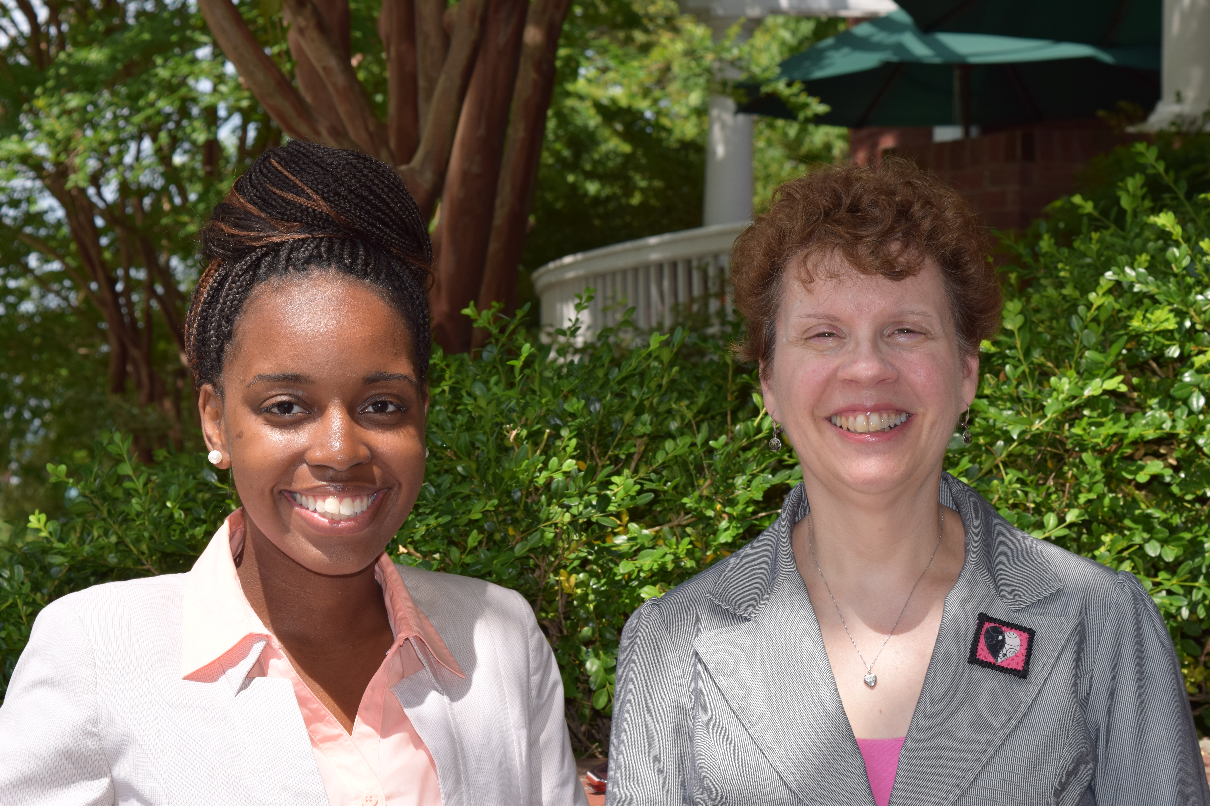
University of Alabama Washington, DC Internship Program Partnerships

Slide 6
Communication and Coordination between Agencies
Increased coordination of learning experiences for students
Increased communication between supervisors:
Communicating with supervisors
Coordinating rotations
Sharing information quickly and supporting each other if student difficulties arise

Slide 7
Strategies that work:
Orient students to the rotation model
Utilize a tool to measure learning needs and measure growth (such as geriatric competencies, evaluation, Older Adult Matrix)
Use field instructors who are familiar with the work of all agencies to assist with learning transitions
Avoid duplication of learning and make transitions quickly
Track student experiences
Communication between Field Instructors and other supervisors
Use and refer back to selected tool above

Slide 8
University of Alabama Washington, DC Internship Program Partnerships
The Seabury directors and social workers after presenting at Dementia, Depression, and Delirium CEU Workshop
4/2010

Slide 9
Partnership Benefits to Field Instructors
Increased support
Increased connections to others in the field; exciting new perspectives, resources
Shared responsibility of student
Increased connection to the University
Opportunity to shape curriculum/shape student learning
Intellectual stimulation
Can view their own practice in a larger context, incorporating connections and resources for clients with other agencies

Slide 10
Benefits/Opportunities to Students and Agencies
Students:
Increased diversity in learning experiences
Broader experience
Interdisciplinary learning
Learn from experts
Community Agencies:
Increased collaboration between agencies and with the University
Development of joint projects and grant applications

Slide 11
Student Field Rotations

Slide 12
Student Field Rotations
Benefits:
Exposure to the diversity of older adult clients
Mastery of today’s complex healthcare and social service systems
Understanding of and exposure to role of multiple care providers

Slide 13
Field Rotations
Benefits:
-Focus on student’s education
-Interdisciplinary practice
-Ability to address gaps in learning
-Informed perspective on policy

Slide 14
Field Rotations
Internal rotations:
- different departments within a large agency system (Walter Reed National Military Medical Center)
External rotations:
- separate agencies either concurrently or sequentially during an academic year

Slide 15
Field Rotations
Sequential, concurrent or combination
Stratification: primary and secondary
Competencies: which can be gained at each site?
Consortium
Importance of communication
Different populations within aging
Collaboration between departments or agencies

Slide 16
Rotation Model
Intra-agency (multiple roles):
Administration/Policy
Advocacy/Community Organization
Direct Practice

Slide 17
Rotation Model
Intra-agency (unit rotations):
Inpatient Geriatric Psychiatry Unit
In-patient/outpatient medical unit

Slide 18
Field Rotation Model Variations
Year (Foundation or Concentration)
Length (1 semester or 2, 1 or 2 days per week, 5 days per week)
Timing (concurrent, sequential, block)
Number of settings to be used (2-4)

Slide 19
Field Rotations
Field instructors:
Instruct multiple students for shorter time periods
Emphasize the importance of collaboration between agencies
Consider the depth and the detail of each experience
Believe that rotations provide broader experiences, and exposure to more population

Slide 20
Successful Implementation of Rotations
Select students who have demonstrated good academic skills and experiential skills
Provide orientation to rotation model for students, field instructors and faculty advisors
Establish a strong partnership between MSW program and VA and other agencies

Slide 21
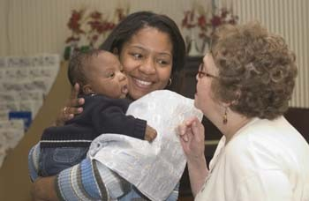
Benefits to Field Instructors
Increased support
Increased connections to others in field; exciting new perspectives, resources
Shared responsibility of student
Increased connection to the University
Opportunity to shape curriculum/shape student learning
Intellectual stimulation
Inter agency connections for clients

Slide 22
Student Recruitment and Leadership Development

Slide 23
Student Recruitment
Goals: -To increase pool of students interested in working with older adults
-To increase the awareness of all students about the importance of working with older adults

Slide 24
Student Recruitment
Opportunity to participate in a specialized curriculum with a selective cohort
Opportunity to learn about older adults over the life continuum
Opportunity to develop community connections
Job placement or career opportunities

Slide 26
Effective Recruitment Strategies
Endorsements from students and graduates
Faculty recruitment
Website, brochure
Stipends/Scholarships:
Competitive application and interview process
Excellent internship opportunities with older adults that offer rich educational experiences and outstanding field instruction

Slide 28
Leadership
Primary goal of the HPPAE Model:
-help students become leaders and skilled practitioners, to meet the needs of the growing aging population
All participants--students, field instructors, agencies, and faculty--are able to enhance their leadership skills and opportunities through the program

Slide 29
Students As Leaders
Students:
-Develop a high level of knowledge and skill in working with/on behalf of older adults
-Experience firsthand the range of complex intersecting services provided by multiple agencies
-Address directly the responsibility of becoming future leaders in the field of aging
-Have the opportunity to practice leadership skills through speaking and participating in consortium meetings

Slide 30
Field Instructors as Leaders
Field Instructors:
Lead in the training and education of students
Upgrade knowledge and skills through training opportunities and cross-agency collaboration
Take a leadership role in the consortium as well as in their agencies and in the community
Develop strong connections with other agencies and field instructors through the consortium

Slide 31
Agencies As Leaders
Enhanced leadership opportunity for agencies:
Knowledge and leadership role of their field instructors
High quality of HPPAE students, some of whom they hire
Connection with and support from the schools
Increased visibility in the community
Relationships developed and strengthened with other community agencies through the HPPAE

Slide 32
The School As a Leader
HPPAE consortium brings together faculty and administrators interested in aging and strengthens the field of aging within the school
Increases the number of well qualified students
Increases the visibility of the school as a leader and as a significant contributor to the older adult community

Slide 33
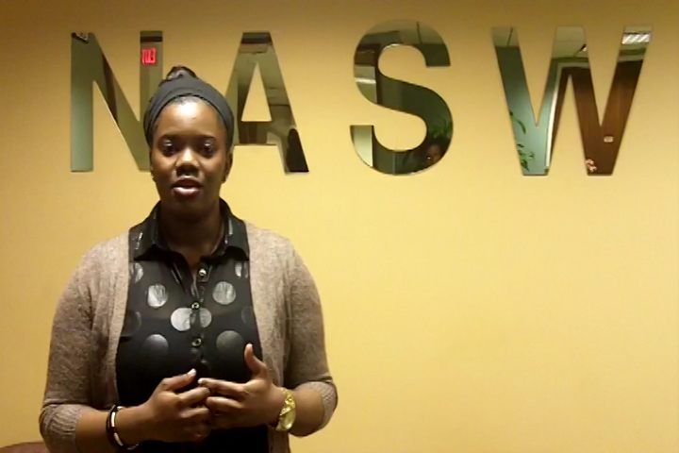
Structured Leadership Program
Students learn to:
Identify and learn to maximize their individual strengths
Set specific personal and professional goals
Develop their own personal leadership style
Identify and understand emotional intelligence and learn how to enhance positive traits and manage weaknesses effectively

Slide 34
Structured Leadership Program
Students learn to:
Utilize and maximize supervision and mentorship from experienced social workers
Interact and network with social work leaders in innumerable roles in all levels of practice, from direct service to managers to directors
Analyze, advocate, and implement relevant social policy issues, which broadens the students' experience and creates significant change for clients
Build and maintain relationships by partnering with social workers

Slide 35
Structured Leadership Program
The Process Never Sleeps!
Strengths assessment
EQ
Personality Assessments
Professional preparedness
Leadership styles

Slide 36
“The Hartford opportunity allowed me to work with the elderly population and learn how to deal with people who are in the final stages of life and the challenges that they face. Being apart of the Hartford allowed me to have a more diverse internship my final year which has prepared me for the work force that I have now entered.” –Elsie R., Iona Senior Services, Class of 2010

Slide 37
Questions

