Slide 1
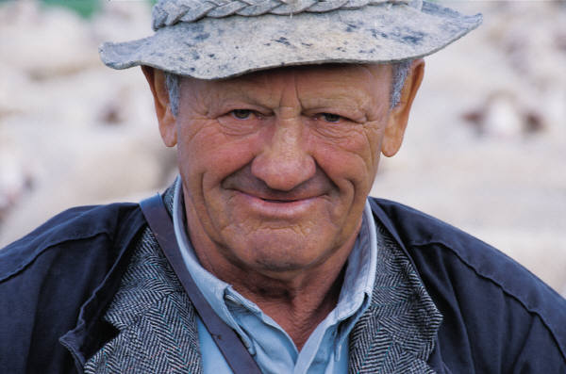
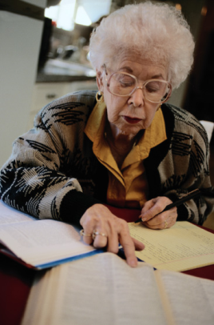
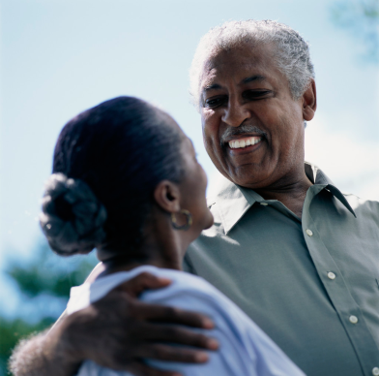
HPPAE: University-Community Partnerships
Katrina J. Boone, Director of Field Education,
Florida State University
November 2014

Slide 2
Field Education: Signature Pedagogy of Social Work
A profession’s characteristic form of teaching and learning is it’s signature pedagogy according to Lee Shulman (2005)
His concept is based on the three dimensions of professional practice:
Thinking – the intellectual aspects of a profession’s knowledge base
Performing – the technical aspects or profession’s skills
Acting with integrity – the moral aspect or a profession’s values and ethics
Examples of signature pedagogies include:
Clinical rounds in medicine
Legal case methods of law
Design studios of architecture and mechanical engineering
Student teaching in teacher education
Field education has been officially designated by the Council on Social Work Education as the signature pedagogy of Social Work (CSWE, 2008)

Slide 3
Background and Development
Florida State University and the University of Central Florida identified community partners who could work with them to develop the HPPAE model and become anchor sites for Fellows (students)
The universities and community partners worked together to conceptualize the field/rotation model to maximize mentor relationships as well as provide broad experiential exposure to aging issues and populations

Slide 4
Criteria for Community Partners
Agency’s identity as an educational site
Supervision of Fellows (students)
Quality of current educational program
Commitment to accepting students as learners
Commitment to education of future professionals
Willingness to partner with us to develop the program (interest commitment meetings/FSU)

Slide 5
Scope of Practice Experience: Community Partners
Direct practice
Case work/case management
Care coordination
Group work
Vulnerable populations
Clinical practice/counseling
Community organization
Policy
Research and evaluation
Administration

Slide 6
Rotation Model: Goals
To expose students to the diversity of older adult clients
To improve students’ understanding of and mastery of the complex health care and social service delivery systems
To enhance students’ understanding of and exposure to different roles and providers of care in work with older adults
To provide an informed and critical perspective on policy reform in regard to how programs and services are configured for older adults
To provide exposure to different competencies involved in care of elders

Slide 7
Rotation Model: Guidelines
Fellows have a minimum of two rotations
Rotations should be related to competencies
Internal rotations:
Should expose students to the organizational system and context in which the rotation takes place
Should expose students to and enable them to participate in a totally different level and system of care
May be an experience where the student follows a specific client across continuum of care

Slide 8
Rotation Model: Guidelines
External rotations can be other anchor sites or can be developed externally by the field educator and/or student
Student, field educator and satellite host must agree on the rotation experience
Student, field educator and task supervisor must agree upon and clarify the responsibilities of each role

Slide 9
Integrative Seminar
Students may be integrated into the established field seminars for the social work program or may have seminars designed specifically for them
Extra field seminars/trainings may be developed specifically for the students and held at various anchor sites or at the university

Slide 10
Important Considerations
Changing the culture is a process, takes time/patience/persistence
Provide clear incentives to participate
Find/nurture partners who will publically commit to the model
Recognize that budget cuts and financial pressures on the agencies make it hard for them to commit to field educator time
Engage the field in dialogue about job creation for the students*

Slide 11
Conclusion
These practicum models:
Test new approaches using consortia of local agencies and enriched experiences across a continuum of care
Draw new students into social work programs related to aging
Serve as a vehicle for enhancing geriatric field education

