Slide 1
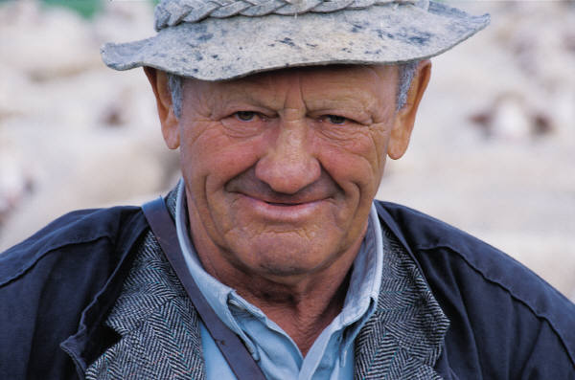
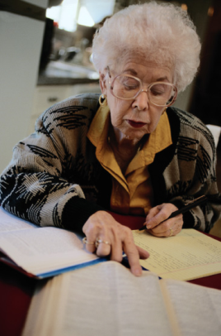
Hartford Partnership Program for Aging Education Overview
Patricia J. Volland, MSW, MBA
Director, Social Work Leadership Institute
Silberman School of Social Work at Hunter College

Slide 2
What is HPPAE?
A university and community partnership based on a collaborative educational model
Recruits MSW students to specialize in aging
Plays leadership role in national efforts to advance aging education in social work
Employs competency-based training
Offers a unique rotational approach to field education

Slide 3
HPPAE Six Essential Components
University-Community Partnerships
Competency-driven education
Field rotations
Expanded field instructor role
Student recruitment
Leadership

Slide 4
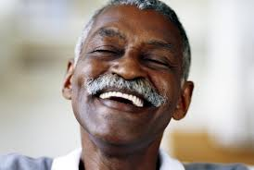
Why Implement HPPAE?
The rapid aging of the
population
The need for more specialists
in aging
The aging of the current workforce
The opportunity to recruit students – the jobs will be in aging

Slide 5
HPPAE and Workforce Challenge
HPPAE imperatives:
Engage social work
community to address
critical shortage of
elder-serving social workers
Build university and community partnerships to expand training opportunities and develop workforce

Slide 6
HPPAE and Workforce Challenge
HPPAE imperatives:
Leadership opportunity for all groups:
Deans and Directors
Field Directors
Students
Community-based agencies
Promote social work expertise to navigate complex systems of care and participate in interprofessional care teams

Slide 7
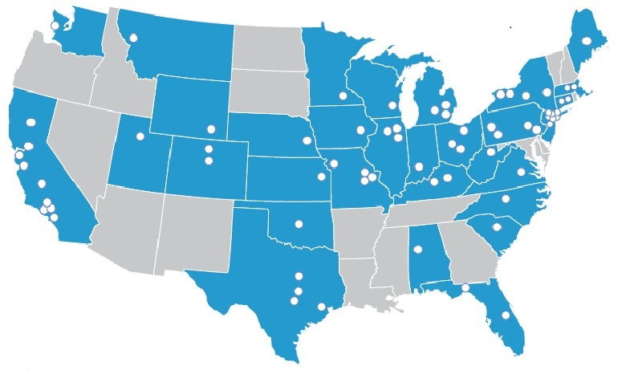
HPPAE Outcomes
Over the course of 12 years (2000- 2012), 69 schools of social work in 33 states received funding to implement HPPAE
By spring of 2012, approximately 2,600 HPPAE students graduated
The HPPAE has been initiated in a total of 97 programs in 37 states

Slide 8
University and Community Partnership Collaborative Roles
Partnership functions include:
Program planning and oversight
Student recruitment
Student selection
Curriculum development
Evaluation
Fundraising
Agency staff training

Slide 9
Competency-Driven Education
The Social Work Leadership Institute (SWLI) and the Council on Social Work Education (CSWE) Gero-Ed Center refined gero competencies with the input of multiple stakeholders to create the Geriatric Social Work Competency Scale II
This scale has been used to measure students’ pre and post competencies in aging field education settings
“82% of participating schools reported they agreed or strongly agreed that they would continue the use of the GSW competencies following the end of the grant period”
(Impact of HPPAE on Social Work Education, 2013)

Slide 10
Field Rotations
Rotations have been significantly endorsed by schools as well as students:
76% of schools will continue using the rotational model
37% will expand the rotational model
92% of students agree that the rotations enabled them to learn about the range of services for older adults
Students comments:
“Being placed at two very different settings where each setting had a range of services offered really benefited me.”
“[The rotation] experiences have had a great influence on my understanding of social work.”
“ The practicum rotations were helpful, in that I was able to work at a macro level in one placement, and do more direct work at another.”

Slide 11
Perspectives of Deans and Directors of Schools of Social Work
89% report a positive impact on curriculum
98% report a positive impact on field instruction
100% report a positive impact on student learning

Slide 12
Perspectives of Deans and Directors of Schools of Social Work
79% report a positive impact on faculty and student research
100% report a positive impact on the school and agency relationship
85% report a positive impact on the image and reputation of the MSW program

