Slide 1
Anita Rosen Panel Session for Best Practices in Gerontological Infusion
Skidmore College
Presenters:
Crystal Dea Moore, Program Director
Emily Gorbach, BSW Student

Slide 2
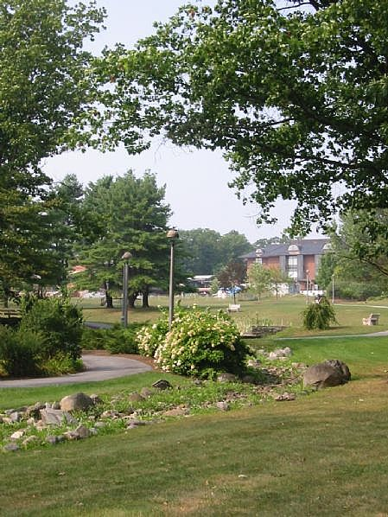
About Skidmore College
Small, private liberal arts college in upstate New York (approx. 2,400 students)
Located in a mixed urban-rural county
Accredited Social Work Program (3 faculty, approximately 10 majors graduate each year)
Social Work program part of the Department of Sociology, Anthropology, and Social Work

Slide 3
Skidmore’s BEL Project
Five gero-experiential activities infused throughout the foundation curriculum
Interviews of an older mentor from a mentoring program for youth who are at-risk
Intergenerational events at local senior center and congregate housing with youth from mentoring program
Tour of a continuous care retirement community and lunch with residents
Oral histories of older adults (both community dwelling and in nursing home)
Aging-specific field placement for senior social work majors (block placement)

Slide 4
Intergenerational Event
Part of coursework in Social Work Practice with Groups, Organizations, and Communities (40-hour volunteer placement requirement)
A team of four students developed and implemented two intergenerational programs in the Saratoga Springs community
Seniors were from a senior center and congregate senior housing
Youth were from a mentoring program (Big Brother/Big Sister-type program)

Slide 5
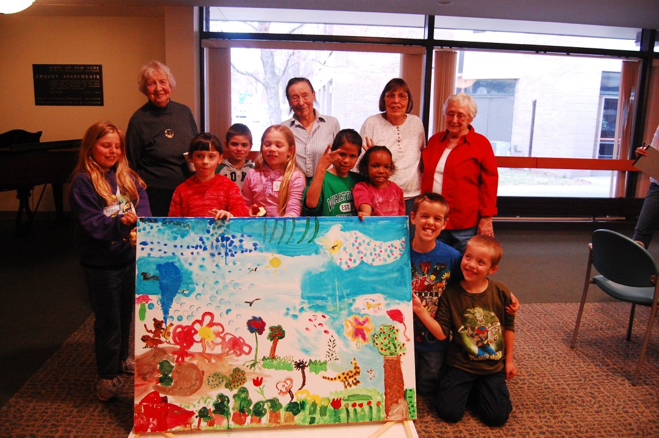
Event Implementation
Programs centered on social interaction and art
During both events, murals were created
Participants played board games and interacted with one another about hobbies/interests
Snacks/food were provided at both events

Slide 6
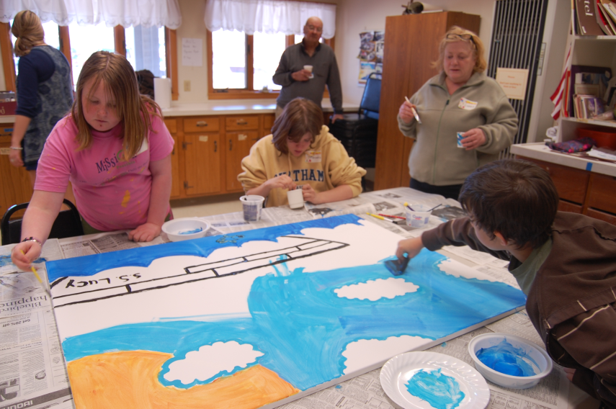
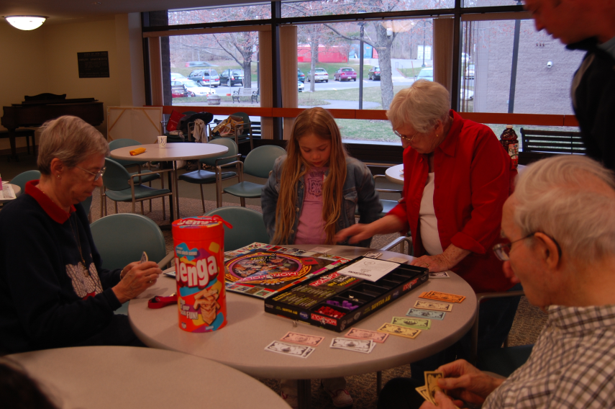
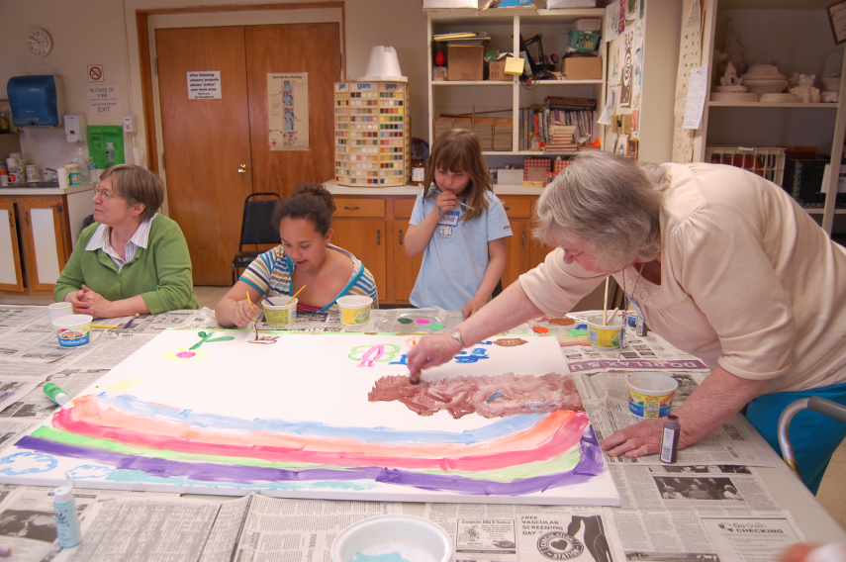
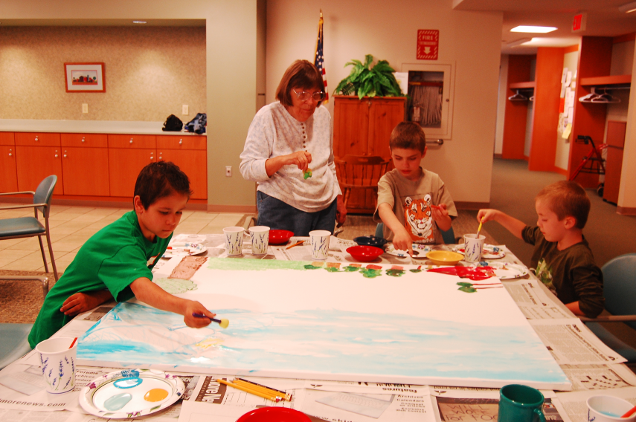
Event Photos

Slide 7
Learning Goals of Skidmore’s BEL Project
Expose students to advantages of intergenerational relationships
Provide examples of the social environments where older adults live and how aspects of those environments can effect well being
Develop skills in establishing rapport and the maintenance of effective working relationships with older adults
Provide contexts for demonstration of gero competencies

Slide 8
Selected Gero Competencies
Address respectfully the cultural, spiritual, and ethnic values of older adults and their families
Use empathy and sensitive interviewing skills to assess social functioning and support
Establish rapport and maintain an effective working relationship with older adults and their family members
Utilize group interventions
Identify how policy, regulations, and programs impact older adults and their caregivers

Slide 9
Data from BEL Common Measures
Correlated groups t-tests performed on the 5 questions addressing interest in working with and studying about aging populations (N=32)
Significant increases (p < .05, one-tailed) observed in four items: plans to pursue a career in gero social work, to pursue graduate level study in gero social work, to take course work in aging, and self-perceived competency to work with this population.
Non-significant item was plans to pursue a field placement with older adults

Slide 10
Intergenerational Program: Goals Accomplished
Increased competency in establishing a working relationship with older adults
Stimulated interest in working with older adults
Impacts on community participants:
Decrease negative stereotypes of older adults from the perspectives of the children and college students involved in the project
Decrease negative stereotypes of youth from the perspective of older adults

Slide 11
Other BEL Activities
Goal was to expose ALL social work majors to at least one gero-experiential activity (35 students participated so far and we have 25 majors)
Tour of CCRC and lunch (HBSE & Policy)
Interviews with older adults (Intro & Micro)
Field placement (Field Practicum)
Intergenerational events (Macro)

Slide 12
BEL Synergy
Development of new community partnerships with agencies that serve older adults
Infusion of gero-activities in other classes (not part of BEL-funded activities)
Development of needs assessment tool for older adults with low incomes in research class
Interviews of older adults for micro practice assignment (development of clinical portfolio)

Slide 13
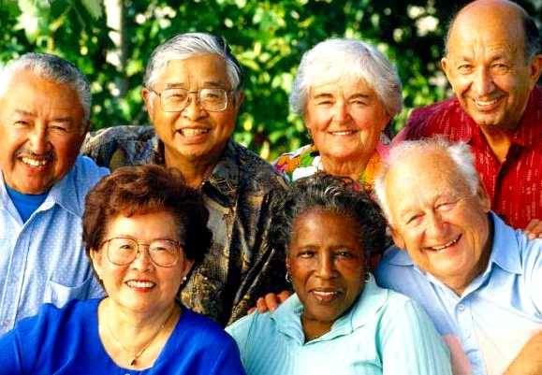
Further Impact of BEL Funding
Stimulated interest in working with this population
Gero-experiential activities provided opportunity to develop social work competencies and deepen understanding of social work practice with this population
Impact on future social work practice

Slide 14
Special Thanks….
Kelly Mills-Dick for her work in implementing so many of the BEL activities during the 2008-2009 academic year – We miss you!
CSWE Gero-Ed Center – Meredith Eisenhart, Megan Mills, and Nancy Hooyman
The John A. Hartford Foundation
The elders that participated in our programs

