Slide 1

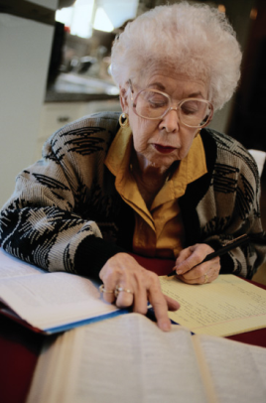





Student Field Rotations
Amy DeGurian, MSW, LSW
Field Education Coordinator, University of Pittsburgh
Melissa Brusoski, MPH
HPPAE Program Coordinator, University of Pittsburgh
October 2, 2014

Slide 2
Overview
Inter or intra-rotational
Options
Available to both first- and second-year students

Slide 3

Intent
Focus on breadth of experience not so much depth
Maintain signature pedagogy of field work outlined within the MSW curriculum standards

Slide 4

Inter-Rotation
Inter-rotational is suitable for first year and some second year students interested in gerontology.
Ex: UPMC hospice 1st semester, nursing home second semester

Slide 5

Intra-Rotation
Intra-rotational or internal rotations fit best with second-year students.
Ex: V.A.M.C. opportunities; GRECC, GEM, Community Living Center, Spinal Cord Clinic

Slide 6
Challenges
Some students love the rotational options and the opportunity to have multiple experiences
Others find it difficult to “switch gears” mid-stream.

Slide 7
Benefits
Our goal through the rotational field model is that all HPPAE students gain proficiency in the CSWE geriatric competencies.

Slide 8
CSWE Competencies
Values and Ethics
Assessment
Intervention
Services and Policies
Leadership
Enlightened Professional Self

Slide 9
Discussion
What if a student wants to stay in first placement?
Recruitment and determination of quality intra-rotational sites…
Share your experiences…

