Slide 1



Welcome to the Gero-Ed Track
Kick-Off Panel!
Addiction and Aging
Gero-Ed Track Chairs
Gero-Ed Track Sponsors
Barbara Berkman, PI, Hartford Scholars Program
Nancy Hooyman, Co-PI, CSWE Gero-Ed Center
Jim Lubben, PI, Hartford Doctoral Fellows Program
Nora O’Brien-Suric, Senior Program Officer, John A. Hartford Foundation
Pat Volland, PI, Hartford Partnership Program for Aging Education

Slide 2
Just Say Know: Addressing Substance Use
Disorders Among Older Adults
Daniel Rosen, Ph.D.
University of Pittsburgh
November 10, 2012

Slide 3
Service users 50+ years old with a substance use diagnosis – Allegheny County 2000 -2009

Slide 4
Service users 50+ years old with a substance use diagnosis – Allegheny County 2000 -2009
# of service users
203%
Total Cost (millions)
358%
Average cost per person
51%

Slide 5
Number and Percentage of Articles focusing on Older Adults and Substance Use Disorders (SUD) (Top 10 Journals 2000-2010)

Slide 6
Number and Percentage of Articles focusing on Older Adults and Substance Use Disorders (SUD) (Top 10 Journals 2000-2010)
Aging Journals
Substance Use Journals

Slide 7
Number and Percentage of Articles focusing on Older Adults and Substance Use Disorders (SUD) (Top 10 Journals 2000-2010)
Aging Journals
  11,598 articles
Substance Use Journals

Slide 8
Number and Percentage of Articles focusing on Older Adults and Substance Use Disorders (SUD) (Top 10 Journals 2000-2010)
Aging Journals
  11,598 articles
  102 articles on SUDs (0.9%)
Substance Use Journals

Slide 9
Number and Percentage of Articles focusing on Older Adults and Substance Use Disorders (SUD) (Top 10 Journals 2000-2010)
Aging Journals
  11,598 articles
  102 articles on SUDs (0.9%)
Substance Use Journals
  8,174 articles

Slide 10
Number and Percentage of Articles focusing on Older Adults and Substance Use Disorders (SUD) (Top 10 Journals 2000-2010)
Aging Journals
  11,598 articles
  102 articles on SUDs (0.9%)
Substance Use Journals
  8,174 articles
  79 articles on aging (1.0%)

Slide 11
Number and Percentage of Articles focusing on Older Adults and Substance Use Disorders (SUD) (Top 10 Journals 2000-2010)
Aging Journals
11,598 articles
102 articles on SUDs (0.9%)
OVER 11 YEAR PERIOD:
67 articles on alcohol abuse
5 articles on illicit drug abuse
5 articles on prescription drug abuse
25 articles on polysubstance abuse
Substance Use Journals
8,174 articles
79 articles on aging (1.0%)

Slide 12
Number and Percentage of Articles focusing on Older Adults and Substance Use Disorders (SUD) (Top 10 Journals 2000-2010)
Aging Journals
11,598 articles
102 articles on SUDs (0.9%)
OVER 11 YEAR PERIOD:
67 articles on alcohol abuse
5 articles on illicit drug abuse
5 articles on prescription drug abuse
25 articles on polysubstance abuse
Substance Use Journals
8,174 articles
79 articles on aging (1.0%)
OVER 11 YEAR PERIOD:
53 articles on alcohol abuse
7 articles on illicit drug abuse
1 article on prescription drug abuse
18 articles on polysubstance abuse

Slide 13
Number and Percentage of Articles focusing on Older Adults and Substance Use Disorders (SUD) (Top 10 Journals 2000-2010)
Aging Journals
11,598 articles
102 articles on SUDs (0.9%)
OVER 11 YEAR PERIOD:
67 articles on alcohol abuse
5 articles on illicit drug abuse
5 articles on prescription drug abuse
25 articles on polysubstance abuse
Substance Use Journals
8,174 articles
79 articles on aging (1.0%)
OVER 11 YEAR PERIOD:
53 articles on alcohol abuse
7 articles on illicit drug abuse
1 article on prescription drug abuse
18 articles on polysubstance abuse

Slide 14
Preventable Deaths from Prescription Drugs and Motor Vehicles
Source: Center for Disease Control

Slide 15
Substance Use Disorders and Older Adults
Changing demographics
Impact of problem
Older adult methadone clients
Screening tools and approaches to treatment

Slide 16
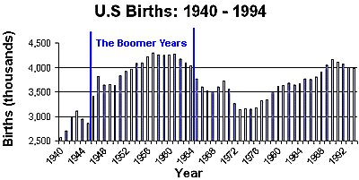
What is a Baby Boomer?
Those born between (and including) 1946 and 1964
Currently represent 29% of the U.S. population

Slide 17
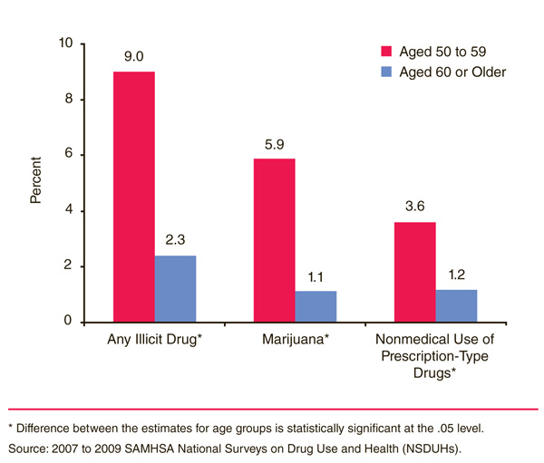
Illicit Drug Use among Older Adults
An estimated 4.8 million adults aged 50 or older, or 5.2 percent of adults in that age range, had used an illicit drug in the past year.

Slide 18
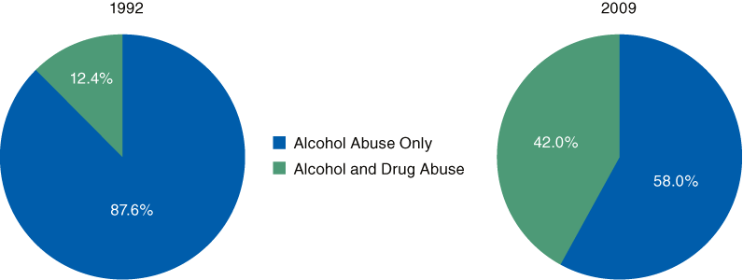
Alcohol Admissions Aged 50 or Older Reporting Alcohol Abuse Only and Combined Alcohol and Drug Abuse: 1992 and 2009
Source: SAMHSA Treatment Episode Data Set (TEDS), 1992 and 2009.

Slide 19
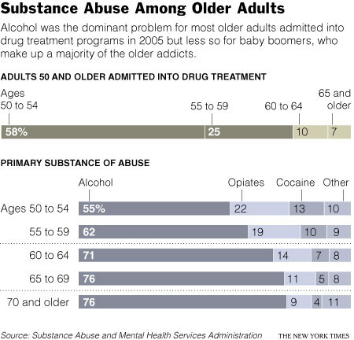

Slide 20
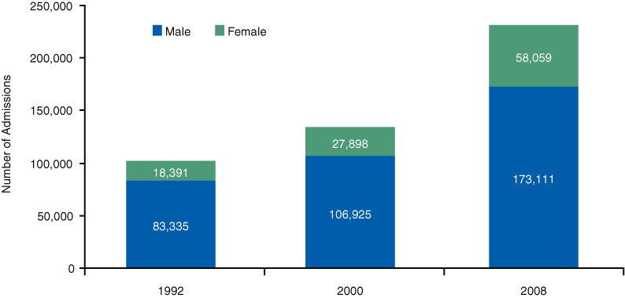
Substance Abuse Treatment Admissions Aged 50 or Older, by Gender: 1992, 2000, and 2008
Source: SAMHSA Treatment Episode Data Set (TEDS), 1992, 2000, and 2008.

Slide 21
Older Adults and Opiate Addiction
Opiates are already the second most frequently cited primary substance of abuse (after alcohol) for all admissions to substance abuse treatment by adults over the age of 50
In 2005, 1 in 5.3 substance abuse admissions of 50 to 54 year olds were for heroin abuse.
Between 1992 and 2008, admissions aged 65 or older for opiate addiction increased from 7.2 percent to 16.0 percent (SAMHSA, 2007)

Slide 22
The Health and Mental Health of Older Adult Methadone Clients (n=140)

Slide 23
Results of Urine Screens
Nearly 2/3 (61.4%) of respondents had at least 1 positive month of a urine screen in the year prior to the interview
One in five participants (21.0 %) acknowledged that they had consumed four or more alcoholic drinks in one day in the past twelve months

Slide 24
Barriers to Addressing Problem
All health care providers need education
Symptoms mistaken for depression, dementia, etc.
Medical appointments rushed
Attitudes towards treatment (waste of time, resources)
Older adults more likely to hide problem (shame)
Older adults and families also ashamed (stigma)
Attitudes of family and providers (“why not –life is short”)
Older adults less likely to seek treatment
Socially isolated

Slide 25
Screening
To separate elderly people who have no alcohol or drug abuse problems from those who need a more in depth assessment
Screening tools that are used should be easily administered
(Include information about use of prescription and OTC medications)
      CAGE test- Questions about cutting down on drinking
      HEAT- Asks open-ended questions
      CHARMM- Sets a timeframe of the past year
      MAST-G 24-item screening test for older adults
Clinicians should be aware of the language they use

Slide 26
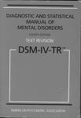
Why the DSM- IV will not help you now?
The DSM-IV indicators of addiction are not always applicable to elderly people.
For example: Areas of significant impairment of distress for the diagnosis of substance abuse are
  failure to fulfill a major role obligation at work, school, or home
  using substances in situations in which it is physically hazardous; and
  legal problems
For an elderly person who is socially isolated and does not drive, work, or volunteer, these criteria are not relevant.
We will see about the DSM-V

Slide 27
Applying DSM-IV Criteria to Older Adults
Tolerance
Withdrawal
Large amounts/longer time
Can’t cut down
More time using/giving up activities
May not occur; small amounts can be a problem
May not occur in late onset
Cognitive impairment impairs self monitoring
Low levels can be a problem
Reduced activities may mask detection

Slide 28
Advantages to Same-Age Treatment
Recent movement is away from generic treatment approaches to more specific tailored programs to meet the need.
Topic specific support: grief & Loss, retirement, depression, social isolation
Help with increased social supports –sober networks
A Slower pace of individual and group support to help older adult
Linking client to services for medical and case management needs.

Slide 29
Future challenges
Address stigma, negative bias to older persons
Implement consistent and appropriate screening instruments
Evidence based age appropriate, culturally competent tools & intervention
Identify co-morbid physical illnesses
Increase awareness by health/human services
This is everyone’s issue

Slide 30
A Second Chance
“When you get older and you look back on your life, that’s a beautiful feeling. I didn’t have to live this long. I’ve been shot. I have O.D.ed numerous times. When you close your eyes and you pass out and your on that floor or in that bed and your not moving, and then you finally wake up, and ask what happened. Or when you focus clearly and realize what you went through and God brought you back. That is a beautiful thing. Because my cousin, my best friend, didn’t make it. And I have to, I have to make a commitment and let everybody know wherever I’m at , in church , in the barber shop, here, let them know that I appreciate life more than I ever did because I’ve been through it. I was dead and God gave me life back. Do you understand that? I was dead. I was dead. Do you understand that? If only you could have seen me. And I woke up. And I asked, I said what happened? And Gold told me I’ll give you another chance to be with mom and dad and your sisters. Because so many of us, man, didn’t wake up, and didn’t get off that ground.”

Slide 31
Thank you!
National Institute of Drug Abuse
Staunton Farm Foundation
Hartford Foundation
University of Pittsburgh SSW
Lindsey Smith/Amanda Hunsaker
Staff of Various Projects
Most of all:
The older adults with substance abuse problems who gave of their time, insights, and thoughts

Slide 32
Selected References
Conner, K.O., Rosen, D., Wexler, S., and Brown, C. (2010). “It’s like night and day. He’s white. I’m Black”: Shared Stigmas between Counselors and Older Adult Methadone Clients. Best Practices in Mental Health: An International Journal on Aging and Mental Health, 6(1), 17-32.
Rosen, D., Morse, J.Q., and Reynolds, C.F. (2011). Adapting problem-solving therapy for depressed older adults in methadone maintenance treatment. Journal of Substance Abuse Treatment, 40(2), 132-141.
Rosen, D., Hunsaker, A.E., Albert, S.M., Cornelius, J.R., & Reynolds, C.F. (2011). Characteristics and consequences of heroin use among older adults in the United States: a review of the literature, treatment implications, and recommendations for further research. Addictive Behaviors, 36(4): 279-285.
Rosen, D., Smith, M.L., & Reynolds, C.F. (2008). Characteristics and needs of older adult methadone clients. The American Journal of Geriatric Psychiatry, 16(6), 488-497.
Wu, L.-T., & Blazer, D. G. (2010). Illicit and nonmedical drug use among older adults: A review. Journal of Aging and Health, 23, 481-504.

Slide 33
Gambling Addiction in
Older Adults
Kim L. Stansbury, PhD, MSW
Eastern Washington University
School of Social Work
11/10/12

Slide 34
Of All Issues, Why Gambling Addiction?
48 States offer some form of gaming opportunity in the US except for
  Utah and Hawaii
Marked increase in gaming across all age groups, especially in older adults.
Gambling addiction is invisible
Causes disruption across all systems

Slide 35
Prevalence
National studies indicate-older adults least likely to be problematic gamblers- than other age groups
Regional studies have found higher rates of problem gambling among older adults
  11-23% identify with a gambling problem
  Bingo- # 1 on-site recreational activity
  Casino- #2 off-site recreational activity

Slide 36
Vulnerability to Gambling
Risk factors
  Retirement/Leisure time
  Death of a spouse
  Loneliness
  Lack of social opportunities
Casinos tailor marketing strategies to attract more senior patrons

Slide 37
Classification of Gambling Addiction
Not in DSM IV-TR
  At risk, 1-2 symptoms
  Problem Gambling 3-4 symptoms
In DSM-IV-R
  Pathological Gambling 5 or more symptoms
Notes:
CHANGE

Slide 38
Symptoms (5 or more)
Preoccupation
Increasing amounts bet (tolerance)
Unsuccessful efforts to control
Restless, irritable when cutting back (withdrawal)
Escape from problems
Chasing losses
Lies to family, therapist, others
Committed illegal acts (hot checks, theft, etc)
Lost relationships, job
Relies on others for bail-outs

Slide 39
Gender Differences in Gambling
Increased number of older women participating in gambling activities
Later onset of habitual gambling for women in contrast to men (54.8 versus 33.2)
Women reach problematic levels of gambling faster (5.6 years versus 16 years for men)
Women enter treatment soon than men (4-5 years versus 11 years)
Self-Help for the Elderly Problem Gambling Technical Assistance & Training Project

Slide 40
Short Screening tools
Lie-Bet Screening Instrument
1) Have you ever felt the need to bet more and more money?
2) Have you ever had to lie to people important to you about how much you gambled?
http://www.npgaw.org/media/pdfs/PDF6.pdf

Slide 41
5-Item Short Gambling Screen Centre for Addiction and Mental Health
In the past 12 months, have you gambled more than you intended?
In the past 12 months, have you claimed to be winning money when you were not?
In the past 12 months, have you felt guilty about the way you gamble, or about what happens when you gamble?
In the past 12 months, have people criticized your gambling?
In the past 12 months, have you had money arguments that centered on gambling?
* Two or more “yes” responses indicate that there may be a problem with gambling and the individuals should be referred for an assessment.

Slide 42
Impact of Gambling Addiction on
Older Adults
Financial: less time to recoup losses
Psychological: depression, suicide
Social: isolation, withdrawal
Family: neglect and abuse
Vocational: decline in work performance
Older adults least likely to access treatment
  Stigma, lack of knowledge, shame, cognitive impairment

Slide 43
How to Help
Express care and concern
Be specific about behavior
Listen with empathy (non-judgmentally)
Offer to help find treatment if willing
Remember if the older person is not open to treatment, help is available to family members
Notes:
Judgementally

Slide 44
Resources
Helplines
  National Help line 1-800-522-4700
  At states have a help line
Support Groups
  Gamblers Anonymous (National)
    http://www.gamblersanonymous.org
  GamAnon (National)
    http://www.gam-anon.org

Slide 45
Resources (Cont’d)
U.S. Administration on Aging (extensive list of gambling-related internet resources)
http://www.aoa.gov/prof/notes/notes_gambling.asp
U.S. Administration on Aging (extensive list of gambling-related internet resources)
http://www.aoa.gov/prof/notes/notes_gambling.asp
Florida Council on Compulsive Gambling (online risk assessment questionnaire for seniors, brochures)
http://www.gamblinghelp.org/sections/seniors/index.html

Slide 46
Questions
References available upon e-mail request!

Slide 47

Hoarding and Older Adults
Gail Steketee, PhD
Boston University
School of Social Work
11/10/12

Slide 48
Proposed DSM-5 Criteria for Hoarding Disorder
OC Spectrum Committee
A. Persistent difficulty discarding or parting with personal possessions, even if apparently useless or of limited value, due to strong urges to save items, distress, and/or indecision about discarding.
B. Symptoms result in the accumulation of a large number of possessions that clutter the active living areas of the home, workplace, or other personal surroundings and prevent normal use of the space. If living areas are uncluttered, it is only because others keep these areas free of possessions.

Slide 49
Proposed Hoarding Disorder Criteria
C. Symptoms cause clinically significant distress or impairment in social, occupational, or other important areas of functioning (including maintaining a safe environment for self and others).
D. Hoarding symptoms not due to a general medical condition (e.g., brain injury, cerebrovascular disease).
E. Hoarding symptoms not restricted to symptoms of another mental disorder
  obsessions in OCD
  lack of motivation in MDD, delusions in Psychotic Disorders, cognitive deficits in Dementia, restricted interests in Autistic Disorder, food storing in Prader-Willi Syndrome).

Slide 50
Proposed Hoarding Disorder Criteria
Specify if:
With Excessive Acquisition: symptoms accompanied by excessive collecting, buying or stealing items that are not needed or for which there is no available space.
Good or fair insight: Recognizes that hoarding-related beliefs and behaviors are problematic.
Poor insight: Mostly convinced that hoarding-related beliefs and behaviors are not problematic despite evidence to the contrary.
Delusional: Completely convinced that hoarding-related beliefs and behaviors are not problematic despite evidence to the contrary.

Slide 51
People who hoard save for the same reasons we all do – just more so
Sentimental –
“This represents my life. It’s part of me.”
Instrumental –
“I might need this. Somebody could use this.”
Intrinsic –
“This is beautiful. Think of the possibilities!”
Notes:
Why do these people save things? Are their reasons different? Understanding their reasons can help us in developing treatments. Our research indicates that they save things for exactly the same reasons we all save things. There are 3 types of such reasons:
Sentimental saving refers to the attachment of emotional value to a physical object. It is, in a sense, a way of extending our identity to incorporate objects.
“This is a part of me, of who I am.” Envelope example. Box for every year eg.
Also has implications for feelings of safety/vulnerability. Safety signals.
Instrumental - Refers to saving things for a specific need or use. You save your old mortgage bills for tax purposes. Toilet Paper roll eg.
Intrinsic saving refers to saving not because of emotional significance or instrumental value, but simply because it is appealing.
Picture on wall
For Pat - bottle cap example.

Slide 52
Mobility Hazards
But there are problems:
Blocked Exits

Slide 53
Community Costs
Sanitation problems
79% of cases involved multiple agencies

Slide 54
Social & Functioning Problems
Social isolation
Strained relationships
  family, friends, landlords, neighbors
Legal and financial problems
  Credit card debt
  High expenses – buying, storage unit fees
  Property damage - loss of investment
  Eviction, divorce, bankruptcy

Slide 55
Profiles of Hoarding Fires
Death in house fires - 6%
8 times the cost of ordinary fires
77% are men
Nearly 40% are 65 or older

Slide 56
Hoarding Crosses Cultures
North America
  US, Canada
Europe
  UK, France, Germany, Netherlands, Italy
  Poland, Turkey
Africa
  Egypt, South Africa
South America
  Brazil, Costa Rica
Asia
  Japan, Singapore

Slide 57
Epidemiology
Recent estimates- 4-5% in adults
  US – 5% Samuels et al. (2008)
  UK – 2% Iervolino et al. (2010)
  German – 4.6% Mueller et al. (2009)
More common among older people and those with low incomes
Among elder service organizations:
  15% at Elders at Risk Program, Boston
  10-15% at Visiting Nurse Assn., NYC
  30-35% at Community Guardianship, NYC

Slide 58
Hoarding worsens with time and becomes moderate-severe after age 30

Slide 59
Most have other MH problems
(n=217 people with clinical hoarding)
Frost, Steketee, Tolin et al., 2011

Slide 60
Health Threats in 62 Elders who Hoard (seen by 40 caseworkers)

Slide 61
Cognitive Problems did not Explain Hoarding in Elders

Slide 62
Previous Interventions for Elders Rarely Worked
Intervention
By Whom
Outcome

Slide 63
Special Challenges for Elders with Hoarding
Reduced capacity - cooking, cleaning, bathing, sleeping
Decreased supports - physical and emotional
Safety –fire, falling, mold, emergency medical access
Physical health - respiratory problems, self-care, nutrition
Social isolation - embarrassment about clutter
Legal problems –compulsive buying, debt, lost and unpaid bills & applications for services
Risk of homelessness due to eviction

Slide 64
Community Challenges
Increased social service provider load for:
  Public health departments
  Housing and inspection services
  Housing managers & landlords
  Elder service agencies
  Mental health department
  Health care organizations
The time and money required to resolve serious hoarding cases strains agency resources
Notes:
Time consuming to deal with hoarding
Give a few specifics about costs, time.

Slide 65
Specialized Treatment for Hoarding
(Steketee & Frost, 2007)
Education and case formulation based on theoretical model for hoarding
Determine values, set goals
Motivational enhancement
Skills training for organizing, problem solving, decision-making
Practice discarding & non-acquiring
Challenge thoughts and beliefs
Prevent relapse

Slide 66
Brookline Flexible CBT for Hoarding
(modified from Steketee & Frost 2007 manual)
Alternating home and office visits
1.5 – 2 hour sessions
~40 sessions over ~ 12 months
Treatment team:
  agency clinicians
  B.A. staff member hired and trained to provide hoarding treatment
Flexible application of skills training, exposure practice and basic cognitive strategies

Slide 67
Brookline Study Recruitment
Excluded those with dementia, problem personality features
9 began treatment; 6 completed
5 women, 1 man
Mean age = 72, range = 56 - 86 years
Only 1 had no MH problems; 5 had depression, 1 PTSD, 1 ADHD
5 lived alone; 1 lived with roommates
Physical health problems included
  Diabetes, overweight, arthritis
  Chronic bronchitis, glaucoma, Parkinson’s

Slide 68
Engagement Strategies
Humor and inspirational quotations
Schedule sorting times
Listen to music while sorting
Review progress via before and after photos
Review life goals, esp. as priorities change with declining health
Reward self for work done - but not with new items!
Balance homework with leisure

Slide 69
28% overall reduction in physical clutter
Elderly Clients | CIR % Reduction
1 | 17%
2 | 20%
3 | 25%
4 | 29%
5 | 36%
6 | 46%
Mean | 28%

Slide 70
Open trial of CBT for Older Adults
Used similar treatment methods, but less flexible therapy
12 elders participated
3 improved by 30% or more, but one relapsed
9 did not improve noticeably
Responders had previous psychotherapy, high homework compliance and lower mean age (68 v. 76)

Slide 71
Older Age Complicates Hoarding Treatment
More health problems and safety risks – falling, fire
Low insight, limited motivation and ambivalence requires strong relationship building
A history of deprivation contributed to some clients’ worries about necessities and urges to save
Downsizing homes provokes special challenges:
  Who should receive cherished objects
  How to physically remove items
Cognitive therapy less useful for those with some cognitive decline

Slide 72
Successes with CBT for Elders
High satisfaction with focused practical treatment
Compulsive acquiring changed more quickly
Reductions in clutter take 1 year or more
Structured assignments (esp. sorting) with daily goals and scheduling worked best
In-home coaches were especially helpful
Therapy provided good social support – how to promote this when therapy ends?

