Slide 1
Gerontology Curriculum Strategies:
Outcomes of Infusion and Specialization
Nancy Hooyman, CSWE Gero-Ed Center
Gary Bachman, Park University
Adrian Kok, Dominican University
Greta Slater, Ball State University
Kathleen Farkas, Case Western Reserve University

Slide 2
Strategies Background
Phase 1: GeroRich & CDI Programs
Infusion of gero competencies and content within required course work at the generalist level
BSW Experiential Learning (BEL) Program
Phase 2: MAC Project
Infusion of gero content into advanced mental health, substance use & health curriculum

Slide 3
Strategies Background
Phase 3: Specialized Gero Program
Development of gero-specific curriculum structures
HPPAE field model of education
Intersections Among Approaches
Ongoing infusion as basis for student recruitment and specialization

Slide 4
Ideal “Gerontologized” Curriculum
Infusion in All Required Courses
Experiential activities with older adults for all students
HPPAE field model of education
Infusion in Advanced Non-Aging Curriculum
Specialized Gero Courses and Curriculum Structures
Integrated With Field Education

Slide 5
Structural Issues
Specialization vs. Infusion
Issue for most fields of practice and social work programs
Factors to Consider
Resources
Student Interest/Demand
Faculty Capacity
Program Size
Administrative Support

Slide 6
What Works?
How effective are these different approaches in preparing gero competent social workers?
How do we define effective?
How are outcomes measured?
How are challenges of implementation addressed?

Slide 7
Presentation Format
Accomplishments To Date
Major Challenges Faced
Strategies to Address Challenges
Recommendations to Other Faculty/Programs
Questions and Discussion

Slide 8
Curriculum Development Outcomes in a
Small BSW Program
Gary E. Bachman, MSSW, LSCSW
Associate Professor
Director of Field Education
Park University

Slide 9
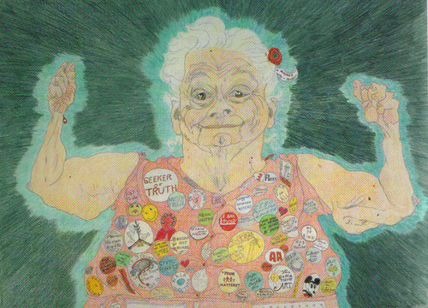

Slide 10
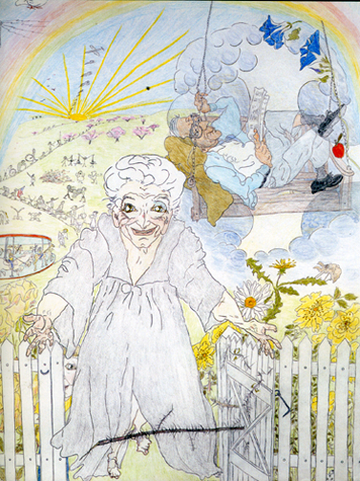
Infusion of Content on Aging (Where we are: 3 years in)
Aging has been infused into every course:
Introduction to Social Work
Social Welfare Policy & Programs
Human Diversity & Social Justice*
HBSE* (Micro) & (Macro)
Practice (l, ll, & lll)
Social Work Research*
Field*

Slide 11
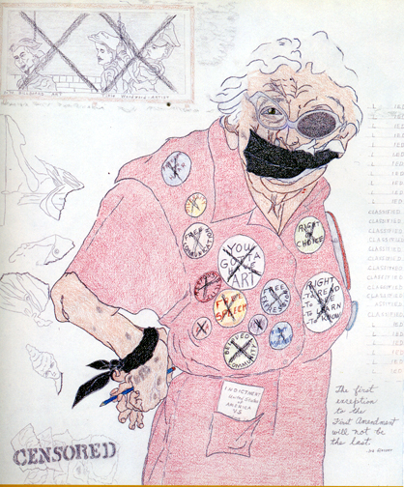
Primary Successes: Human Diversity & Social Justice
Course competencies are built around recognition of the “Faces of Oppression.”
Elders represent one of the seven core focus populations examined in the course.

Slide 12
Primary Successes: Human Diversity & Social Justice
Vulnerabilities often confront aging populations within the framework of ageism, poverty, domestic violence, financial exploitation, neglect and self neglect, and threats of homelessness.
The paradox of well-intended but perhaps unwanted actions pursued “for your own good.”
Competency: self-determination, guardianships and conservatorships. (Not all injustice is intentional.)

Slide 13
Primary Successes: Human Diversity & Social Justice
The Five Faces of Oppression
Iris Young, Oppression, Privilege, & Resistance, McGraw-Hill, 2004.
Media: Secrets in America: the Crisis of Elder Abuse
Stanislaus County, CA 2009

Slide 14
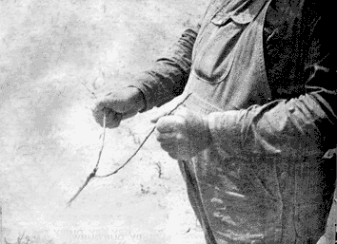
Primary Successes: Human Diversity & Social Justice
The “social construct” of aging, and the “biological realities” of life are a focused entry point for much of our new content.
Some of this material is now being transitioned or linked into other courses.

Slide 15
Primary Successes: Human Diversity & Social Justice
Divining the 3 Ds presents a foundation for examination of, and differentiation between, dementia, delirium, and depression.
Ageist Angst takes on and challenges many of our limiting social constructs about “old people.”
CARE: Client Assessment, Referral, and Evaluation is a screening tool used to identify needs and resources for individuals at risk for out-of-home placement.

Slide 16
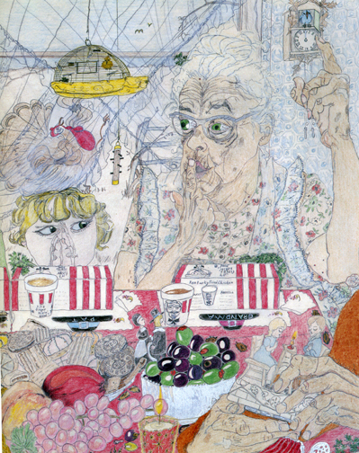
Primary Successes: partnering with
Social Work Research Course: Class Project, Service Learning, and Core Assessment (fall semester only)

Slide 17
Primary Successes: partnering with
Each student conducts between four and eight structured, in-home visits with elders enrolled in Meals on Wheels.
Students conduct the required periodic review in addition to a needs assessment inventory developed in the research course.
Requisite documentation is completed, original content is analyzed for trends, and recommendations are proposed.
A formal class presentation of findings before the agency’s board of directors.

Slide 18
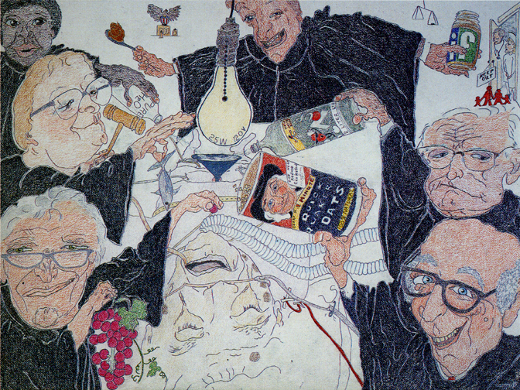
Challenges Challenged, Competencies Created
Our greatest challenge was one of timing, as we were in the midst of our first reaffirm- ation through CSWE.
But sometimes challenges can also reveal strengths.

Slide 19
Challenges Challenged, Competencies Created
Exhibit A: Knee replacement & rehab
Exhibit B: What it’s like to have a stroke.
Exhibit C: Bilateral cataracts.
Lesson A, B, C: Take care of yourself. Always.
Model this for your students as well as for your own welfare.
This might be a good time to talk about advance directives!

Slide 20
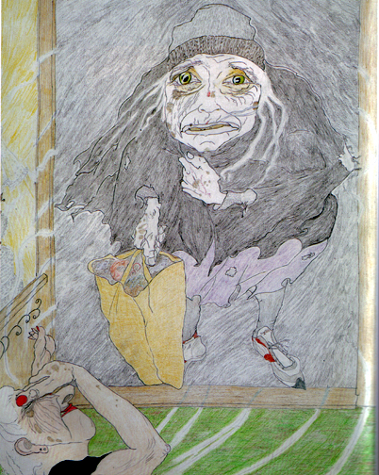
Recommendations: Attend to Competencies
Know that many of your students may have had very little contact with elders.
Pursue this content intention-ally: confronting bias, dread, and ageism.
Maintain a focus on strengths and resilience.
Do YOUR homework: Identify and link to community resources. You may need them some day!

Slide 21
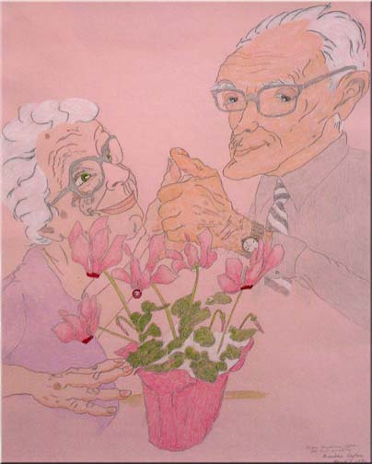
Recommendations: Have Fun With This Material
Embrace our foundation of generalist practice: recognize and attend to common themes and experiences.
Don’t reinvent the wheel: use the resources available to you.
It’s OK to laugh. It’s OK to cringe. It’s not OK to ignore.
Aging is contagious: You get it when you don’t die.

Slide 22
3S Approach to Setting Up a Successful Gerontology Certificate Program: Strategies, Successes, & Sustainability
Adrian Kok, PhD
Graduate School of Social Work
Dominican University

Slide 23
Context: Development of Gero Initiative
Dominican University – newly accredited social work program
Motivations
Organizational
Demand for social workers
2005 – CDI
2008 – HPPAE Grant
2009 – Spec Gero Grant

Slide 24
Successes I
The DU gero program has been institutionalized
Recognition and support from faculty, university, community agencies
Gero internships available locally, nationally, and internationally
20% internships in gerontology in 2011
$10,000 set aside for student Gerontology scholarships in 2011/2012
Best student award in gerontology practice
Gero competencies as a school outcome measure

Slide 25
Successes II
Media recognition
Articles in the Chicago Tribune & local newspapers
Composition of Teaching Faculty
25% of tenured faculty are gero-inclined
20% of adjuncts have gero work experience
Assistant field director
Recruitment of adjuncts with gero experience – an ongoing priority

Slide 26
Three Strategies
Incremental infusion work
Information sessions to recruit students and FEED them! Invite faculty too!
Consistent visibility of gerontology
School meetings
University meetings
Blasting of emails
Information sessions
Posters on the door and wall on aging

Slide 27
Three Challenges
So much to do and so little time and… resources!
One-on-one with faculty, recruitment, research, community partners, networking
Faculty buy-in
Perception that other marginalized groups are neglected
Administration support
Not all administrators were supportive

Slide 28
Recommendations
Importance of 2Ms
Media – Excellent public relations tool!
Marketing – Raises visibility of initiative!
Incremental approach will ultimately lead to curricular & organizational changes
Ripple Effects → Policies → Gero Certificate → Concentration
Make use of the support at the Gero-Ed Center and resources on the Gero-Ed website!

Slide 29
Master’s Advanced Curriculum Project Teaching Resources for Health, Mental Health and Substance Use
Kathleen Farkas, PhD
Case Western Reserve University

Slide 30
Mandel School of Applied Social Sciences
Research Intensive School with a Strong History of Curriculum Development and Teaching
Ability-Based Learning/The 8 MSASS Abilities
Specialization Approach to Advanced Master’s Curriculum in Direct Practice:
Aging, Mental Health*, Alcohol & Other Drug Abuse, Children Youth and Families*, Health
Advanced courses in Methods, Policy, and Field Education specific to each specialization area

Slide 31
Challenges of Infusion
Prior attempts to “infuse” content at MSASS
Difficult to convince instructors to include content
Courses “full” already
Faculty agreed with need for content, but didn’t think it was their responsibility to deliver it
MSASS curriculum structure
Multiple courses, sections and instructors
Difficult to implement changes in all courses
Difficult to maintain changes over time

Slide 32
“…chance favors the prepared mind”
Curriculum Concerns:
Content on screening & assessment content and skills across all specializations was targeted as a concern.

Slide 33
“…chance favors the prepared mind”
MAC Grant and Products
Tailored to address MSASS faculty’s concerns regarding screening and assessment skill development in the curriculum

Slide 34
“…chance favors the prepared mind”
Delivery
New course developed; required for all direct practice students in all specializations
Content and skills development on screening & assessment with older adults built into course objectives, content and assignments

Slide 35
“A Perfect Storm”
Faculty Concerns about Screening/ Assessment Content and Skills
Faculty Expertise and Willingness to Develop MAC sponsored Innovations
MAC Opportunities to Develop Curriculum Products

Slide 36
Primary Successes
MAC developed “clinical scripts”, videos, and curriculum modules regarding mental health and AODA issues among older adults
All MSASS students receive content on MH/AODA and older adults
Embedded assignment on screening/ assessment provides data on a practice behavior for curriculum evaluation.
Typically about half of students select older adult case for final assignment
Students consistently rank course highly.

Slide 37
Primary Successes

Slide 38
Recommendations
Target faculty’s curriculum concerns and shape project to meet them
Only some concerned about content on older adults
Only some concerned about mental health/AODA
But… All concerned about screening/assessment skills
No substitute for champions and experts on the faculty
Honestly, timing helped

Slide 39
Engaging Learners in the Development of Essential Research Skills (ELDERS)
Greta Slater, PhD
Ball State University

Slide 40
Ball State & BSW program
BSU founded in 1918 as a teacher’s college by the Ball Brothers (Ball jars for canning)
Residential 4-year college with around 20,000 students and 180 majors
Notes:
Second person
40

Slide 41
Ball State & BSW program
BSU is highly accessible for people with disabilities & very tech-oriented campus
BSW program has around 300 majors & 90 minors
8 full-time faculty
No graduate program (yet)
Notes:
Second person
41

Slide 42
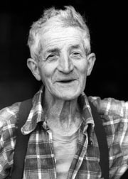
ELDERS Project
Purpose was to provide:
Direct research experience (Immersive learning: connect concepts w/activities)
Experience working with elders
Community service (i.e., evaluation)
Partnered w/ Lifestream Services
Area Agency on Aging
Serves 7 county region
Notes:
First person
42

Slide 43
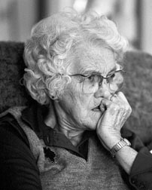
ELDERS Project: Activities
Involved ≈ 60 students per semester (N=128)
Key component of Research Sequence
SOCWK 340 (Research I: Methods)
SOCWK 440 (Research II: Stats)
Notes:
Second person
43

Slide 44
ELDERS Project: Activities
Evaluation of AAA services
Transportation Services (Sp ’08*)
Nutrition Services (Fa ’08, Sp’09, Sp ’10)
Housing Services (Fa ‘09) * pilot
Notes:
Second person
44

Slide 45
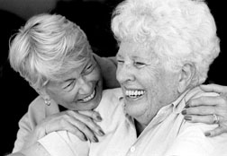
ELDERS Project: Evaluation
Indirect measures (pre & post):
Aging Competency Scale (22 competencies)
Research Attitudes & SE Scale
5-item measure from CSWE/BEL
Notes:
Second person
45

Slide 46
ELDERS Project: Evaluation
Direct measures (w/rubrics):
Research I:
Article critique
Survey critique
Data collection log
Final Paper/ Poster
Research II:
Data collection log
SPSS Database & output files
Final Paper/ poster
Notes:
Second person
46

Slide 47
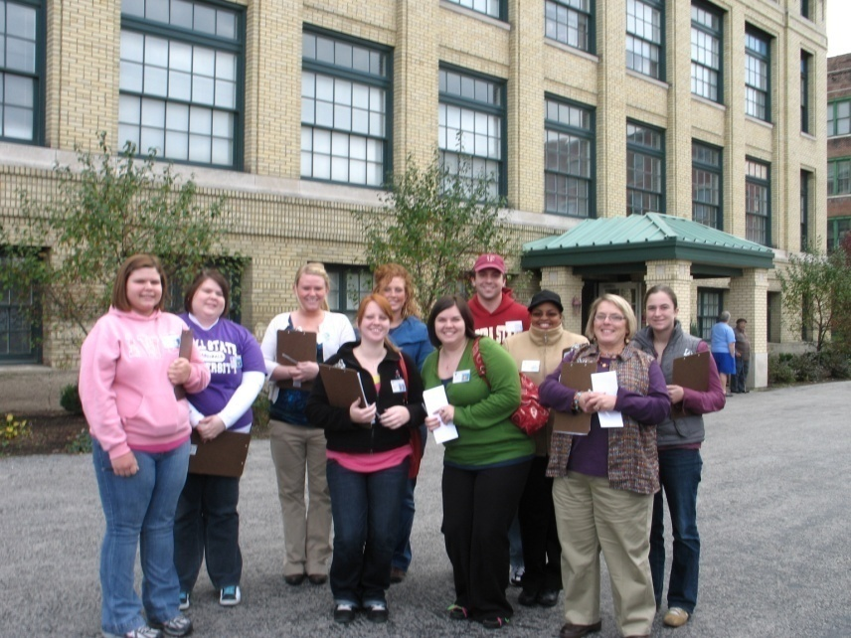
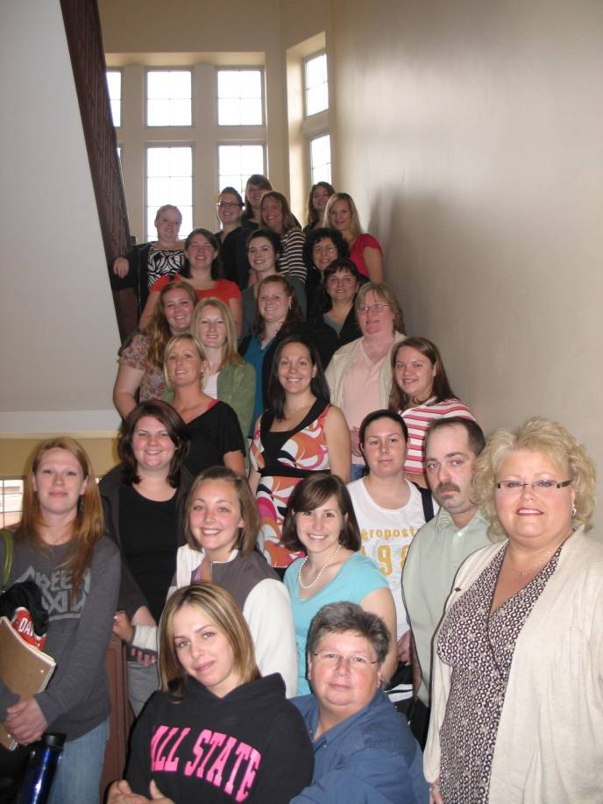
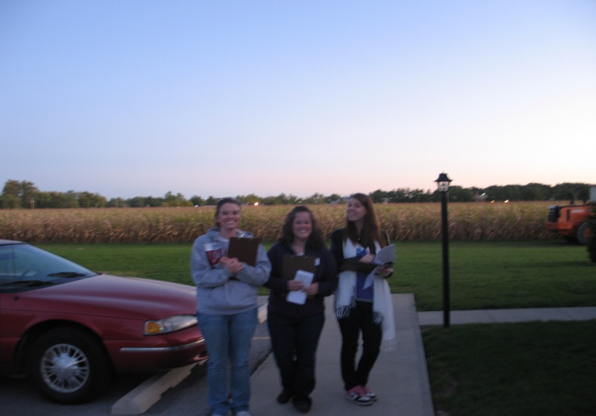
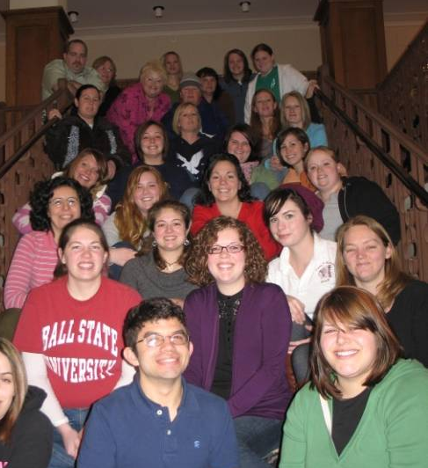
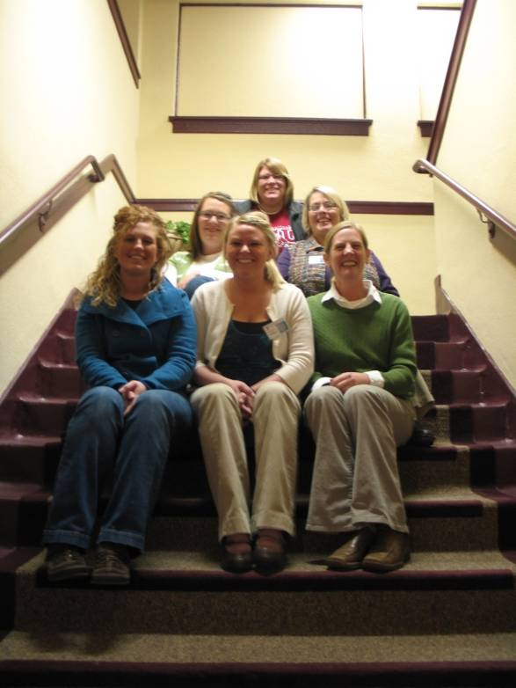
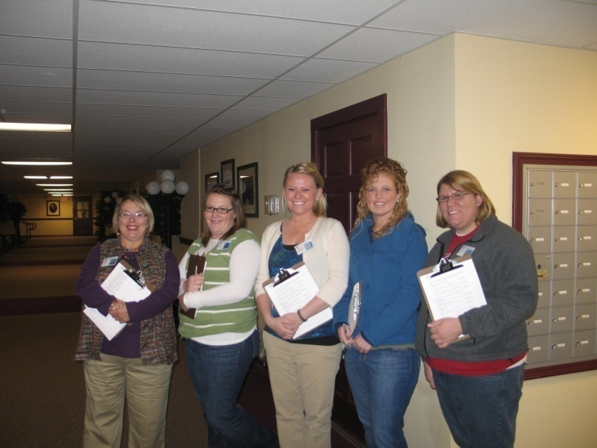
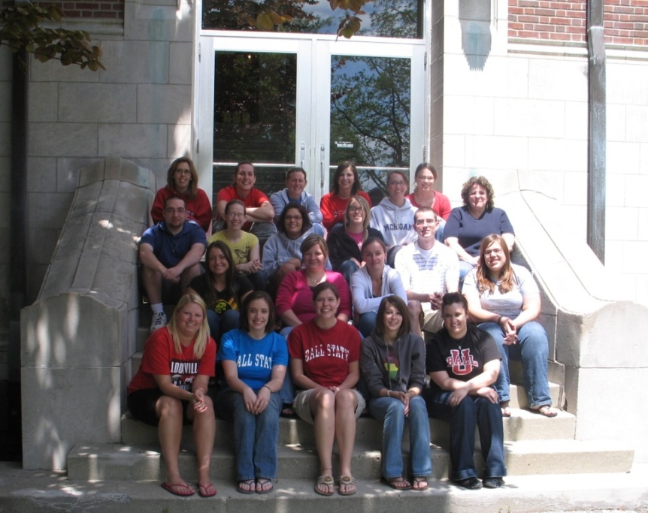
Notes:
Greta’s slide
47

Slide 48
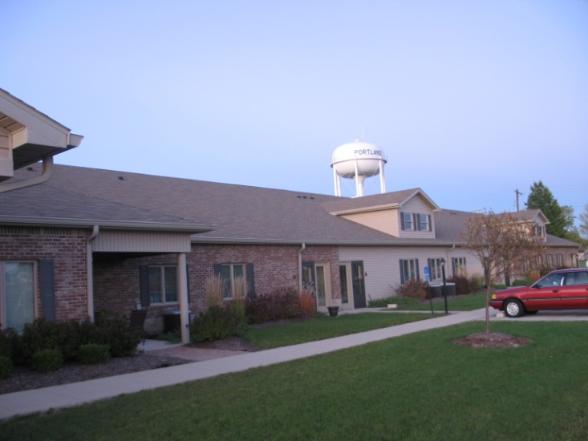
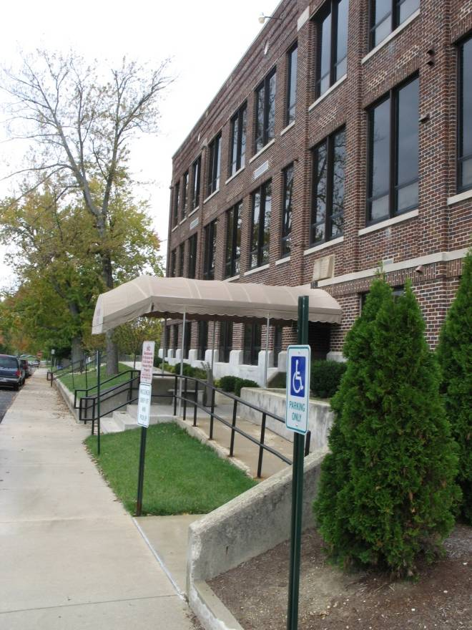
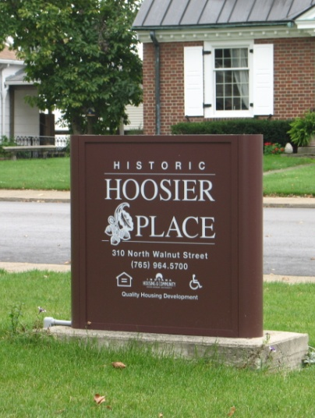
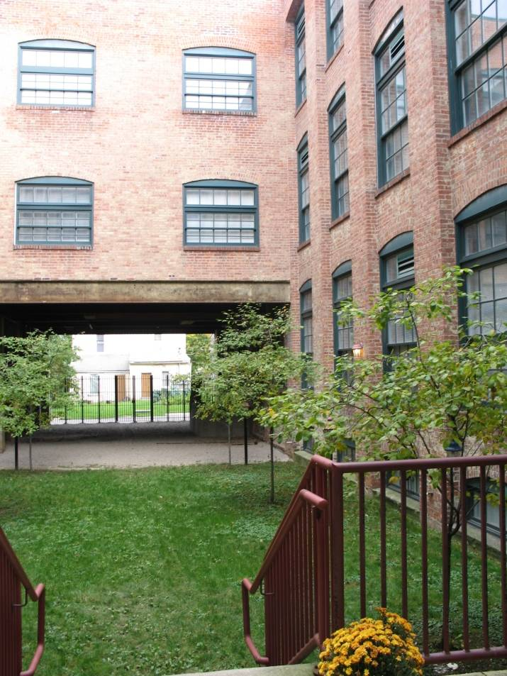
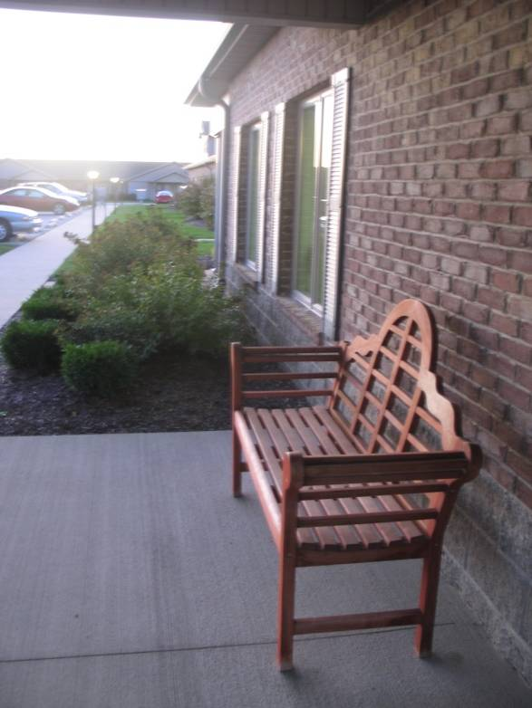
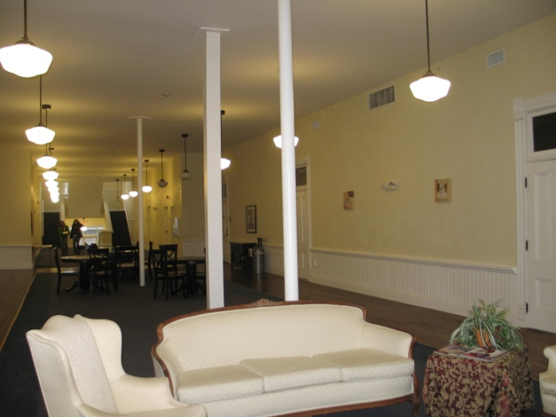
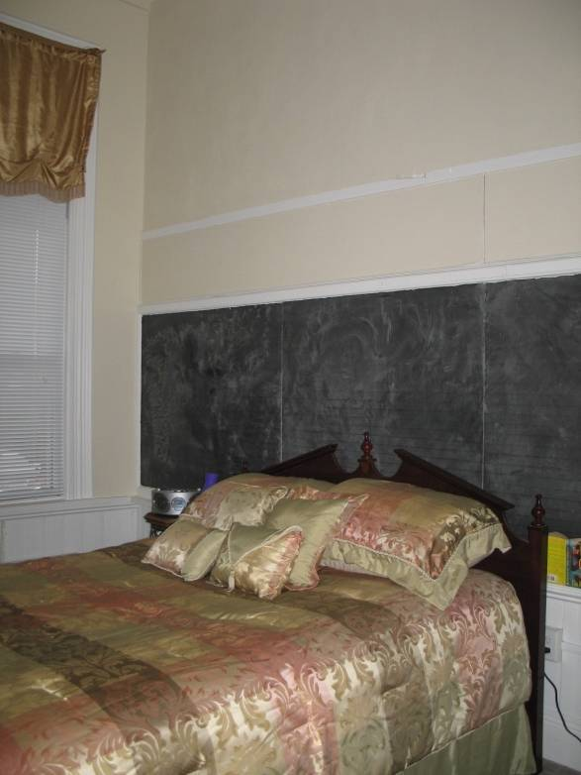
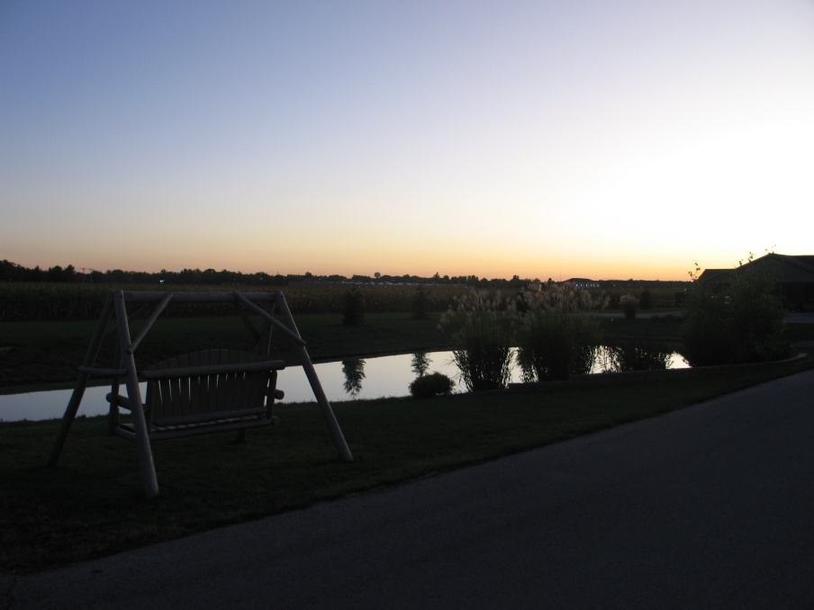
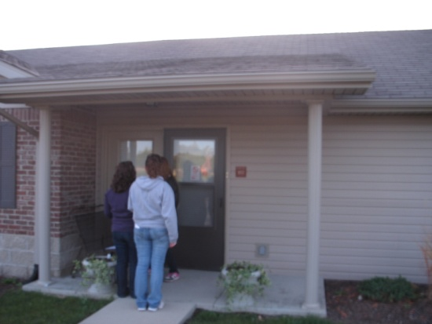
Notes:
Greta’s slide
48

Slide 49
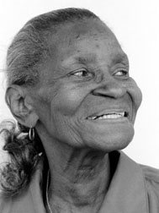
ELDERS Posttest: Descriptives
ELDERS Posttest (N=120):
28.4% plan internship w/elders (+5.1%, +6 students)
24.8% pursue a career in gerontology (+3.1%, +4) (3.1% nationally)
14.6% graduate coursework in aging (+2.1%, +3)
77.7% competent working w/elders (+14.4%, +17)
Notes:
Andrew’s part
49

Slide 50
ELDERS Posttest: Descriptives
Research outcomes (N=118):
25% very interested in research (+19.9%, +24)
54% see research as very important (+34.5%, +41)
58% feel confident doing research (+50.4, +59)
Notes:
Andrew’s part
50

Slide 51
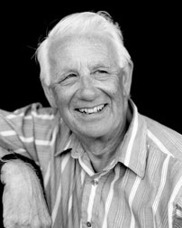
Field Data
Also collected data regarding field outcomes of students (baseline & ELDERS)
We have between 45-65 placements/yr.
Average 18.9% who chose aging-related field placements (‘05-’07 baseline)
Notes:
Greta’s part
51

Slide 52
Field Data
Spring ‘09= 45.5% (+30.8%) (15x nat’l avg.)
Summer ‘09= 29.4% (+10.5%)
Spring ‘10= 28.6% (+9.7%)
Summer ‘10= 40% (+21.1%)
Notes:
Greta’s part
52

Slide 53
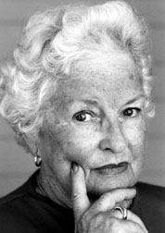
ELDERS Successes
Significantly improved students’ aging & research competencies
ACS-A was reliable (α= .949, N=128)
22 competencies (all higher at post: Λ=.611 )
NO differences between students interested in aging and those who were not
Notes:
Greta’s part
53

Slide 54
ELDERS Successes
Improved interviewing skills (unintended effects ☺)
Provided AAA evaluation of transportation, nutrition, & independent living services (at no co$t)
Notes:
Greta’s part
54

Slide 55
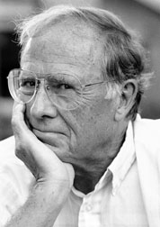
Challenges & Strategies
Transportation evaluation didn’t work as well
Student reluctance (both research & aging)
Notes:
Greta’s part
55

Slide 56
Challenges & Strategies
Student time commitments (availability)
Coordination & management (60+ students at multiple sites)
Notes:
Greta’s part
56

Slide 57
Challenges & Strategies
Flexibility is essential
Frequent communication with sites
Incentives were helpful (gas cards popular!)
Organizational skills are crucial
Notes:
Greta’s part
57

Slide 58
Implications for SW Education
This model WORKS!
Student attitudes about research & elders changed significantly after ELDERS
Our students felt more comfortable doing research after doing the project
Notes:
Greta’s part
58

Slide 59
Implications for SW Education
Increased competency in research & aging leads to better generalist practitioners
Community service helped strengthen university/community connections
Notes:
Greta’s part
59

