Slide 1
Poverty and Resilience Among Elderly Veterans
Deborah Amdur, LCSW, ACSW
Chief Consultant,
Care Management and Social Work Service
Department of Veterans Affairs
October 28, 2011

Slide 2
What is Poverty?
Fundamentally, poverty is a denial of choices and opportunities, a violation of human dignity. It means lack of basic capacity to participate effectively in society. It means not having enough to feed and clothe a family, not having a school or clinic to go to, not having the land on which to grow one’s food or a job to earn one’s living, not having access to credit. It means insecurity, powerlessness and exclusion of individuals, households and communities. It means susceptibility to violence, and it often implies living in marginal or fragile environments, without access to clean water or sanitation.
(United Nations)

Slide 3
US Census Bureau Poverty Thresholds - 2010
US Census Bureau 2010 poverty rate
  15.1 percent (approximately 43.6 million)
  Up from 14.3 percent in 2009
  Highest level since 1993
  Poverty rate for people 65 and older – 9 percent
  Census Bureau uses a set of income thresholds that vary by family size and composition to determine who is in poverty.
Poverty Income Thresholds for 2010 for people over 65 years
  One person - $10,458
  Two people - $13,194

Slide 4
General Demographics of Elderly Poverty
More elderly poor are women
Very elderly women have even higher poverty rates
Over 2.3 million women over the age of 65 - 11.5 percent - live at or below the poverty line
Slightly over 1 million - 6.6 percent - of senior men live in poverty
Nearly one in five of single, divorced, or widowed women over the age of 65 are poor, and the risk of poverty for older women only increases as they age
Among married women, longer female life expectancy makes it likely that they will outlive their spouses, and be left without additional sources of income they bring to the household
(Center for American Progress)

Slide 5
Poverty Among Veterans between 2000-2009
Poverty rates among Veterans are nearly half that of the general population
  Poverty rates of Veterans ranged between 5.0-6.3 percent
  Poverty rates of non-Veterans ranged between 10.7-11.9 percent
Poverty rates consistently lower among Veterans for every period of service

Slide 6
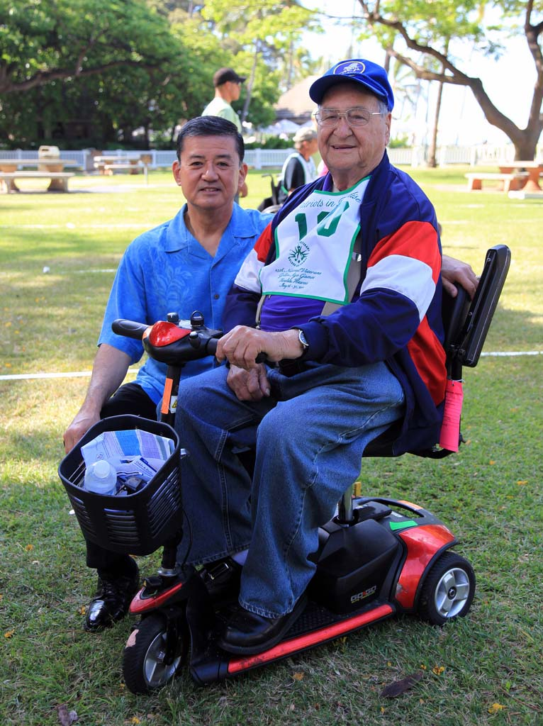
Who are our elderly Veteran?

Slide 7
Department of Veterans Affairs
The Veterans Health Administration (VHA) is one of the Department of Veterans Affairs three major administrations

Slide 8
VA Health Care System
152 medical centers
965 Outpatient Clinics
    798 Community-Based
    152 Hospital-Based
    9 Mobile
    6 Independent
133 community living centers
98 domiciliary residential rehabilitation programs
280 readjustment counseling centers (Vet Centers)

Slide 9
Today’s Veterans
AGE

Slide 10
Chronic Conditions Highly Prevalent in Older Veterans
94 % of Veterans ages 65 years and older are managed in primary care
Chronic Conditions highly prevalent in older Veterans in primary care
  Hypertension – 80-90%
  Coronary Artery Disease – 50-65%
  Arthritis – 35-55%
  Chronic obstructive pulmonary disease – 30-55%
  Diabetes mellitus – 25-45%
  Cancers – 25-40%
  Depression – 15-40%
  Dementia – 5-35%
Veterans Age 65 and older account for 49% of the 11.9 million outpatient visits/year (2008)
42.3 % of the $27.7 billion spent on primary care in 2008 was spent on care of Veterans age 65 and older
Shay and Yoshikawa, Overview of VA Healthcare for Older Veterans, Journal of the American Society on Aging, Summer 2010

Slide 11
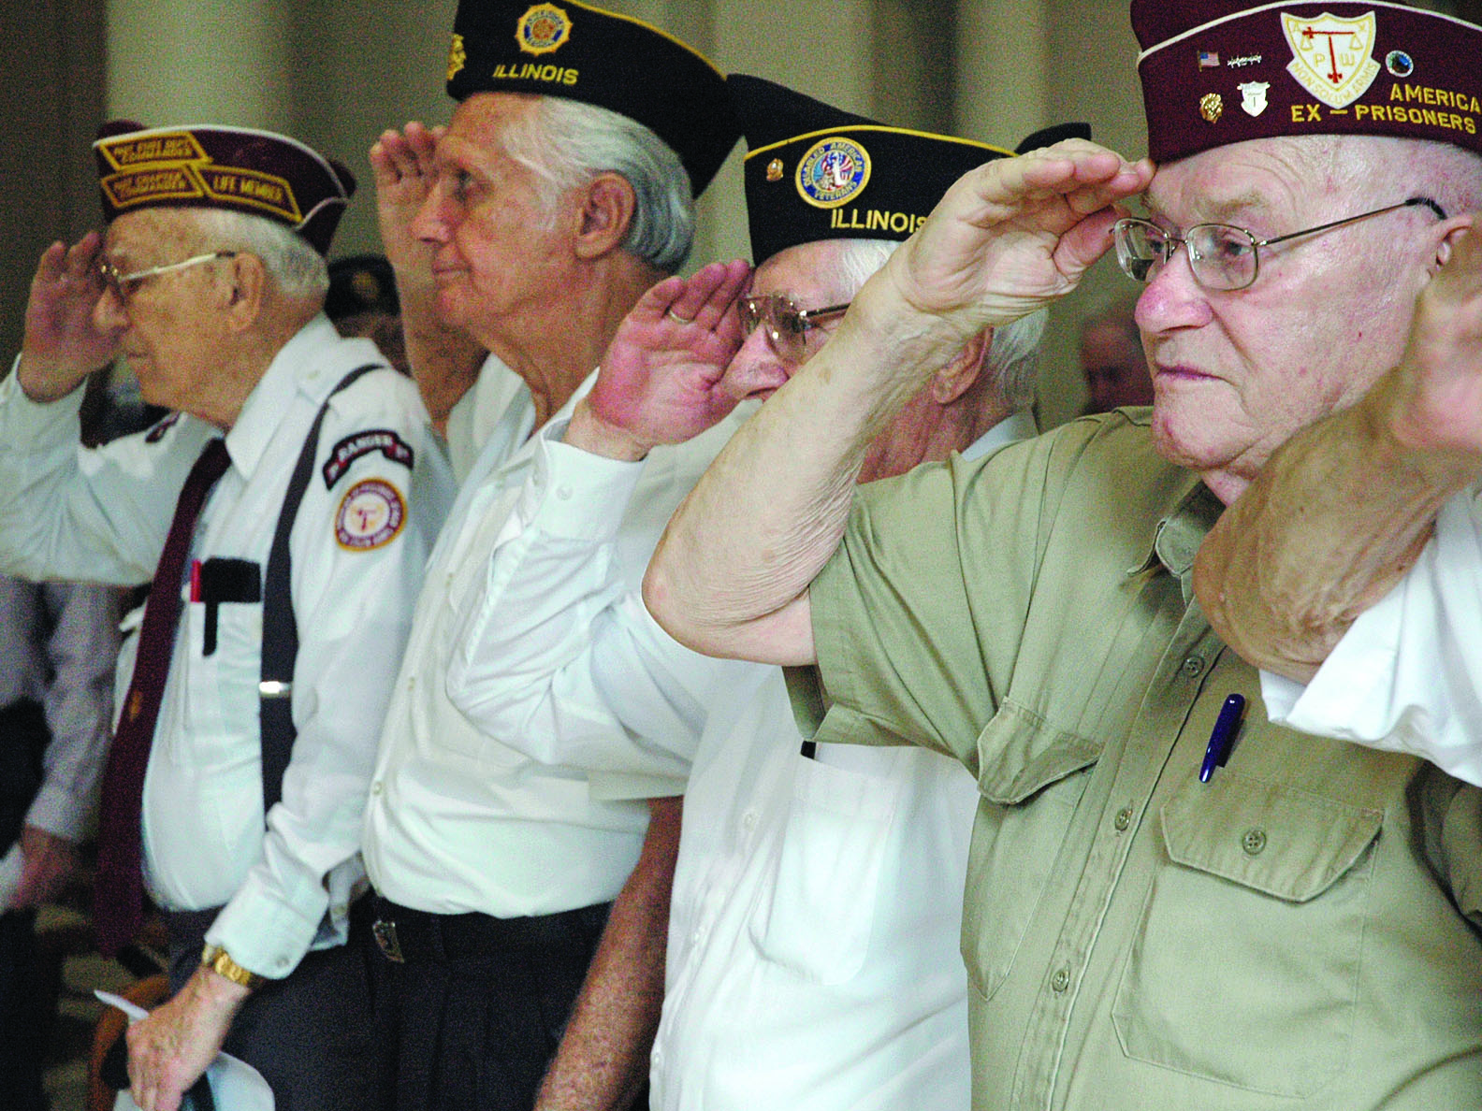
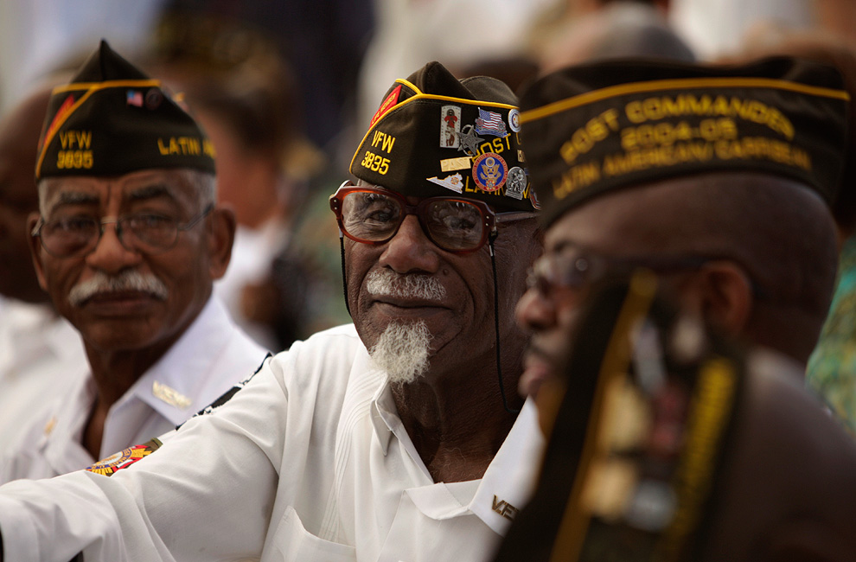
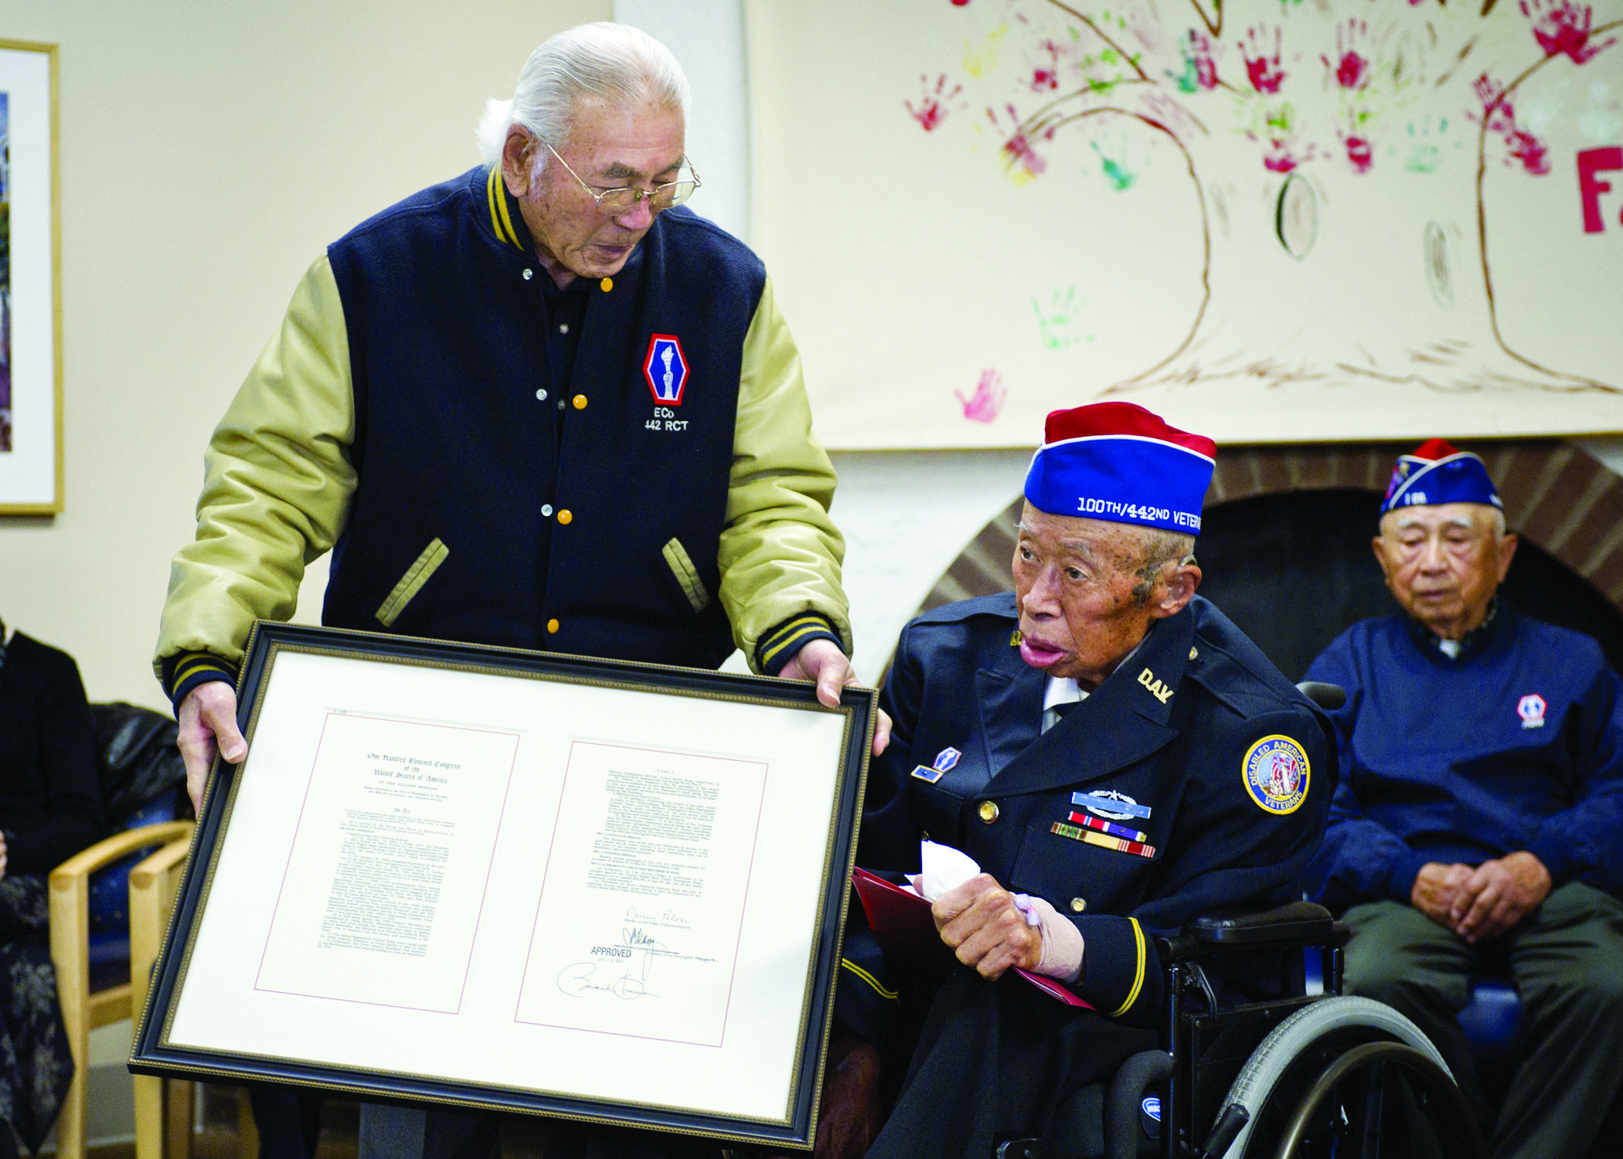
Who are our elderly Veteran?

Slide 12
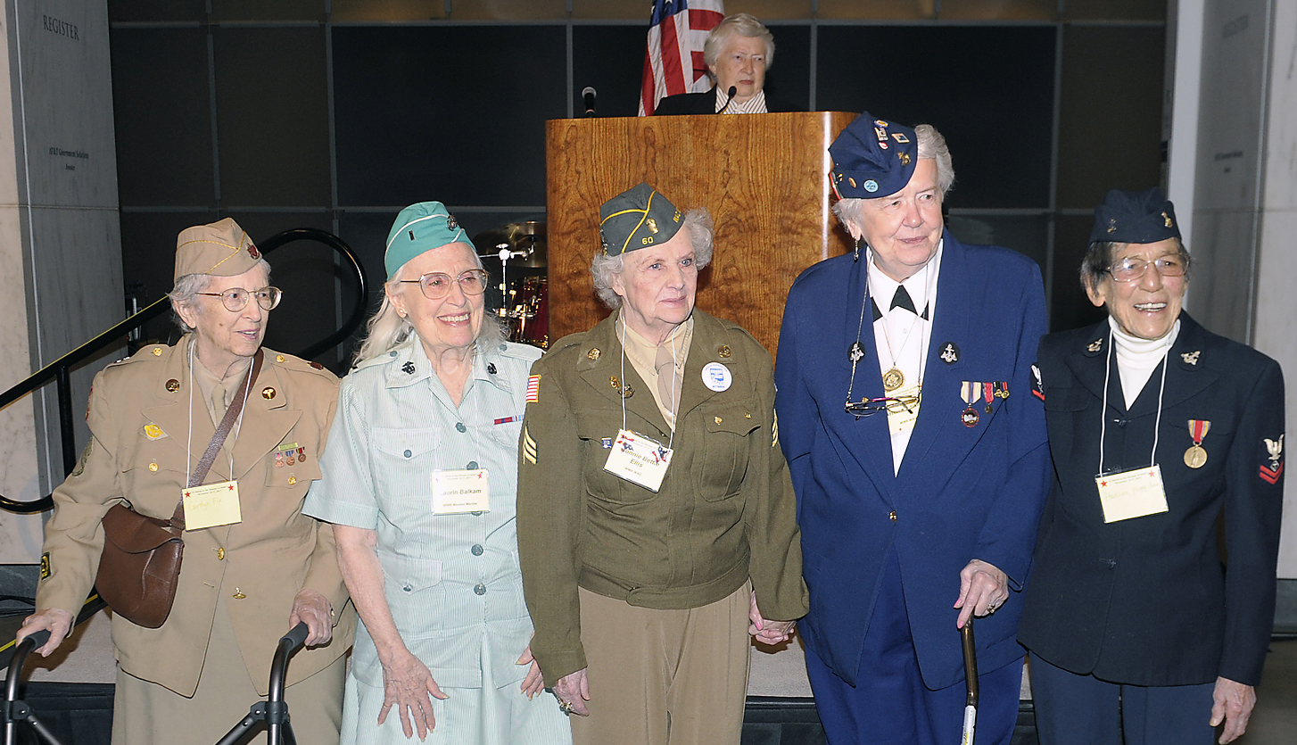
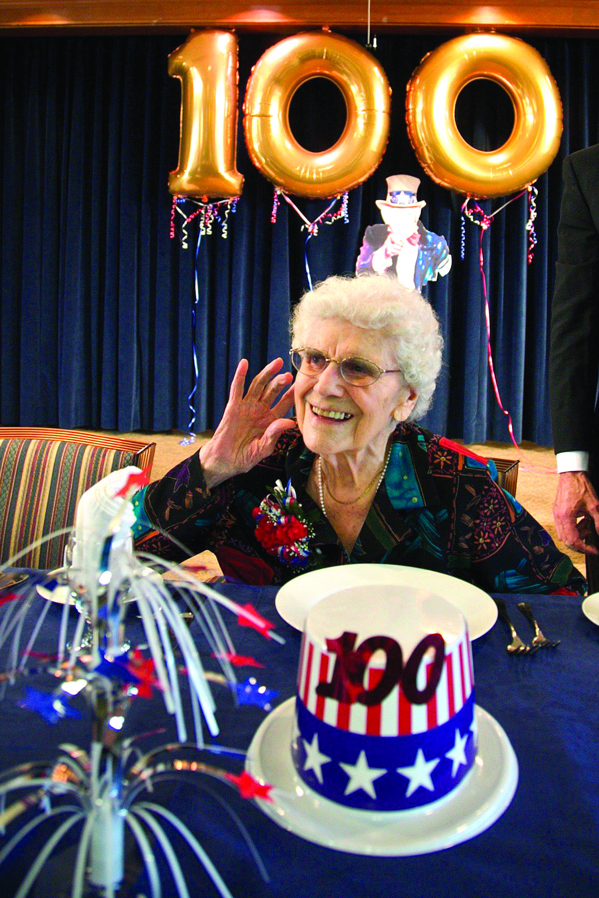
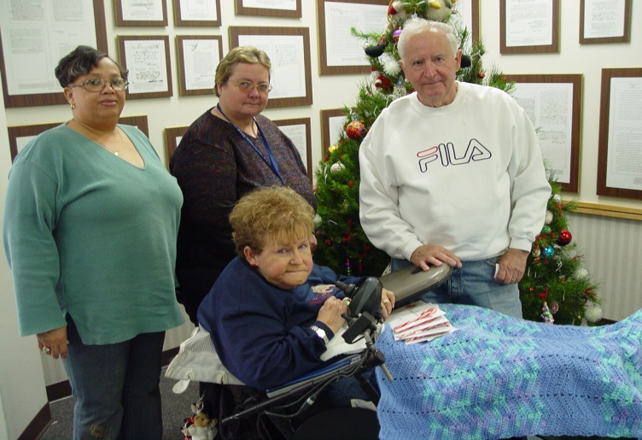
Who are our elderly Veteran?
8% of Veterans are Women

Slide 13
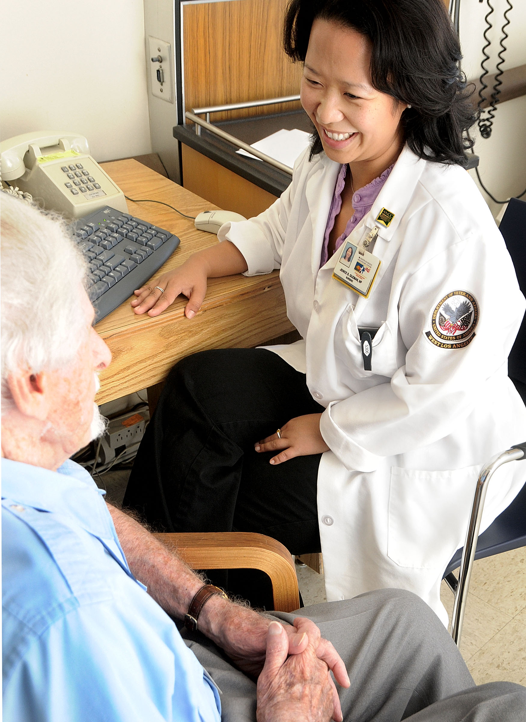
VA Support Promotes Resilience in Elderly Veterans
Focus on holistic, Veteran and Family-Centered Care
Emphasis on psychosocial programming
Access to preventative health care
Access to longitudinal health care
Many special programs directed at giving elderly Veterans the opportunity to remain in their own homes
Outreach – inner cities and rural communities
Telehealth and Telemental Health in the home
Access to additional income sources

Slide 14
Meeting the Needs of Elderly Veterans:
Institutional Care
VA Community Living Centers
    Provide short-stay and long-stay nursing home care to Veterans on or near a VA medical center property
VA Contract Nursing Homes
  Provide care for Veterans in community nursing homes that have a contract with VA
State Veterans Homes
  Provide nursing home, domiciliary and adult day health care to eligible Veterans. Owned and run by the state and formally recognized by VA
Community Residential Care
  Room, board, limited personal care and supervision ,to eligible Veterans not in need of hospital or nursing home care but who, because of medical and/or psychosocial health conditions , are not able to live independently and have no suitable family or significant others to provide care
Medical Foster Home (MFH)
  A type of Community Residential Care (CRC) home chosen by the Veteran who is unable to live independently, as a preferred means to receive family-style living with room, board, and personal care

Slide 15
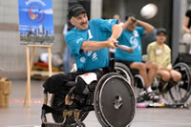
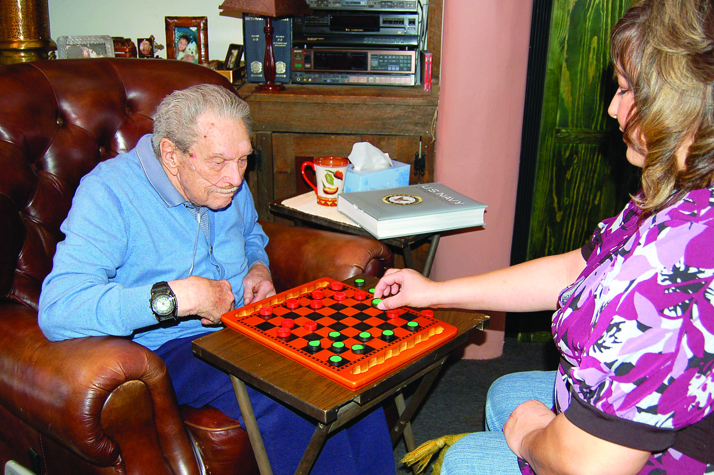
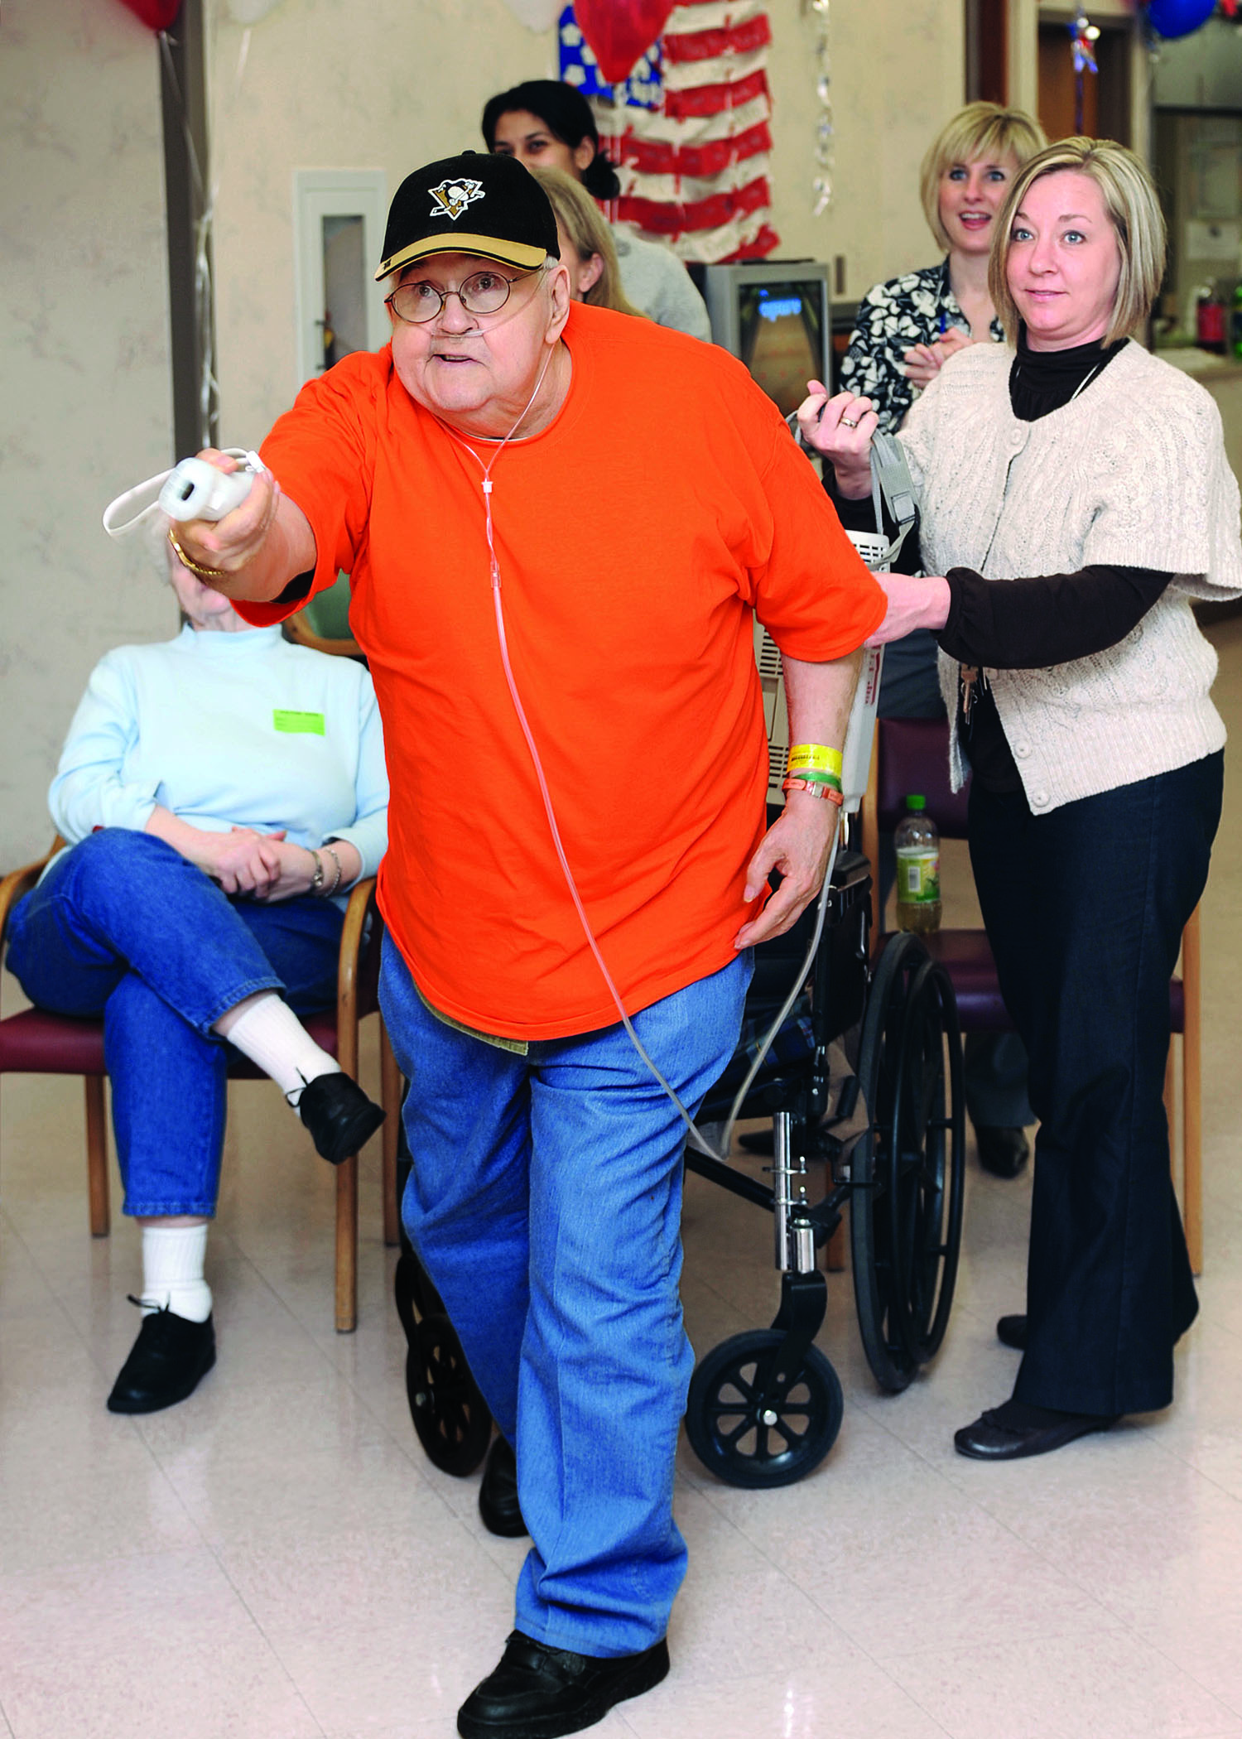

Who are our elderly Veteran?

Slide 16
Meeting the Needs of Elderly Veterans:
Home and Community Based Care
Home Based Primary Care
  Provides comprehensive, interdisciplinary, primary care in the homes of Veterans with complex medical, social, and behavioral conditions for whom routine clinic-based care is not effective
Homemaker Home Health Aide
  Permits the VA to pay for homemaker and home health aide assistance for Veterans
Veterans Directed Home and Community Based Programs
  The Veteran and their family caregiver will: manage a flexible budget; decide for themselves what mix of services will best meet their personal care needs; hire their own personal care aides, including family or neighbors; and purchase items or services to live independently in the community
Purchased Skilled Home Care
  Professional home care serviced purchased by VA from private-sector providers

Slide 17
Meeting the Needs of Elderly Veterans:
Home and Community Based Care
Adult Day Health Care
  Adult Day Health Care is a therapeutic day program that provides eligible Veterans with activities, socialization and some health services in a safe, group setting.
Caregiver Support Program
  Comprehensive support for family caregivers is provided by a network of caregiver support coordinators at each VA medical center. A Caregiver Support Line and Website make information about resources and services for family caregivers readily available to the public at large. Caregiver Support is integrated into all VA clinical programming.
Respite Care
  Provides Veterans with short-term institutional and non-institutional services in order to give the Veteran’s caregiver a period of relief from the demands of providing daily care.
Hospice and Palliative Care
  Provides comfort-oriented and supportive services for Veterans with advanced life-limiting disease
Homeless Veterans Programs
  Provide outreach, prevention, treatment, affordable and safe housing for homeless Veterans in collaboration with many federal, state, tribal and community partners

Slide 18
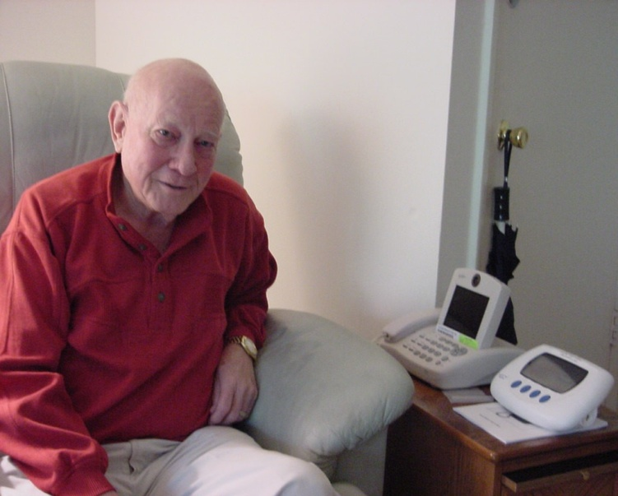
Telehealth Services
  40% of Veterans reside in rural areas
  VA is recognized as the national leader in the use of innovative technologies to promote patient-centered care
  Provides the right care - in the right place - at the right time
  Makes the home or local community the preferred site of care
  Helps coordinate care across the continuum
  Supports both Veteran patients and caregivers

Slide 19
Home Telehealth Patient Census
FY2008-2011 Growth, FY12 Projected

Slide 20
VA Home Based Primary Care (HBPC)
Comprehensive, longitudinal primary care
Delivered in the home
By an Interdisciplinary team:
Nurse, Physician, Social Worker, Rehabilitation Therapist, Dietitian, Pharmacist, Psychologist
Serves Veterans patients with complex, chronic, disabling disease
When routine clinic-based care is not effective
For those “too sick to go to clinic”

Slide 21
Differences Between VA HBPC & Medicare Home Care
VA Home Based Primary Care Medicare Home Care
Targets complex chronic disease Remediable conditions
Comprehensive Primary Care Specific problem-focused
Skilled care not required Requires skilled care
Strict homebound not required Must be homebound
Accepts declining status Requires improvement
Interdisciplinary team One or Multidisciplinary
Longitudinal care Episodic, post-acute care
hospital days
Limited geography & intensity No definitive impact

Slide 22
HBPC
“Too sick to go to clinic”
HBPC serves Veterans of all eras
Mean age 78.4 years; 96% male; 4% female
More than 8 chronic conditions; among 5% highest cost
48% dependent in 2 or more Activities of Daily Living (ADL)
Mean duration in HBPC 315 days; 3.1 visits/mo; 28 visits/yr
Medicare home care: 31 days; Home Hospice: 73 (2006)

Slide 23
Impact of Home Based Primary Care
Inpatient days: 78% reduction
30 day readmission rate: 18.2% decrease
Reduction in total cost per Veteran from $45,980 to $39,796 after adding in the costs of HBPC $9113 per pt/yr
Satisfaction: “Very Good or Excellent …82.7%....the highest overall satisfaction rating from all (VA) patient surveys“

Slide 24
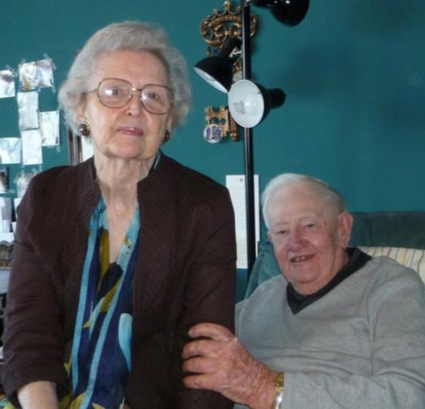
Benefits to Caregivers
Caregivers
feel less stress because they are supported in the care of their loved ones
value education on how to better care for the Veteran, medications management and oversight of Veterans’ medical needs
reported that reduced stress resulted in better health for Veteran and Caregiver
“Well, [HBPC] just about saved my life. I’d a went down sooner, if it hadn’t of been for them coming out here. It’s a wonderful program. Because if I need anything, all I have to do is tell one of them….It’s done wonders for me.”
(Caregiver of WWII Veteran)

Slide 25
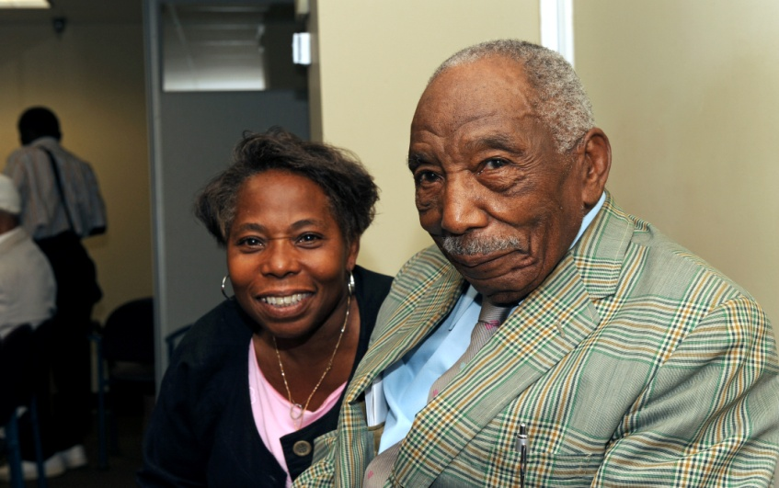
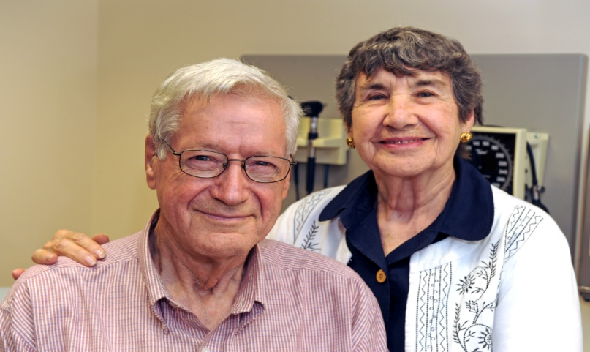
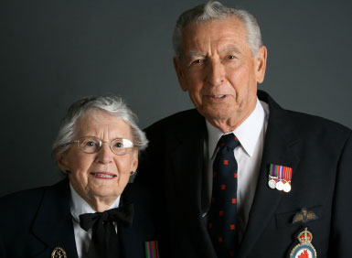
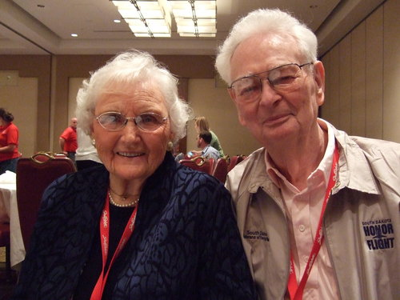

Slide 26
2000 to VetVeterans Served Daily in HBPC C
2000hhhh to 20102010
Veterans Served Daily in HBPC 2000 to Veterans Served Daily in HBPC
Notes:
26

Slide 27
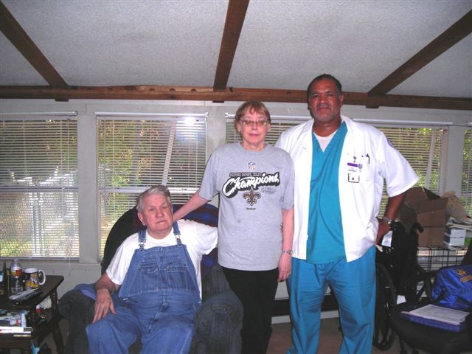
Veterans and Caregivers Supported by
Home Based Primary Care

Slide 28
VA Mental Health Care Delivery System and Aging
System that is interdisciplinary, integrated, and evidence-based
Unique opportunities to provide team-based mental health care which is valuable for older mental health patients who have multiple co-morbidities
20% of Veterans ages 65 and older receiving care in VA had Mental Health (MH) diagnosis (excluding dementia) data from 2009
Of that 20% with MH diagnosis: 41% received mental health treatment
Rate of mental health care use among older Veterans with mental health diagnoses decreased with age
  Ages 65-74 : 46% received mental health treatment
  Ages 75-84: 38% received mental health treatment
  Ages 85 and older: 33% received mental health treatment

Slide 29
Expansion of Mental Health Care Access and Capacity
Integrate mental health services into non-mental health settings
Primary Care
Home Based Primary Care
Hospice and Palliative Care
VA Community Living Centers
Change the culture to focus on recovery even for the most serious mental illnesses
Promote evidence-based mental health care
Break down physical and psychological access barriers to geriatric mental healthcare
Delivers full range of cognitive and psychological assessment and treatment services
Provide behavioral medicine interventions for managing health related issues:
  Sleep disturbance
  Chronic pain
  Disability
  Medical adherence

Slide 30
Demographic Characteristics Among Homeless Veterans in FY 2010
Gender
  Male – 94.3%
  Female – 5.7%
Age – Mean
  <25 – 51%
  25-34 – 7.2%
  35-44 – 12.2%
  45-54 – 41.9%
  55-64 – 32.5%
  65 and older – 5%
Race
  White, non-Hispanic – 47.5%
  African-American – 42.4%
  Hispanic – 6.7%

Slide 31
Root Causes of Homelessness
Lack of Affordable Housing
Insufficient Income/Poverty
Lack of Health and Supportive Services
Decline in Public Assistance
Lack of employment opportunities/low wages and job loss
Lack of child support
Domestic Violence
Drug and Alcohol related problems
Illness
Mental Illness

Slide 32
Veterans Homelessness
121,277 Veterans served in VA’s Specialized Homeless Programs in FY2010
The provision of safe housing is fundamental; however, ending homelessness among Veterans requires additional support services:
  Mental Health stabilization
  Substance Use Disorder treatment services
  Enhancement of independent living skills
  Vocational and employment services
  Assistance with permanent housing searches and placement
  Assistance with access to benefits
VHA’s model fully incorporates:
  Prevention and Outreach
  Collaborations
  Rapid-Response & Support

Slide 33
Fostering Resilience
The military taught them a set of survival skills and strengths to help them survive war,
combat and loss………how do you continue to use these strengths?
  Survived war
  Survived being away from loved ones
  Resilient survivors find meaning, purpose and value in difficult circumstances

Slide 34
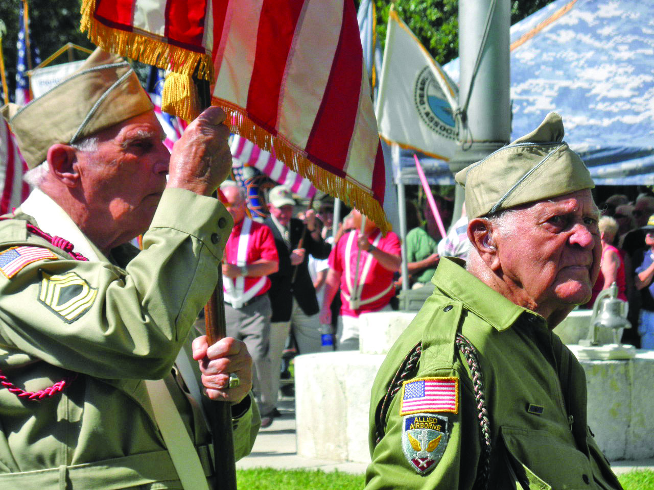
Who are our elderly Veteran?

Slide 35
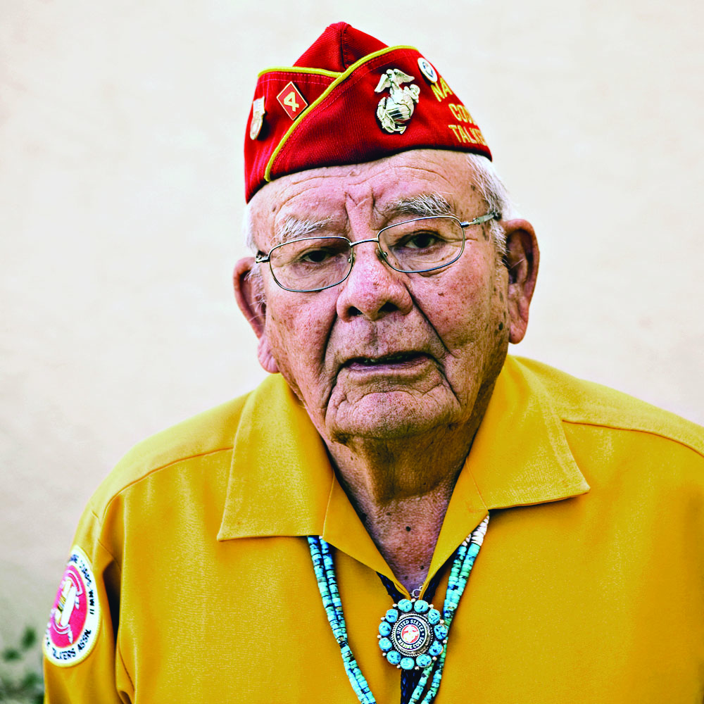
Who are our elderly Veteran?

Slide 36
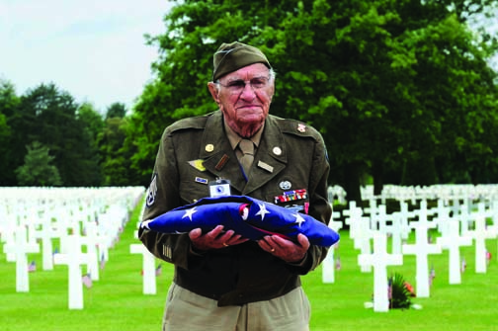
Who are our elderly Veteran?
Approximately 800 World War II Veterans Die Every Day

Slide 37
"As we express our gratitude, we must never forget that the highest appreciation is not to utter words, but to live by them."
-John Fitzgerald Kennedy

Slide 38
Questions?
Deborah Amdur, LCSW
Chief Consultant, Care Management and Social Work
Department of Veterans Affairs
202-461-6780
deborah.amdur@va.gov

