Slide 1
The L.A. Gay & Lesbian Center’s Seniors Services Department
LGBT Aging in Place Initiative
Arielle Rosen
Director of Seniors Services

Slide 2
Seniors Services
The L.A. Gay & Lesbian Center (the Center) has been providing services and support to LGBT seniors (50+) for more than 12 years.
As part of the U.S. Administration on Aging’s Community Innovations for Aging in Place initiative, the Center was awarded a three year, $1.17 million demonstration grant to develop new models for LGBT aging in place work.
This grant was the first time AoA awarded money directly to an LGBT organization.
Notes:
Center’s Strategic Plan – invested staff and money into expanding our services for seniors 2 ½ years ago

Slide 3
The Center’s Aging in Place Model
Project goal:
Ensure that LGBT older adults in Los Angeles are treated with dignity and respect as they access a comprehensive and coordinated continuum of aging-in-place support services that target LGBT seniors.

Slide 4
The Center’s Aging in Place Model
Project objectives:
Provide social programming, support services, and educational and intergenerational opportunities that assist LGBT older adults in building community and improving social networks, thereby decreasing isolation and invisibility
Provide case management services, offering LGBT seniors individual support and assistance in times of need and crisis
Train local health and human service agencies and providers to ensure that LGBT older adults receive quality care in mainstream institutions
Notes:
Critical to have this three-prong approach…

Slide 5
Advancements & Lessons Learned
Baby Boomers vs. Seniors
Women’s Programming: Lesbians 50+ Project
Men’s Programming
Educational Workshops & Presentations
Intergenerational Opportunities:
The Buddy System
Forever Young Chorale
Diversity Training Program
Case Management Services
Resource & Referral Database
Notes:
Just began our 2nd year of the 3 year project
Baby Boomers vs. Seniors – new, bigger discussions
Women’s Programming: Lesbians 50+ Project – continued growth
Men’s Programming – men seeking more! Planning committee and programs
Educational Workshops & Presentations – with money, added food and people are attending in droves!
Intergenerational Opportunities:
The Buddy System – pilot program March (9 pairs), launch next round in Nov!
Forever Young Chorale – built social network w/ strong support (Karen)
Diversity Training Program – launched in September with outreach, have 7 scheduled and now targeting nursing homes
Case Management Services - new division w/ full-time staff CM (see chart)
Resource & Referral Database – currently helps CM staff w/ referrals, ultimate goal-to produce a resource guide

Slide 6
Case Management Usage Trends

Slide 7
Societal Connections
Society
Family & Friends
Individual
Community
Laws and protections
Cultural belief systems
Media representation
Neighborhood
Faith-based institutions
Social service providers
Schools
Family of origin
Family of choice

Slide 8
Societal Connections
Society
Individual
Community
Family & Friends

Slide 9
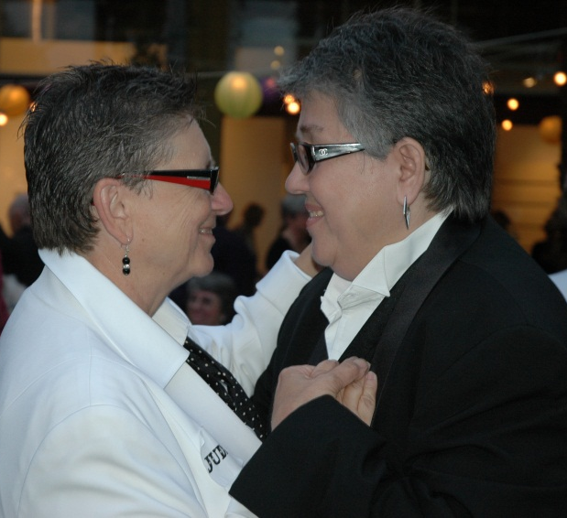
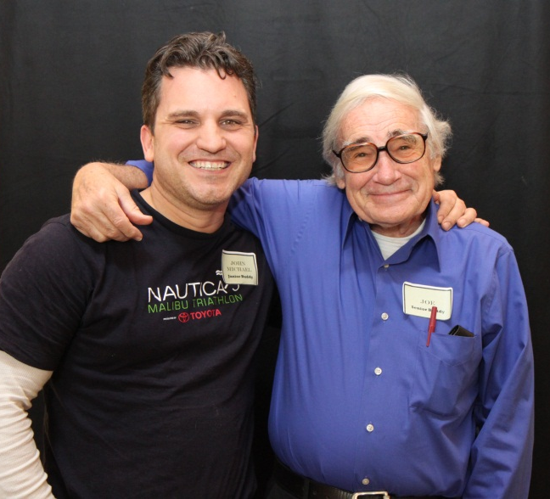
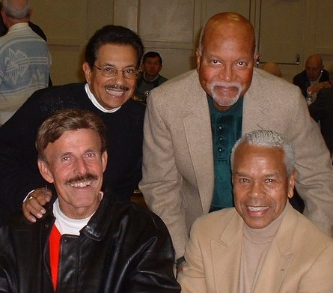
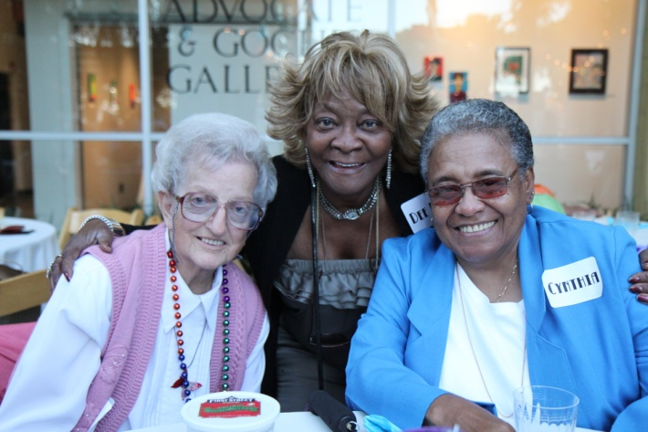
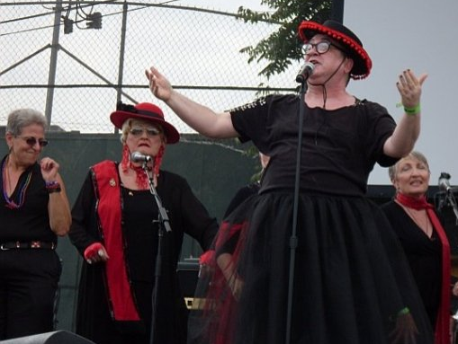

Slide 10
L.A. Gay & Lesbian Center Seniors Services Department
Arielle Rosen
323-860-7397
arosen@lagaycenter.org
www.lagaycenter.org/seniors

