Slide 1
Lesbian, Gay, Bisexual and Transgender Older Adults

Slide 2
Mission
To improve the overall quality of life for LGBT seniors,
To foster a greater understanding of aging in all communities, and
To promote positive images of LGBT life in later years

Slide 3
SAGE Affiliate Locations
SAGE New York
SAGE Long Island
SAGE of the Hudson Valley
SAGE/Queens Rainbow
SAGE of the Genesee Valley
SAGE Upstate New York
SAGE Metro DC at the DC Center
SAGE Philadelphia at William Way

Slide 4
Affiliate Locations Continued
SAGE CenLa (Central Louisiana)
SAGE South Florida
SAGE Center on Halsted (Chicago)
SAGE of Metro St. Louis
SAGE Milwaukee
SAGE Palm Springs
SAGE of the Rockies
SAGE Utah

Slide 5
SAGE Affiliates

Slide 6
Our Maturing Movement
State-By-State LGBT Aging Policy and Recommendations
May, 2010
www.thetaskforce.org

Slide 7
Improving the Lives of LGBT Older Adults
www.sageusa.org
www.lgbtmap.org

Slide 8
LGBT Elders Face Unique Challenges to Successful Aging
1.
2.
Need to rely upon “families of choice” for care and support
Effects of stigma, past and present
Twice as likely to be single, four times less likely to have children
Rely on friends and partners who lack legal and social recognition
1.6 million LGBT elders; largely closeted
A psychiatric disorder (until 1973)
Criminal (until 2003)
Fear accessing health and community services
3.
Unequal treatment under laws, programs and services for older adults
Design safety nets around marriage, then exclude LG couples
Fail to address stigma and discrimination
Notes:
Three major challenges facing LGBT older adults that make successful aging difficult for them are: the effects of stigma, past and present
Effects of stigma past and present / this is a generation that came of age at a time in which the language of sexuality was absent and heavily stigmatized; homosexuality was criminalized, deemed a mental; we also saw a variety of policy changes in courts and in state laws over the years / what this means, is that people who lived through they changes have the accumulated effects on the mental health / many are likely to remain closeted
Aging is difficult without some form of support / loneliness can lead to higher rates of morbidity, mortality, infection, depression and comparative decline / less isolated report higher levels of health / system supports married spouses and blood families / LGBT older adults rely less on marriage, rely less on children, rely less on parents, siblings and other blood relatives, rely more on friends and caregivers
The numbers of older adults are increasing / how will institutions provide support for these people? / safety net programs and laws fail to provide equal protections / means that they fail to recognize families of choice, or the cumulated impact of discrimination on LGBT older people

Slide 9
The Three Challenges Obstruct LGBT Elders’ Successful Aging
Successful Aging
Financial Security
LGBT Barriers
Need to rely on “families of choice”
Stigma
Good Health/ Health Care
Unequal treatment under laws & programs
Social/ Community Support
Notes:
Financial security / 10 percent of older adults live in poverty / most have minimal retirement savings / LGBT older adults a lifetime of discrimination has meant: earning disparities, reduced lifelong earnings, smaller Social Security payments, fewer opportunities o build pensions, and more limited access to health care / living alone can be related to poverty
Living alone not the same as living in social isolation / are more likely to live alone / more likely to be unwelcome in health care and community settings / may be denied services, face harassment from service providers or feel their specific needs are ignored / many also feel isolated from the LGBT community / insufficient opportunities to contribute /housing discrimination

Slide 10
Gay & Lesbian Elders Poorer; Receive Less Social Security
Rate of Poverty
Annual social security income
Lower lifetime earnings, inequitable laws
Notes:
If you look for example at poverty rates, you see the long-term financial costs of a liftetime of discrimination:
Poverty rates are higher among older gay couples, and even higher among older lesbian couples
LGBT couples not equally eligible for SS benefits / spousal benefits, survivor benefits and death benefit
Financial security / 10 percent of older adults live in poverty / most have minimal retirement savings /
LGBT older adults a lifetime of discrimination has meant: earning disparities, reduced lifelong earnings, smaller Social Security payments, fewer opportunities o build pensions, and more limited access to health care / living alone can be related to poverty

Slide 11
Other Financial Disparities
Medicaid long-term care
Retiree health insurance benefits
Tax-qualified retirement plans
Pensions (survivor annuities)
Veterans’ benefits
Inheritance laws
Notes:
MEDICAID. Spousal impoverishment protections / LGBT survivors cannot keep home, substantial assets or livable income
RETIREE HEALTH INSURANCE BENEFITS. Federal law allows am employer to provide health insurance to the hetero spouse of an employee or retiree as a tax-free benefit / for same-sex couples, the LGBT retiree pays income taxes on this benefit / this taxation costs more than $1000 per year in taxes
TAX QUALIFIED RETIREMENT PLANS. IRA’s / retirement savings in the U.S. / under current federal law, same-sex couples must begin drawing down the amount after the original accountholder dies / lower amounts drawn out by survivors
PENSIONS. About half of employers do not offer these benefits / surviving partners
VETERAN’S BENEFITS are not available to same-sex couples / pensions (for those killed), medical care and home loan guarantee / DODT discharge lose all pensions and benefits accrued / bereavement counseling, death pensions, education, a burial flag vnot available to same-sex partners
INHERITANCE LAWS same-sex couples need specific and expensive legal arrangements / will, a revocable living trust, a pour-over will, financial power of attorney / state laws step in and most states don’t recognize inheritance laws

Slide 12
Good Health/ Health Care

Slide 13
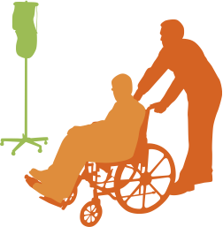
Barriers to Good Health and Health Care
Health disparities
Inhospitable healthcare environments.
Nursing homes often fail to protect LGBT elders
Limited support for family-of-choice caregivers
Notes:
Health care / health care disparities are overlooked and ignored
families of choice are not give legal recognition
health care environments are inhospitable
nursing homes to do not protect elders
visitation policies and medical decision-making laws exclude families of choice

Slide 14
Delay Care, Neglected by Caregivers
Delay or not seek health care
Neglected by a caretaker because of sexual orientation or gender identity

Slide 15
Social and Community Support

Slide 16
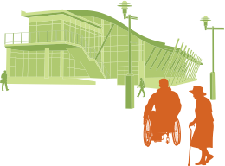
Barriers to Social and Community Support
Unwelcoming mainstream aging programs
Isolation from broader LGBT community
Insufficient opportunities to contribute
Housing discrimination

Slide 17
Elder Services Exclude LGBT Elders
Area Agencies on Aging: “LGBT people would not be welcome at our senior centers”
LGBT Elders Tentative About Using AAA Services Due to Lack of Trust

Slide 18
Tying it Together
Financial
Security
Good Health/ Healthcare
Social/
Community Support

Slide 19
Two Stories of Aging
Maria
Combined Social Security of $1,431/month
Financial security with joint survivor pension
Engaged in community and volunteerism
George
Retirement
Good health
House
$50K nest egg
Pension
Combined Social Security of $980/month
No joint survivor option on pension
Feel unwelcome at local senior center
Ellen
Rita

Slide 20
Two Stories of Aging
George enters nursing home 5 yrs later
Medicaid allows Maria to keep home, savings, income
Maria
Knowledge-able, friendly providers
Maria makes critical care decisions
George released; receives HCBS
George
George and Rita fall ill
Rita enters nursing home 2 yrs later
Ellen loses nest egg and Rita’s income to Medicaid
Health providers are hostile when Ellen visits
Ellen challenged for medical decision-making authority
Rita released; fears help from HCBS providers
Ellen is un- supported caregiver
Ellen
Rita

Slide 21
Two Stories of Aging
Bottom Line
Inherits nest egg and home
Receives George’s pension
$954/mo Social Security survivor benefit
Makes burial decisions
Gets emotional support from community
Home
Nest egg
Income
Support
Maria
George
George and Rita pass
Nest egg already gone to pay for Rita’s long-term care
Loses home
Cannot get Rita’s pension
No Social Security survivor benefit
Stays closeted in community; no emotional support
Food stamps and SSI supplement
No home
No nest egg
No income
No support
Ellen
Rita

Slide 22
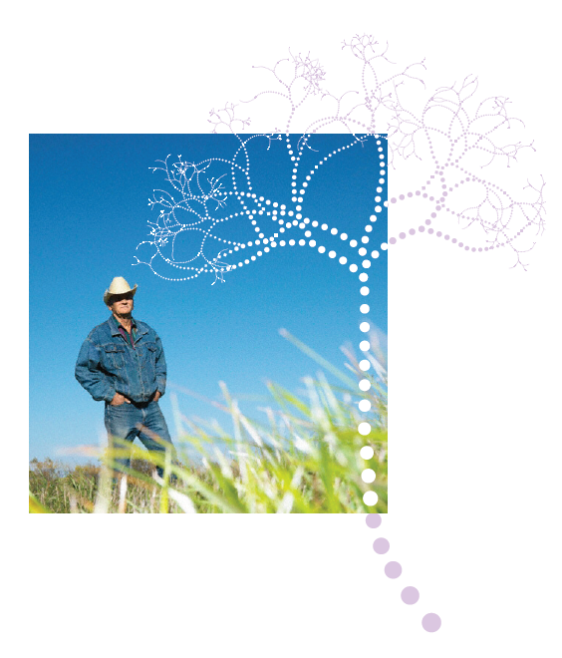

Slide 23
Goals
To equip LGBT older adults with resources
Connect aging providers and LGBT groups to best practices, training and relevant information
Broaden public awareness about LGBT aging
Position SAGE and 10 national partners

Slide 24
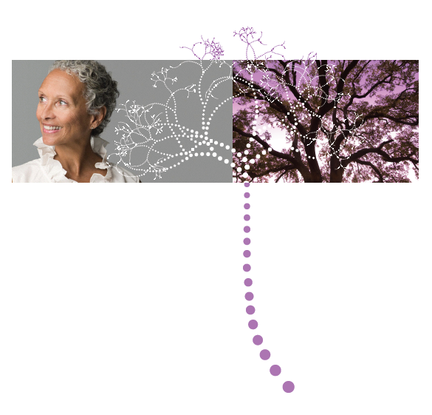

Slide 25
Serena Worthington
Director of Community Advocacy and Capacity Building
sworthington@sageusa.org 773-508-1111 office
312-919-4506 cell
SAGE
www.sageusa.org
National Resource Center on LGBT Aging
www.lgbtagingcenter.org

