Slide 1
Enhancing and Sustaining Innovative Services for LGBT Elders
Karen I. Fredriksen-Goldsen, PhD

Slide 2
Collaborators
Caring and Aging with Pride
Karen I. Fredriksen-Goldsen, PhD (PI), Hyun Jun Kim, PhD, Charles Emlet, PhD, Anna Muraco, PhD, Elena Erovesa, PhD, Nancy Hooyman, PhD, Karina Walters, PHD
Funded by the National Institute of Health/National Institute on Aging (R01)
Caregiving with Pride
Karen Fredriksen-Goldsen, PhD (PI), Hyun Jun Kim, PhD, Anna Muraco, PhD
Funded by the Hartford Foundation
Diversities in Health Disparities
Karen I. Fredriksen-Goldsen, PhD (PI), Hyun Jun Kim, PhD,
Susan Barkan, PhD
Funded by the University of Washington Diversity Grants

Slide 3
Collaborating Agencies
Minnesota
GLBT Generations

Slide 4
The Well of Loneliness

Slide 6
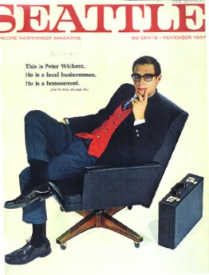
Notes:
Seattle Magazine cover from November 1967 which reads: This is Peter Wichern. He is a local businessman. He is a homosexual.

Slide 7
Plugged In:
Gay rights are good business, no matter the politics.
Queer Inc.
How Corporate America fell in love with gays and lesbians. It's a movement.
Same-Sex Weddings The Gay-Marriage Windfall: $16.8 Billion

Slide 9
The Kids Are
All Right

Slide 12
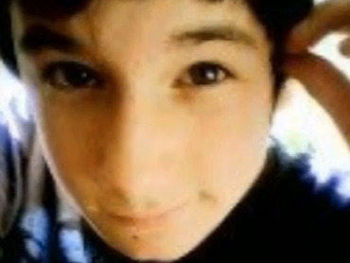
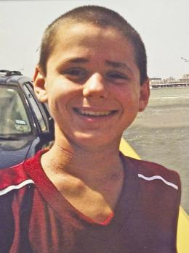
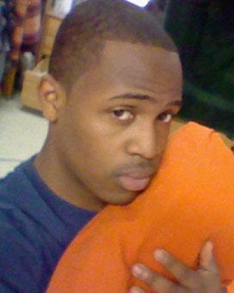
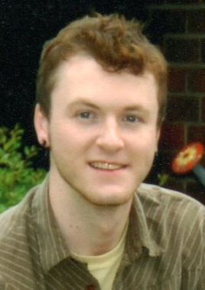
Seth Walsh
Asher Brown
Billy Lucas
Raymond Chase
Zach Harrington
Tyler Clementi
Notes:
Sept 9—Billy Lucas, 15, hanging
Sept 22—Tyler Clementi, 18, Rutgers University, Jumped to his death from the George Washington Bridge
Sept 23—Asher Brown, 13, 9mm Beretta, school ignored his and his parents complaints of harassment
Sept 30—Seth Walsh, 13, died after being taken of life support from hanging himself 9 days prior
Oct 1—Raymond Chase, Johnson & Wales University, hanging
Oct 5—Zach Harrington, 19, Norman, OK

Slide 13
Gender-queer
Lesbian
Gay
Queer
Questioning
Intersex
transgender
Two-Spirit
Bisexual

Slide 16
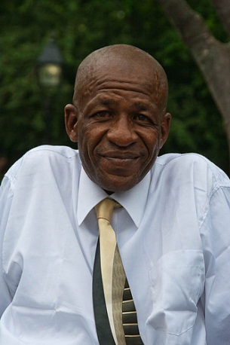

Slide 17
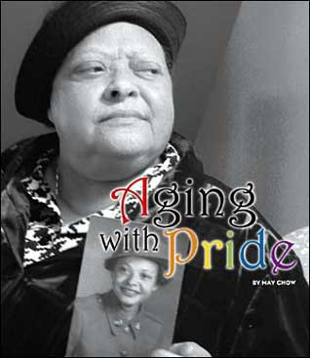

Slide 18
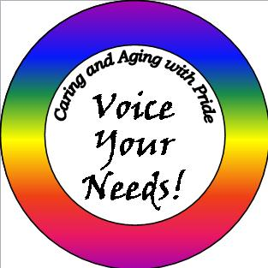

Slide 19
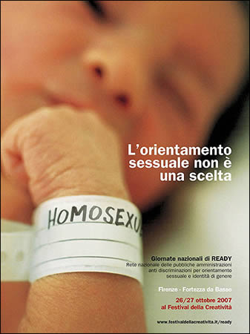
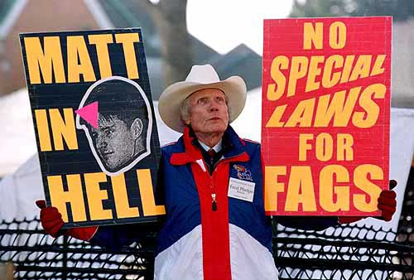

Slide 20
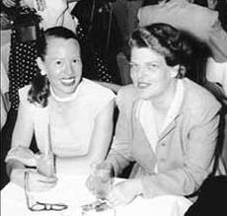
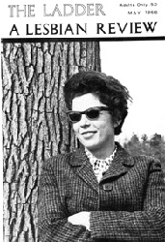
Notes:
The first couple to be married in San Francisco after California Supreme Courts legalized same sex marriage in CA (married June 16, 2008). They met in 1950, became lovers in ‘52, and moved in together in 1953 on Valentine’s day on Castro Street in SF. They founded the Daughters of Bilitis (DOB) in 1955. The 1st social/political organization for lesbians in us. They both acted as presidents and editors of The Ladder until ‘63. The DOB’s organization was a social alternative to lesbians bars, which at the time, were illegal and subject to police raids/harassment. The name “Bilitis” was chosen for it’s reference to Sappho, an ancient greek poet born on the island of lesbos. Bilitis was a name of an isle near the island. In addition, it’s obscurity allowed for concealment. Martin and Lyon reported later, “If anyone asked us, we could always say we belonged to a poetry club” (Meeker, Martin. Contacts Desired: Gay and Lesbian Communications and Community, 1940s-1970s. University of Chicago Press, 2006.) The word ‘daughters’ was used evoke correlations to other American social clubs→Daughters of the American Revolution.

Slide 21
Discrimination
and
Stigma
Sexual Orientation, Gender Identity and Expression

Slide 22
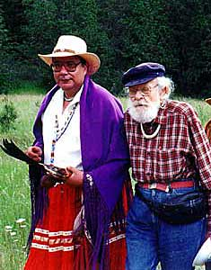

Slide 24
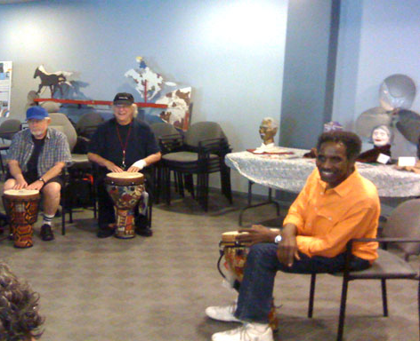
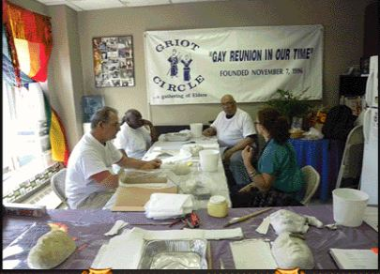
Notes:
Pic w/ woman and drag queen taken from GLEH of LA, triangle park. http://gleh.org/meet-our-residents/resident-photos/19-other-resident-events
Pic w/ group and bongos. http://gleh.org/meet-our-residents/resident-photos/16-drum-circle.
Pic w/ Griot signs are from Griot.

Slide 27
American Medical Association
“Unrecognized homosexuality by the physician or the patients’ reluctance to report his or her sexual orientation can lead to failure to screen, diagnose or treat important medical problems.”

Slide 29
DENIED TREATMENT
Notes:
Vaught said when she, her wife and son went to the ER on July 18, she was entered into the hospital computer system as male despite an ID that stated she was female. 'I pointed out that my ID says female,' Vaught said. 'There were two ladies there, and one of them snickered a little bit and covered her mouth. The other got a very annoyed look on her face.' When she went to the exa- room, 3he was met with stares and insults and was referred to as a 'he-she,' an 'it,' and a 'transvestite.' Vaught said she was kept waiting for two hours without any treatment before a doctor saw her and said she couldn't treat her because of her transgender condition. 'I was confused,' Vaught said. 'I told them I didn't know my condition, that's why I was there. She said 'No, the transvestite thing.' She said I couldn't see a doctor until I came back with test orders from my doctor in Indy.' Benge said such reactions are not uncommon. But Vaught and her supporters wrote about her experience on the hospital's Facebook page, attracting the attention of advocacy groups including the Indiana Transgender Rights Advocacy Alliance and Indiana Equality."

Slide 31
The National Resource Center on LGBT Aging

Slide 32
The Mautner Project
Notes:
based in Washington DC, has developed a cultural competency training program which encourages participants to explore many aspects of culture including personal privilege, the cultural interplay of individuals and the medical system, and the impact of institutional heterosexism. Removing the Barriers provides specific focus on cultural distinctions of women who partner with women and how those impact their access to preventive health screenings as well as risk factors that may be significant for this specific population. RTB explores the use of culturally appropriate language, family recognition and legal issues, as well as clinical concerns specific to women who partner with women, in an effort to aid providers in reaching their goal of serving underserved women.
The ultimate goal is to improve individual’s practitioner’s skills and create systematic change so that lesbians can truly feel comfortable in a health care setting”
Take from information web page. http://www.mautnerproject.org/education/removing_barriers.cfm.
Background on Mautner—Mautner Project is committed to improving the health of women who partner with women including lesbian, bisexual and transgender individuals, through direct and support services, education and advocacy. (Mission statement)

Slide 35
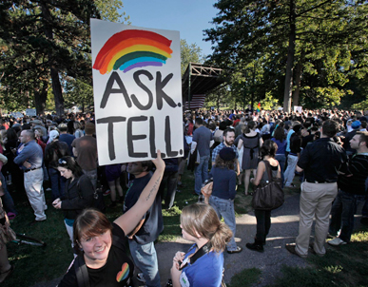

Slide 36
Notes:
Homosexuality an illness?
NO! More than 35 years of objective, well-designed scientific research has shown that homosexuality, in and itself, is not associated with mental disorders or emotional or social problems. Homosexuality was once thought to be a mental illness because mental health professionals and society had biased information. In the past, the studies of gay, lesbian, and bisexual people involved only those in therapy, thus biasing the resulting conclusions. When researchers examined data about such people who were not in therapy, the idea that homosexuality was a mental illness was quickly found to be untrue. In 1973 the American Psychiatric Association confirmed the importance of the new, better-designed research and removed homosexuality from the official manual that lists mental and emotional disorders. Two years later, the American Psychological Association passed a resolution supporting this removal. For more than 25 years, both associations have urged all mental health professionals to help dispel the stigma of mental illness that some people still associate with homosexual orientation.
LGBs good parents
Yes. Studies comparing groups of children raised by homosexual and by heterosexual parents find no developmental differences between the two groups of children in four critical areas: their intelligence, psychological adjustment, social adjustment, and popularity with friends. It is also important to realize that a parent's sexual orientation does not indicate their children's.
Reparative therapies don’t work
Some therapists who undertake so-called conversion therapy report that they have been able to change their clients' sexual orientation from homosexual to heterosexual. Close scrutiny of these reports, however show several factors that cast doubt on their claims. For example, many of these claims come from organizations with an ideological perspective that condemns homosexuality. Furthermore, their claims are poorly documented; for example, treatment outcome is not followed and reported over time, as would be the standard to test the validity of any mental health intervention. The American Psychological Association is concerned about such therapies and their potential harm to patients. In 1997, the Association's Council of Representatives passed a resolution reaffirming psychology's opposition to homophobia in treatment and spelling out a client's right to unbiased treatment and self-determination. Any person who enters into therapy to deal with issues of sexual orientation has a right to expect that such therapy will take place in a professionally neutral environment, without any social bias.

Slide 38
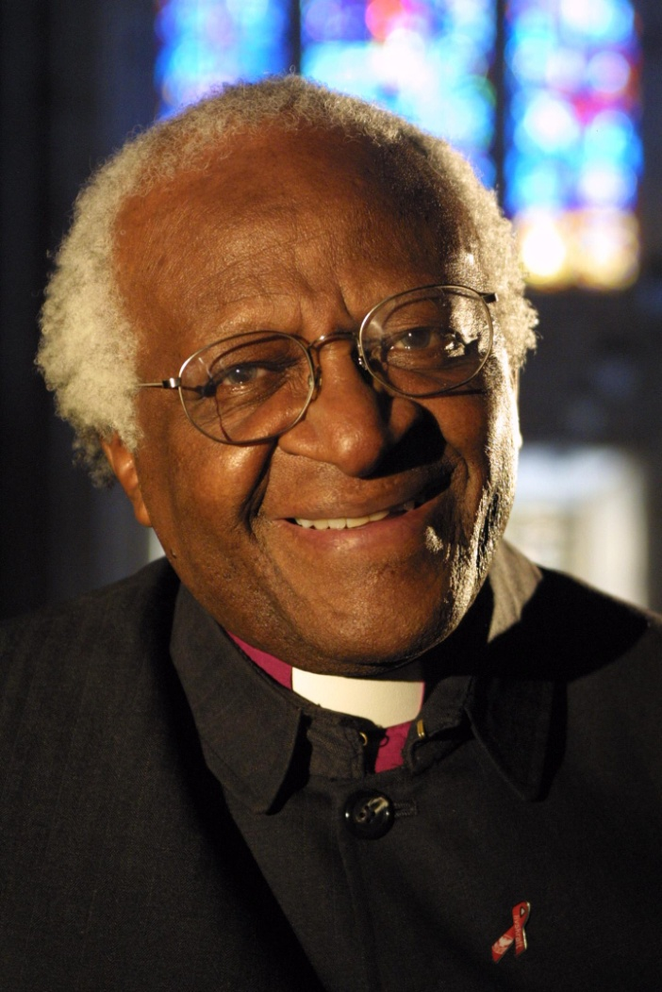
Notes:
Africans unite against Sodomy Photo courtesy of Advocate. http://www.advocate.com/News/Daily_News/2010/08/05/Uganda_Kill_the_Gays_Bill_Stalled/
August 5, 2010
“I have spoken against the injustice of apartheid, racism, where people were penalized for something about which they could do nothing, their ethnicity… I therefore could not keep quiet, it was impossible, when people were hounded for something they did not choose, their sexual orientation.” Archbishop Emeritus of Cape Town--Desmond Tutu

Slide 39
