Slide 1
Universal Design: Towards an Inclusive Learning Environment
Council on Disabilities and Persons with Disabilities
CSWE APM 2010
Portland, Oregon

Slide 2
Outline of Presentation
Overview
  Disability laws and higher education
  Disability services
Teaching Strategies for Inclusiveness
  Syllabus
  Lecture
  Group Discussion
  Collaborative Learning
  Instructional Technologies
Sharing Experiences
Summary and Implications

Slide 3
Disability/Education Laws
IDEA /IDEIA (2004)
Education… Act (1973)
Rehabilitation Act:
Section 504 (1973)
ADA (1990)
Elementary/
Secondary
Postsecondary
Elementary/Secondary/
Postsecondary/
General Public
Public schools must provide services to students with disabilities
Universities that receive federal funds must be accessible
University programs must be accessible regardless of federal funds
School is responsible for finding students and providing services
Students are responsible for disclosure and requesting services
Students are responsible for disclosure and requesting services

Slide 4
ADA Definition of Disability
A person has a disability if he or she:
1) has a physical or mental impairment that substantially limits one or more of the major life activities (walking, standing, seeing, speaking, hearing, breathing, taking care of oneself, learning);
2) has a record of having a disability; or
3) is regarded as having a disability.

Slide 5
Numbers of Students with Disabilities
Full-Time Freshman
1988 7.0%
1991 8.8%
1994 9.2%
1998 9.4%
2004 10.7%
2008 10.4 %
National Center for Educational Statistics, 2008

Slide 6
Types of Disabilities - Nationwide
Full-Time Freshman (2008)
Mental illness 24.1%
ADD/ADHD 19.2%
Orthopedic 15.4%
Specific learning 8.8%
Health 5.8%
Visual 2.7%
Speech .7%
Other 17.3%
Dramatic
Increase

Slide 7
Reasonable Accommodations
A modification or adjustment to a course, program, service, job, facility, or activity that enables a qualified person with a disability to have an equal opportunity.
Institutions are obligated to make reasonable accommodations only to known limitations of an otherwise qualified individual.

Slide 8
Mandated Services
Books on tape
Notetakers
Testing accommodations
Access to learning opportunities and materials

Slide 9
Non Mandated Services
(Enhanced)
Tutoring
Counseling
Learning Strategies Help
Career Counseling
Access to Professionals with LD Expertise

Slide 10
Appropriate Academic Accommodations/Modifications
Course substitutions
Extended time limits for degree completion
Modifying the manner in which courses are conducted
Modifying course examinations
Providing taped texts, sign language interpreters, and readers in libraries
Adapting classroom and lab equipment

Slide 11
Unreasonable Modifications
Those that would fundamentally alter demonstrable academic or technical standards
Those that substantially alter the nature of the benefit received from the course, program or service
Those that present an undue hardship

Slide 12
Academic Modification
Requires Balance Between
College’s right to maintain academic and technical standards integral to its mission.
Rights of students with disabilities to equal access.

Slide 13
Disability Services (generic)
Houses disability documentation, certifies eligibility for accommodations
Determines reasonable accommodations
Provides certain accommodations (sign language interpreters, test-proctoring, library assistance, textbook taping, etc.)
Information & Referral

Slide 14
Disability Services - How it Works
Student contacts disability services (DS)
DS certifies a student has a disability
DS determines reasonable accommodations
DS gives ‘faculty letter’ to students outlining accommodations
Student delivers letter to faculty member
Faculty member makes accommodation
Faculty calls DS if they have questions

Slide 15
Disability Services - When to Refer a Student
Student discloses a disability
Student suspects s/he has an undiagnosed disability
Based on your review of a student’s work and after talking with the student, you suspect student may have an undiagnosed condition
Student reports having difficulty in using or getting accommodations.

Slide 16
Disability Services
When in doubt---
ask Disability Services first!

Slide 17
Definition of Universal Design
Universal Design is the design of products and environments to be usable by all people, to the greatest extent possible, without the need for adaptation or specialized design.
The Center for Universal Design,
NC State University
Notes:
As defined by the folks at North Carolina State University, UD is the design…

Slide 18
Universal Design in Architecture
Is based on needs of all users
Has features that are incorporated into the design from the very beginning, not added on
Generally benefits more than one group of users (e.g., the curb cut)
Notes:
Features of UD (still in architecture) are that it is based….

Slide 19
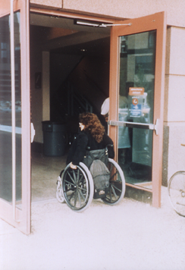
Notes:
(Power assist front door)
Provides same means for all users--shows respect for all
Simple, intuitive design
Low physical effort

Slide 20
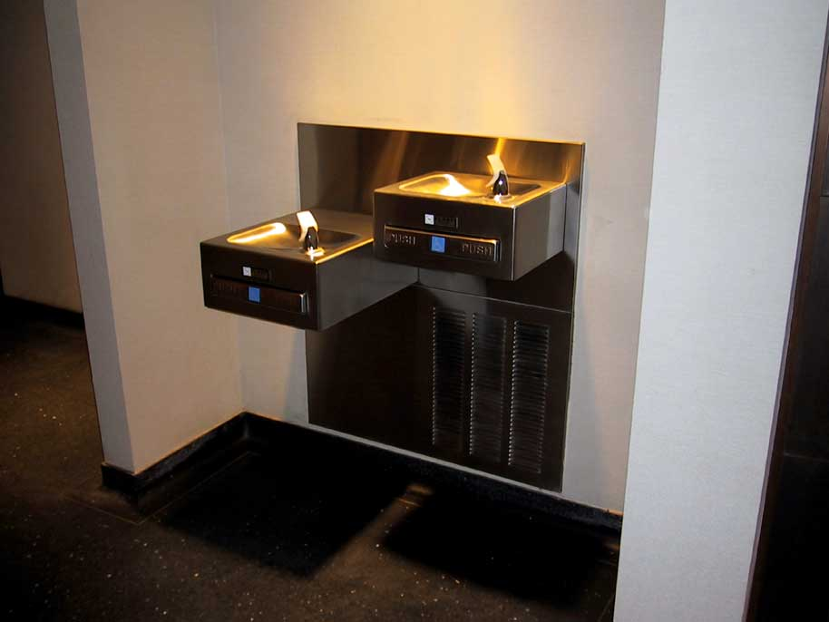
Notes:
(water fountains)
Equivalent means of use (when it’s not identical, it should be equivalent)

Slide 21
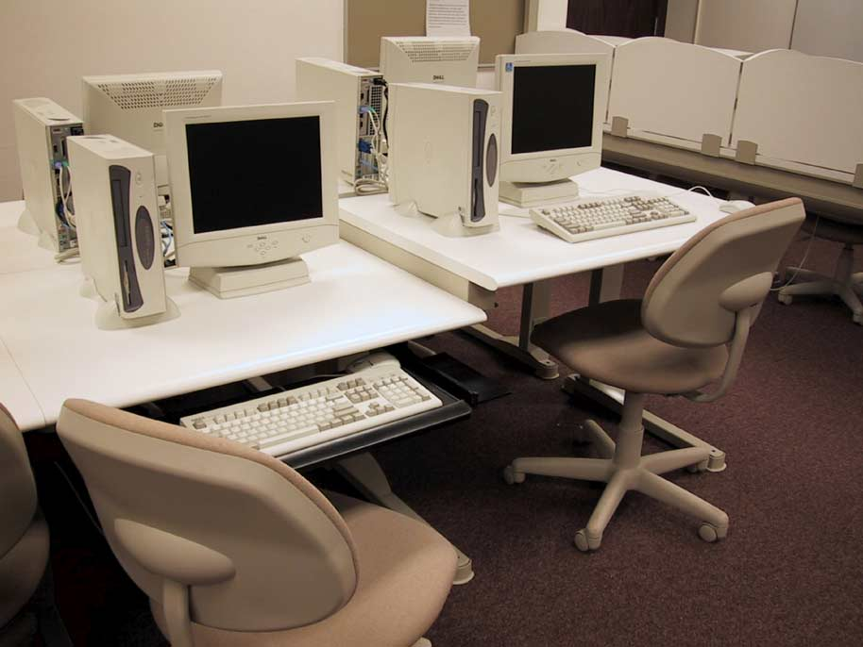
Notes:
classroom tables
Appropriate size and shape
Equivalent use

Slide 22
Curb-Cuts
Physical curb-cut
Electronic curb-cut
Academic curb-cut

Slide 23
Universal Design Continuum
Americans with Disabilities Act
Accommodating individuals one at a time
Universal Design:
Barrier-free,
fewer individual accommodations needed

Slide 24
Definition of
Universal Instructional Design
The basic premise of universal instructional design is that curriculum should include alternatives to make it accessible and applicable to students with different backgrounds, learning styles, abilities and disabilities.
CAST (Center for Applied Special Technology)
Notes:
Here’s a very useful definition of UID.
One instructional parallel of the curb cut would be putting your course materials on the web. This allows the text to be manipulated in a variety of ways: a blind student using a screenreader or a text enlarger; a student with a LD can use the same screenreader, a second language student….

Slide 25
Universal Instructional Design
Includes alternatives
Focuses on accessibility
Includes many accommodations that already exist
Benefits many types of students
Notes:
To review, some important features of UID are that it….

Slide 26
The “universal” in universal design does not imply that one size fits all; instead, it stresses the need for flexible, customizable content, assignments and activities.
CAST (Center for Applied Special Technology)
Notes:
One other VERY important point—the “universal”…

Slide 27
Principles for Applying
Universal Instructional Design
Welcoming Classroom Climate
Focus on Essential Components of Course
Flexible Means of Representation
Flexible Means of Expression and Evaluation
Flexible Means of Engagement

Slide 28
Why do universal design if accommodations are allowed?
  Equal access is consistent with the human rights and social justice mission of social work.
  Students may be embarrassed to ask for accommodations.
  Students may not be able to get testing to prove their disability.
  Easier to plan an accessible approach in advance than make accommodations later.

Slide 29
Classroom Environment
Ensure physical accessibility (e.g. wide doorways, accessible desks, tables)
Minimize distractions (e.g. background noises, student side conversations)
Announce that technology is allowed for note taking (e.g. tape recorder, laptop), but not for texting, playing games.

Slide 30
Classroom Environment
Create a welcoming classroom environment e.g., rules for discussion.
Avoid stereotyping; use person-first language, e.g., person who uses a wheelchair
Never announce a student‘s disability to the class. This is confidential information.
Prepare students in advance for difficult activities.

Slide 31
Syllabus & Course Organization
Put disability accommodation statement on syllabus and discuss in class.
Be organized and include weekly topics in syllabus.
Schedule readings, assignments, lectures, and discussion on same topic at same time.
Stick to the schedule, announce changes in advance.

Slide 32
Lectures
Provide written materials to support and supplement what is stated orally in class.
If possible:
  Provide notes prior to class.
  Provide in electronic format so students with visual or reading disabilities can enlarge or use screen reader.
If using a white board, choose dark pens for lots of color contrast. Avoid using red.

Slide 33
Lectures
Use pictures or graphs to illustrate concepts when possible.
Face the class when speaking.
Augment lectures with discussion and activities to help students learn through multiple means of instruction.
Make available alternative
representations of lectures
  Videotapes
  Post student notes

Slide 34
Collaborative Learning
Based on Vygotsky’s zone of proximal development whereby:
  inherent social nature of learning
  umbrella term for a variety of approaches involving joint intellectual effort by
    students
    students and teachers.
  students work together to search for
    understanding
    meaning
    solutions or to create a product of their learning.

Slide 35
Identifying and Resolving Barriers to Access
Undergraduate Social Policy & Social Justice course
Intent to critically assess physical environment
Assignment based on teams of 2-3 students

Slide 36
Assignment Objectives
Learn about Americans with Disabilities Act (ADA)
Become familiar with the standards of the ADA
Use image manipulation software
Propose a resolution to an identified environmental barrier

Slide 37
Develop Knowledge of ADA Standards
Students
  Took pictures of potential/existing barriers
  Identified and described situation
  Proposed methods to resolve/remove problem

Slide 38
Learning Outcomes
All student groups successfully completed the assignment
All groups collaborated and contributed their skill sets to others in their groups
Students acquired underlying knowledge of ADA standards
Students applied these standards to problem solving

Slide 39
Classroom Discussion: General
Pros: Can provide an opportunity for diversity of perspectives and developing new appreciation for differences.
Cons: Some students will monopolize the conversation while others will not actively engage in discussion.
Disability Factors: Some students with disabilities face challenges participating in class and small group discussions and other interactive activities.

Slide 40
UD for Class Discussion:
Strategies that Benefit All Students
You already know that specific needs vary significantly among your students;
First, understand the needs of individuals who experience disabilities affecting participation in classroom and group discussions; and
Then, focus on developing an integrative and effective classroom discussion approach rather than multiple individual solutions to meet the learning needs of all students, not just those with particular disabilities (Scott, McGuire, & Shaw, 2003).
From http://www.washington.edu/doit/Faculty/Strategies/Academic/Groupwork/

Slide 41
Universal Design for
Class Discussion
Reconfigure your classroom to facilitate communication
Develop a class code of conduct (a.k.a. ground rules) to guide classroom discussion to promote useful, respectful and worthwhile experience for all participants
Prepare discussion topics/questions in advance
Be aware that your interactions and behaviors set the tone
Keep discussions “on-track”
Paraphrase questions and answers and highlight key points throughout discussions
Create options for electronic or computer-assisted discussions
Provide electronic supplementary course/discussion materials
Give clear verbal and written descriptions and explanations of all visual and written materials
Notes:
Students may feel freer to address questions to anyone or everyone in the class, to query the teacher from time to time, to suggest new topics or steer the discussion towards things they are interested in, to request more information or confirmation of something said by someone else, or to express thoughts or opinions that have not been explicitly solicited (Chun, 1998).

Slide 42
Discussion: Motor-Orthopedic-Mobility Impairments
Physical access to the discussion location may pose a challenge for students with mobility impairments.
Students who have difficulty using their hands will have difficulty taking written notes.
Typical accommodations for use in discussions and group work:
  Preferential and accessible seating
  Note takers
  Audio-taped class sessions
  Laptop computer for note taking
  Include student in open discussions
  Allow more time to complete activities
  Use ramps and raised platforms for access
  Lower chalkboard and/or corkboard
From: http://www.washington.edu/doit/Faculty/Strategies/Academic/Groupwork/

Slide 43
Discussion: Learning Disabilities
Challenges may include: difficulty processing, organizing, and remembering large amounts of spoken information; effective note taking due to poor writing and organizational skills; verbal communication skills.
Typical accommodations include:
  Audio-taped class sessions
  Note taker
  Laptop computer in class for note taking
  Options for electronic discussion via e-mail, internet-based classrooms
  Ask questions in a clarifying manner, then have student describe his or her understanding of the questions
Encourage questions during or after class to ensure understanding
Give plenty of reinforcement
From: http://www.washington.edu/doit/Faculty/Strategies/Academic/Groupwork/

Slide 44
Discussion: Vision Impairment
Blindness - Students who are blind will not be able to see a presenter, visual aids, printed materials, or demonstrations.
Typical accommodations include:
  Audio-taped class sessions
  Brailler or computer for note taking
  Electronic course materials which can be converted to speech output
  Having students state their names prior to speaking during discussions
  Verbal descriptions of visual aids and demonstrations
  Handouts in Braille or on tape

Slide 45
Discussion: Vision Impairment-2
Low Vision - Students with low vision may have difficulty seeing visual aids, handouts, and demonstrations.
Typical accommodations include:
  Note takers
  Audio-taped class sessions
  Electronic course materials which can be converted to speech output
  Preferential seating
  Large-print handouts and visual aids
From: http://www.washington.edu/doit/Faculty/Strategies/Academic/Groupwork/

Slide 46
Discussion: Hearing Impairment
Verbal discussions are a challenge .
Students with residual hearing or who use hearing aids may require amplification.
Other students may need to lip read or use sign language interpreters.
Some students with hearing impairments may also have speech impairments.
Environmental conditions may impact ability to hear or read lips effectively. For example,
  Hearing aids may pick up extraneous background noise and interfere with the clarity of sound.
  Poor lighting may make it more difficult to lip read.
  Background lighting from a window can cast shadows on speaker's face.

Slide 47
Discussion: Hearing Impairment-2
Typical accommodations include: :
  Sign language interpreters
  Real-time captioning which allows immediate transcription of words to a computer screen
  Assistive Listening Devices (ALDs) which combined with a student's personal hearing aid can augment and amplify sound in a group setting. Microphones for these devices can then be accessed by the instructor and students
  Preferential seating during the discussion for optimal listening or lip reading
  Options for electronic discussion

Slide 48
Hearing Impairments-3
Communication strategies that can facilitate access to students with hearing impairments include:
  When speaking, face the student directly and avoid obscuring lips or face with hands, books, etc.
  Repeat discussion questions and statements made by other students
  Write discussion key points, questions, and answers on the board or overhead
  Speak clearly and at a normal rate
  Only one person at time speaks
  If the student uses an interpreter, speak directly to the student, not the interpreter
  Clearly identify who is speaking or asking a question
  From: http://www.as.wvu.edu/~scidis/behavior.html and http://www.washington.edu/doit/Faculty/Strategies/Academic/Groupwork/

Slide 49
Discussion: Health Impairment
Students with various health conditions may have difficulty attending class regularly; they may fatigue easily and/or have difficulty taking notes due to physical problems. Medication side effects may impact endurance, memory, and attention.
Typical accommodations include:
  Options for electronic discussion
  Note takers
  Audio-taped class sessions
  Laptop computer for note taking
  Flexible attendance requirements
From: http://www.washington.edu/doit/Faculty/Strategies/Academic/Groupwork/

Slide 50
Discussion: Mental
Health Disorder
Students with a mental health disorder may experience considerable anxiety and worry in contributing to classroom and group discussions. Medication side effects may impact endurance, memory, and attention.
  Help student feel as though he/ he has something worthwhile to contribute to the discussion.
  Call for responses and participation commensurate with the student's skills.
  As the student's comfort level rises and when a safe topic is available, encourage the student to contribute to the discussion or be a group spokesperson.
  With the student, devise a contingency plan in which inappropriate forms of response are replaced by appropriate ones.
  Gradually increase the challenges in the student's participation in group exercises while providing increased positive reinforcement.
From: http://www.as.wvu.edu/~scidis/behavior.html

Slide 51
Instructional Technology: Introduction
Definition of Instructional Technology
Designers of Technology historically lacked consideration for persons with disabilities
  2001 study
  Kindle as one recent example
Pressure from multiple sources is slowly leading to change
  Again, Kindle as an example

Slide 52
Assistive Technology
Definition
Some Examples:
  Screen Readers
  Adapted Computers
  Speech to Text Programs
  TTY

Slide 53
The Intersection of Instructional and Assistive Technologies
Assistive Technologies have limits.
Many Instructional Technologies are designed without consideration of these limits.
This intersection is constantly changing!
To create a UDL course, teachers must pay attention to this intersection.

Slide 54
Some areas for Teachers to Consider
Course materials (lectures, handouts, guides, etc.)
Websites
Textbooks
Articles used in class
Pictures/ tables/ other types of visual representation

Slide 55
Online Courses
Can offer an excellent medium for UDL
Are only as universally designed as the designer’s perception of their students
  Remember: UDL goes beyond persons with disabilities
  Examples: Access/ knowledge of technologies, second language learners, schedules of students

Slide 56
Most Instructional Technology can be Accessible
Sometimes, they won’t even require assistive technology!
  Examples
However, they may require changes in how you use them!
  Examples
Some resources are not accessible, even with the support of assistive technology.
  Examples

Slide 57
Is this Instructional Technology Accessible?
Voluntary Product Accessibility Template (VPAT)
Web Accessibility Initiative/ Section 508 Guidelines for websites
University office that supports persons with disabilities
University Instructional Technology/ Distance Education office
Other resources

Slide 58
General Guidelines for Accessible Course Materials
More than one way of presenting the material.
  Visual materials
  Audio materials
  Electronic versus hard copies

Slide 59
How do I Create Accessible Course Materials?
Use Support.
  Your University
  Other resources
Don’t panic!
Remember who this really assists…everyone!

Slide 60
Sharing Experiences

Slide 61
Summary and Implications
Advanced planning will save time and effort in long run by eliminating need for last-minute accommodations
Allow for multiple means of:
  representing information
  knowledge expression and
  student engagement.
Universal instructional design benefits many groups of students, not just those with disabilities

