Slide 1
Disability and Sexuality:
What Social Workers
Should Know
Council on Social Work Education
Annual Program Meeting
November 3, 2013
Presented by the Councilors of the
Council on Disability and Persons with Disabilities:
Joseph A. LoGiudice, L.M.S.W.
Kristen F. Linton, MSW, Ph.D.
Carolyn A. McAllister, MSW, Ph.D.
Carl L. Algood, LICSW, Ph.D.

Slide 2
Agenda
Overview of the Presentation
Policies, Missing Policies, and Values
Historical Framework of Disability and Sexuality and Its Relationship to Social Work
Preparing Social Work Students to Address Disability and Sexuality in the Field
Intersectionality of Disability and Sexuality with Culture, Ethnicity/Race, and Gender
Questions & Answers
Submission to a Special Theme Issue for the Journal of Sexuality and Disability

Slide 3
Overview of the Presentation
The purpose of this presentation is to explain the history, policies, practices, and pedagogy of sexuality and disability in the context of the social work profession.
Each section of this presentation invokes the need for the profession to recognize the importance of sexuality for those individuals who a part of the Disabled Community.

Slide 4
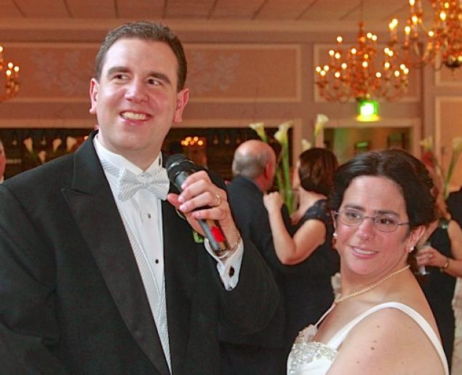
Policies,
Missing Policies,
& Values
Kristen Linton, MSW, Ph.D
Notes:
Paul Farziano, left, and Hava Samuels seated together on their wedding day at East Wind in Wading River, NY. Samuels and Forziano, who are mentally disabled, say the group homes where they live are blocking their request to live together as husband and wife. They are suing for the right to do so. This occurred in early May 2013. I got married the same month that Paul and Hava got married. I could only imagine being restricted the right to live with my husband. However, the reality of no or little support for dating and sexual health of children and adults with disabilities is reflected in policies.

Slide 5
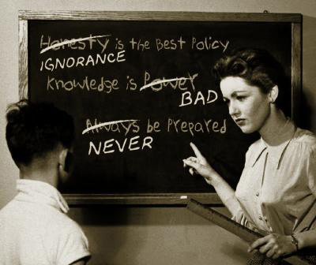
Policies
Notes:
Research has indicated that adolescents with disabilities are just as likely if not more likely to engage in dating and sexual activity than other teens. Doyle, (2008) found that they were 36% more likely to contract STIs. Research has also found that they are 15% more likely than other teens to become pregnant and parent (Shandra, 2012). Sexual health information that is appropriate to adolescents’ lived socio-emotional contexts is lacking since 38 states have abstinence-only policies (Stanger-Hall & Hall, 2011) and adolescents with disabilities are often excluded from sexual health curricula in schools or do not understand it because the curricula is not adapted to meet their needs (Swango-Wilson, 2011). However, we also know that the Individuals with Disabilities Education Act mandates that public school curricula be adapted to meet needs of children with disabilities. Therefore, there is a disconnect from the policy and practice. A colleague of mine, Heidi Adams, and I have recently conducted a study of school social workers and their perception of the dating and sexual health needs of adolescents with disabilities. Much of the responsibility of dating and sexual health education was placed on the school social workers. Many of them advocated for a change in the abstinence only policies and an adapted curricula for adolescents with disabilities (Adams & Bean, Health and Social Work & Children and Schools).
Adults with disabilities do not face very different scenarios. As we can see from Paul and Hava’s situation, to this day, group homes restrict the ability for adults with disabilities to develop and maintain healthy intimate and sexual relationships. As a previous case manager at a regional center for people with developmental disabilities, I do not remember any question about dating and sexuality on the Individual Support Plan, which was used for case workers to support clients to live independently. For many of us, living independently includes developing intimate relationships with others.
However, community programs have been developed to address needs of people with disabilities, such as Planned Parenthood’s developmental disabilities and sexual health curriculum. This is only geared towards adults.

Slide 6
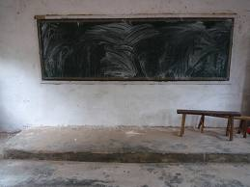
Missing Policies
Notes:
Sometimes we work for agencies that do not have any policies regarding dating and sexuality of adolescents or adults with disabilities. This provides us with a blank slate. While we should rely on our NASW Code of Ethics in this case. As we know, there are often ethical dilemmas. In these cases, we must prioritize ethics, but sometimes we rely on our personal values.

Slide 7
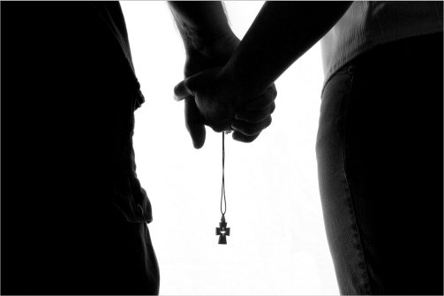
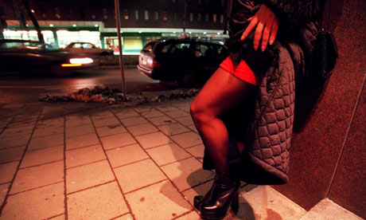
Values
Notes:
When social workers rely on values, they tend to rely on two extreme, dichotomous values. One- a conservative or religious belief that adolescents and/or adults with disabilities should not be engaging in sexual experiences. This belief also may include an assumption that some people with disabilities cannot cognitively understand dating and sexual relationships. An example of this is provided in a publication by Adams and Cimino (2012) which provides a case example of a supervisor of a case worker for a client with developmental disabilities who did not want the client to live with her boyfriend, because it violated the supervisor’s personal values against co-habitation. The second value is that all people deserve dating and sexual relationships. This is reflected in an example provided by a school social worker who reported that a mother hired a prostitute for her teenage son to experience sex. I also remember that social worker at a regional center I used to work for in Clark County would take clients to a prostitution house in Nevada. It was controversial, but there was not explicit policy that limited her from doing so.

Slide 8
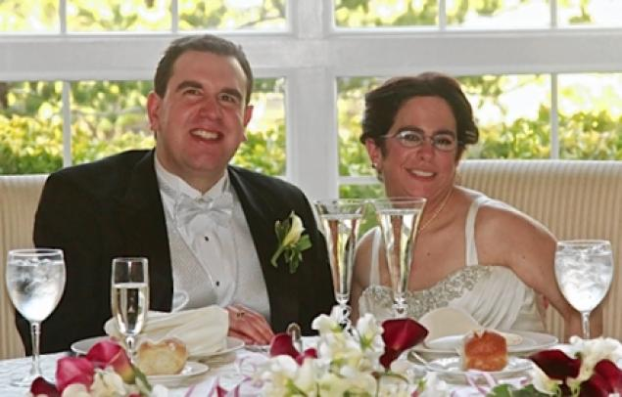
Notes:
We need to develop policies on a national, local, and agency level to address dating and sexual health and adolescents and adults with disabilities that reflect the NASW Code of Ethics of self-determination and anti-discrimination and not our personal values.
1.02 Self­Determination
Social workers respect and promote the right of clients to self­determination and assist clients in their efforts to identify and clarify their goals. Social workers may limit clients’ right to self­determination when, in the social workers’ professional judgment, clients’ actions or potential actions pose a serious, foreseeable, and imminent risk to themselves or others.
4.02 Discrimination
Social workers should not practice, condone, facilitate, or collaborate with any form of discrimination on the basis of race, ethnicity, national
origin, color, sex, sexual orientation, gender identity or expression, age, marital status, political belief, religion, immigration status, or mental or physical disability.

Slide 9
References
Adams, H. & Bean, K. F. (In press). School social workers' needs in supporting adolescents with disabilities towards dating and sexual health: A qualitative study. Children and Schools.
Bean, K. F. & Adams, H. (In press). Pregnancy and parenting experiences and needs of adolescents with disabilities according to school social workers. Health & Social Work.
Cimino, A. N., Adams, H. L., & Roke, J. (in press). Supervisors behaving badly: Witnessing
ethical dilemmas and what to do about it. Journal of Social Work Ethics and Values.
Doyle, J. (2008). Improving sexual health information for young people with learning disabilities. Journal of Pediatric Nursing, 20, 26-28.
Shandra, C. L., & Chowdhury, A. R. (2012). The first sexual experience among adolescent girls with and without disabilities. Journal of Youth and Adolescence, 41(4), 515-532.
Stanger-Hall, K. F. & Hall, D. W. (2011). Abstinence-only education and teen pregnancy rates: Why we need comprehensive sex education in the U.S. PLoS ONE, 6(10), e24658.
Swango-Wilson, A. (2011). Meaningful sex education programs for individuals with intellectual/developmental disabilities. Sexuality and Disability, 29(2), 113-118.
The associated press. (2013). Lawsuit challenges rule that bars mentally disabled married couples from sharing group home bedroom. May 7, 2013.

Slide 10
Historical Framework of Disability and Sexuality and Its Relationship to Social Work
Joseph A. LoGiudice, L.M.S.W.

Slide 11
Historical Framework of Disability and Sexuality and
Its Relationship to Social Work
Constructions and Interpretations of Disability and Sexuality
Working Definitions of Disability and Sexuality According to Social Work
The Relevance of Discussing the Concepts of Disability and Sexuality Among Social Workers

Slide 12
Historical Framework of
Disability and Sexuality and Its Relationship to Social Work (cont’d)
A Review of the Conceptions of Disability and Sexuality from the Late 19th Century to the Present and Its Implications for the Disabled Community:
Late 19th Century to Early 20th Century: Industrialization & Eugenics
1920s-1930s: “Roaring 20s” & Depression Era & Labor Movement
1930s-1940s: The Times of FDR, WWII, Kinsey Studies

Slide 13
Historical Framework of
Disability and Sexuality and Its Relationship to Social Work (cont’d)
1940s-1950s: Return to Conservatism & McCarthyism
1950s-1960s: Baby Boom & Lyndon Johnson’s Great Society
1960s-1970s: Civil Rights Era, Sexual Revolution & New Social Movements
1970s-1980s: From New Social Movements to Reaganomics
1980s-present: Disability Studies & Sexuality Studies

Slide 14
Historical Framework of
Disability and Sexuality and Its Relationship to Social Work (cont’d)
Social Work’s Essential Role in Imparting the Core Competencies & Code of Ethics by Teaching about Disability and Sexuality:
CSWE Core Competencies: 1. Apply social work ethical principles to guide professional practice; 2. Engage diversity and difference in practice; 3. Advance human rights and social and economic justice; 4. Engage in policy practice to advance social and economic well-being and to deliver effective social work services.
Code of Ethics: 1. Cultural competence & social diversity; 2. Social and political action; 3. Discrimination; 4. Social justice; 5. Dignity and worth of the person; 6. Self-Determination; 7. Respect; 8. Social welfare.

Slide 15
Sexuality and Disability
Preparing Students for Field Placement
Carolyn McAllister, MSW, Ph.D.

Slide 16
Why is this an important topic to introduce to SW students?
All internships will include clientele with disabilities
Many internships specifically work with persons with disabilities
Social Work students generally do not feel prepared to discuss any issues around sexuality!
Students likely carry many misconceptions regarding disability and sexuality

Slide 17
Introducing the Topic to Students
Showing a Film Clip
Introducing a Case Study
Assigning an Article/ Book Chapter
Notes:
We will pass out a list of potential films/ television shows that you could show clips from (both mainstream [less recommended] and documentary/ independent films. This may be the most visceral way to introduce the topic.
Introducing a case study: This could be used in combination with a film clip.
Assigning an article: There is a journal entitled Disability and Sexuality that would offer many excellent articles covering a wide variety of topics. Perhaps students could explore and pick an article focusing on a population they are working with in their internship. There are also book chapters that might be good to assign. Unfortunately, the only SW text specifically on the topic was published in 1996.

Slide 18
Helping Students Identify Misconceptions
Bringing up common misconceptions
Allowing students to identify their own misconceptions/ stereotypes
Talk about the ways these misconceptions and stereotypes impact policy and practice with persons with disabilities
Notes:
As we have discussed in this presentation, society’s misconceptions about persons with disabilities and sexuality have serious policy and practice implications. Whether it be not having the right to legally marry, or not be allowed to have privacy with a partner, or not to be given the supports needed to engage in sexual activities, persons with disabilities face frequent roadblocks in the area of sexuality.
The instructor/ field liaison may need to start the discussion by talking about common misconceptions held about persons with disabilities and sexuality, which might include:
The PWD doesn’t know what he/she is doing, so could only be exploited in a sexual relationship
The PWD doesn’t have sexual desires/ needs
A PWD should only have relationships with other PWD
PWD having children is immoral.
Students may not recognize having those thoughts/ feelings, or may feel uncomfortable discussing them.
Talk about the ways these misconceptions end up affecting SW policies and practices. Students may be able to discuss examples from previous workplaces, or their internships. You might take examples from this presentation as well.

Slide 19
Discussion of Social Work Roles
Counselor
Advocate
Educator
Link back to the NASW Code of Ethics
Notes:
Articles focusing on the roles social workers play in the area of disability and sexuality focus on three key areas:
Counselor
Advocate
Educator
You might also link the roles back to the information from this presentation focused on the Core Values of social work.

Slide 20
Introducing the Ex-PLISSIT Model
Ex: Explicitly giving
P: Permission
LI: Limited Information
SS: Specific Suggestions
IT: Intensive Therapy
Notes:
Although the Ex-PLISSIT model could be used to teach practice guidelines towards sexuality generally, this model was designed with a focus on persons with disabilities and sexuality. It helps practitioners realize we can all provide some sexuality related services, even if we are not experts on the topic.
Ex: Explicit. This means that we will verbally giving the individual Permission to talk about sexuality oriented issues. So this may be making a statement when discussing relationships that you are also open to discussing sexuality, or letting the individual know that the topic of sexuality is something you are willing to engage in. Without the explicit permission, the individual will likely be quite hesitant.
Even if the student does not have the skill set or comfort level to have extensive discussions about sexuality, they can and should provide explicit permission for persons with disabilities to discuss issues about sexuality, including entering and maintaining intimate relationships, discussing the impact of a disabling society on the expression of sexuality, practicing safer sex, barriers (policy, societal, physical, emotional, pharmacological) to sexual expression, and promoting healthy sexual expression
Limited Information: For many social workers, this will be the extent of what we can offer on this topic (which is still far more than is often offered!) This may be handouts, basic information , referrals to other agencies or services, limited discussion.
Specific Suggestions: Extended discussion of sexuality related concerns. Students may not be prepared to have this type of engagement on the topic in an internship setting. As a social worker becomes more knowledgeable about particular disabilities and issues that might present, he or she will gain skills to share in this area.
Intensive Therapy: This might involve a thorough medical assessment, extended counseling by a sex therapist, or occupational therapy assessments. Social Workers can and do these practices, but it takes specific training and expertise.

Slide 21
Other ways to prepare
Learning about resources in your area:
  Sex Education Programs
  Sex Therapists
  LGBT Resource Centers
  Occupational Therapists
  Other resources
Thinking about Intersections of disability, sexuality and other identities
Be prepared to look for signs of sexual abuse
  Persons with Disabilities have higher risk of sexual abuse

Slide 22
References
Brashear, D.B. (1978). Integrating human sexuality into rehabilitation practice. Sexuality and disability, 1(3), 190-199.
Goldsmith, L. (1979). Sexuality and the physically disabled: The social work role. Sexuality and Disability, 2(1), 33-37.
Jarman, M. (2012). Dismembering the lynch mob: Intersecting narratives of disability, race, and sexual menace. In R. McRuer and A. Mollow (Eds.). Sex and disability. Durham, NC: Duke University Press.
McAllan, L.C. & Ditillo, D. (1999). Addressing the needs of lesbian and gay clients with disabilities. In R.P. Marinelli & A.E. Dell Orto (Eds.) The psychological & social impact of disability (4th Ed.). New York: Springer Publishing Company.
Mollow, A. (2012). Is sex disability? Queer theory and the disability drive. In R. McRuer and A. Mollow (Eds.). Sex and disability. Durham, NC: Duke University Press.
Mollow, A. & McRuer, R. (2012). Introduction. In R. McRuer and A. Mollow (Eds.). Sex and disability. Durham, NC: Duke University Press.
Rembis, M.A. (2010). Beyond the binary: Rethinking the social model of disabled sexuality. Sexuality and Disability, 28, 51-60.
Shakespere, T. (2000). Disabled sexuality: Toward rights and recognition. Sexuality and Disability, 18(2), 159-166.
Taylor, B. & Davis, S. (2007). The Extended PLISSIT model for addressing the sexual wellbeing of individuals with an acquired disability or chronic illness. Sexuality and Disability, 25, 135-139.
Vash, C.L. & Crewe, N.M. (2004). Psychology of disability (2nd Ed.). New York: Springer Publishing Company, Inc.
Watson-Armstrong, L.A., O’Rourke, B., & Schatzlein, J. (1999). Sexual abuse and persons with disabilities: A call for awareness. In R.P. Marinelli & A.E. Dell Orto (Eds.) The psychological & social impact of disability (4th Ed.). New York: Springer Publishing Company.

Slide 23
The Intersection of Sexuality, Disability & Culture
CARL L. ALGOOD, Ph. D., LICSW
“How a society treats its disabled is the true measure of a civilization”
~Chen Guangcheng

Slide 24
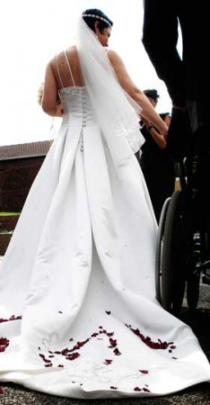
Overview of Presentation
Introduction
Background
Inter-Sectionality
Implications
  Cultural
  Gender
  Race &Ethnicity
  Policy, Practice, & Research
Conclusion

Slide 25
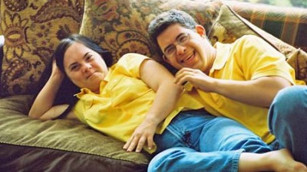
Introduction
Sexuality and disability does not garner wide spread discussions in society.
The literature lacks information on the combined areas of sexuality, disability & culture.
The limited research points to the challenges that persons with disabilities face when confronted with issues of sexuality, culture, race & gender.

Slide 26
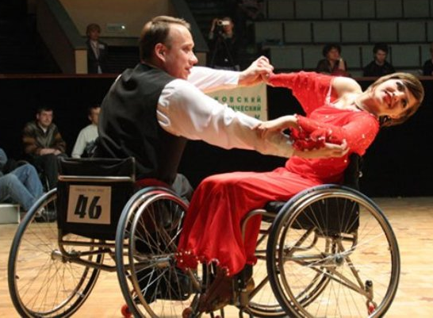
Introduction
A need exists for more studies that explore how disability and culture impact women and sexuality.
A study of ethno-minority women and disability found that the combined impact of culture and disability restricted their capabilities carry out their desires as sexual beings. (Yoshida, Li, & Odette, 1999)

Slide 27
Introduction
Ethnic studies has a history of considering race along with gender, class, sexuality, immigrant and colonial subject status, & their inter-sectionality (James & Wu, 2006).
Yet, there is very little work that addresses the ways in which the categories of race/ethnicity and disability are used to constitute one another(James & Wu, 2006 ).

Slide 28
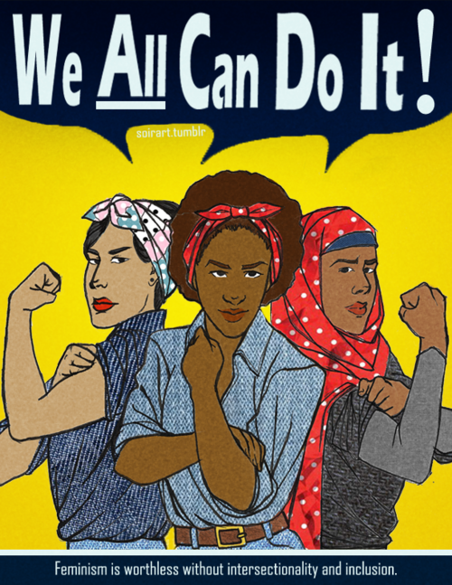
Inter-Sectionality
Rooted in feminist and critical race theories
  Social groups have multiple categories of identity, differences & disadvantages. (Cole, 2009)
The issues of race, class, gender & sexuality are best understood by appreciating the simultaneous interplay of each of these dimensions at any one point in time. (Shiver, 2011)

Slide 29
Implications:
Cultural
An individual’s cultural beliefs, impacts the manner the person regards their role in society and also plays a part in the way their sexuality is shaped(Brodwin & Frederick, 2010)
Negative beliefs of persons with disabilities include not competent, more pathological than normal. These characterizations used to exclude them in activities in the community like jobs, residential, educational & recreational areas (McDonald, Keys & Balcazar, 2007)

Slide 30
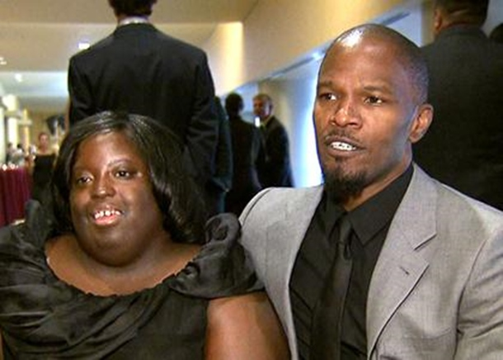
Implications:
Cultural
For persons with disabilities, means of transport are not sometimes obtainable, economic resources don’t always meet their needs, physical barriers are hard to maneuver, and most importantly, behaviors of relatives, acquaintances, professionals , peers, close friends, have been roadblocks to them enjoying and living out their personal sexuality. (Rembis, 2000)

Slide 31
Implications:
Cultural
Beliefs from a cultural focus impacts the manner individuals regard their role in society and also plays a part in the way their sexuality is shaped as (Rembis, 2000)
Sexual enculturation establishes values and rules for the nature of sex and beauty. (Rembis, 2000)

Slide 32
Implications:
Cultural
King (1998) noted African Americans with disabilities are subject to discrimination and stigmatization as people of color and as people with disabilities.
Putnam’s (2005) viewed people with a disability adjusting to discriminatory behaviors by others based on disability status as akin to females or African Americans adjusting to sexism or racism.

Slide 33
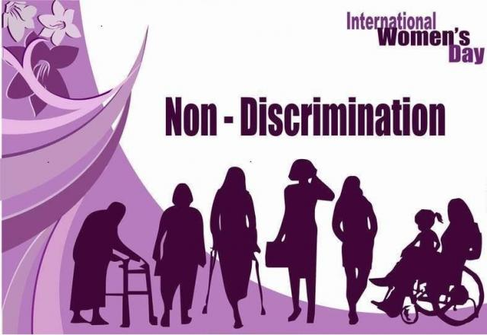
Implications:
Gender
For men and women, the emotions related to being a woman and a man is devalued when faced with the challenges of a disability and the individual is left feeling less than a whole person. (Brodwin & Frederick, 2010)
Negative views by society of not having looks that are appealing, being of little worth, labeled as a burden and lacking in the ability to carry out their position as a women can bring on low self-esteem and thoughts of hopelessness (Brodwin& Frederick, 2010)

Slide 34
Implications:
Gender
Having access to information about sex and sexuality has been identified as an important issue for young women with disabilities.
Young girls and women with disabilities are often denied the opportunities to learn about their sexuality. Barriers to information are often compounded by negative assumptions of individuals with being overly promiscuous. (Rembis, 2010)
Unlike non-disabled women, cultural expectations for women with disabilities , exclude sexuality, work & motherhood.( McDonald, Keys & Balcazar, 2007)

Slide 35

Implications:
Race & Ethnicity
The plight of African American women with disabilities is further compounded because they endure other stigmas as a part of a minority group. (Alston & McCowen, 1994)

Slide 36
Implications:
Race & Ethnicity
Females and African Americans adjusting to sexism or racism , as viewed from the minority group model of disability is likened to persons with disabilities adjusting to discriminatory behaviors based on disability status. (Alston& McCowen, 1994)
The African American women are not encouraged to bear children and may view this as not being able to take care of personal needs and expectations from the African American culture as it relates to motherhood(Alston & McCowen,1994)

Slide 37
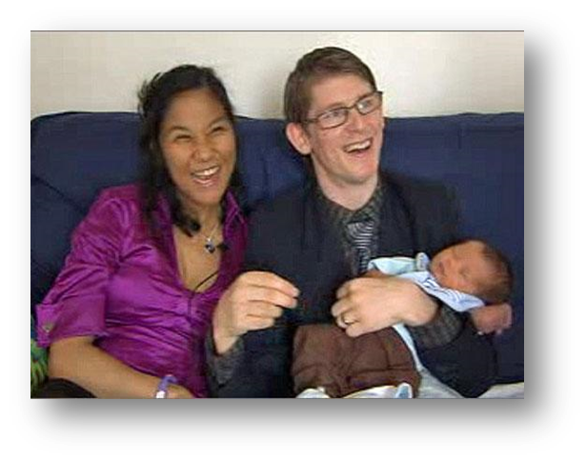
Implications:
Race & Ethnicity
Racial minority LGBTQ students have the challenge of integrating at least two central identities that can be highly charged in our society - race and sexuality. (Harley, Nowalk & Gassaway, 2002)
Although the literature is negligent in inclusion of biracial or multiracial LGBTQ students, it can be assumed that these students are subjected to same issues
of discrimination as other racial
minorities(Harley(Nowalk & Gassaway, 2002)

Slide 38
Implications:
Policy, Practice & Research
Social work practitioners of racial minority LGBTQ students must be sensitive to multi stigma that ethnic minorities face of having a disability, being a person of color & gender when addressing issues of sexuality. (Harley, Nowalk & Gassaway, 2002)
Policies should be implemented in this regard and more research is needed that focuses on the inter-sectionality of sexuality, disability, race, culture & gender (Rembis, 2010)

Slide 39


Implications:
Policy, Practice & Research
If disabled people are going to have power, they must have access in its very broadest sense: physical and social access, access to their own bodies, and access into the consciousness of those individuals currently considered nondisabled (Esmail, Darry, Walter & Knupp, 2010)

Slide 40
Implications:
Policy, Practice & Research
Whereas many people are raised in families in which sex is not openly discussed, those entering health professions such as nursing, social work, counseling, and other rehabilitation-related fields are taught to address the total person, including sexuality (Brodwin & Frederick, 2010)
Perceiving persons living with disabilities as non-sexual creates barriers for both rehabilitation professionals who may be influenced by these views and for persons with disabilities in terms of gaining access to information and acceptance as sexual beings. (Brodwin & Frederick (2010)
If society accepts that sexual expression is a natural and essential part of human existence, then perceptions that deny sexuality for persons with disabilities refute a basic right of expression.

Slide 41
Conclusions
The new trend for viewing sexuality has emerged where sexuality is being recognized as not only engaging in a physical act but also as achievement of an emotional closeness(James & Wu, 2006)
This perception has led to liberation of ideas regarding sex and sexuality and therefore requires the continued advocacy for persons with disabilities, as well as the promotion that sexuality is a natural and very important aspect of their health, well-being & overall satisfaction(James & Wu, 2006)
.

Slide 42
Conclusions
A more holistic definition of sexuality is required.
  The film Sex-Ability exemplified efforts to educate and entertain & had a mainly positive reception from the focus groups.
  Some participants saw the film as reinforcing the stereotype that sex among those with disabilities is inherently different. (James & Wu, 2006)
Finally, as societal attitudes and perceptions are driven by education and knowledge, if there is no exposure to sexuality and disability, it follows suit that society would have a narrow understanding of sexuality(James & Wu, 2006)

Slide 43
References
Alston, R. J., & McCowan, C. J. (1994). African American women with disabilities: Rehabilitation issues.
Brodwin, M. G., & Frederick, P. (2010).Sexuality and Societal Beliefs Regarding Persons Living with Disabilities. Journal of Rehabilitation, 76(4), 37-41.
Esmail, S., Darry, K., Walter, A., &Knupp, H. (2010).Attitudes and perceptions towards disability and sexuality. Disability & Rehabilitation, 32(14), 1148-1155. doi:10.3109/09638280903419277
Greenwell, A., & Hough, S. (2008). Culture and Disability in Sexuality Studies: A Methodological and Content Review of Literature. Sexuality & Disability, 26(4), 189-196. doi: 10.1007/s11195-008-9094-8
James, J. C., & Wu, C. (2006). Race, Ethnicity, Disability, and Literature: Intersections and Interventions. Melus, 31(3), 3-13.
Yoshida, K. K., Li, A. A., & Odette, F. F. (1999). Cross-Cultural Views of Disability and Sexuality: Experiences of a Group of Ethno-Racial Women with Physical Disabilities. Sexuality & Disability, 17(4), 321.

Slide 44
Questions & Discussion
“Not everything that is faced can be changed, but nothing can be changed until it is faced“
~James Baldwin

Slide 45
Journal of Disability and Sexuality
Special Theme Issue: The Intersection of Sexuality and Disability: Implications for the Social Work Profession
Guest Editors: Joseph LoGiudice, LMSW and Kristen F. Linton, MSW, Ph.D.
Suggested topics include:
  Social work policies and values: Do they conflict with sexuality and disability?
  Preparing social work students to address sexuality and disability in the field
  Intersections of disability, sexuality, culture, race, ethnicity, and gender
  LGBTQ and disabled
  Social justice in practice
  Maintaining social work’s ethical obligations in an era of “doing more with even less”

Slide 46
Contact Information
Joseph LoGiudice, L.M.S.W.
JLoGiuDice@gc.cuny.edu
Kristen Linton, MSW, Ph.D.
Kfbean@hawaii.edu
Carolyn McAllister, MSW, Ph.D.
cmcallis@csusb.edu
Carl L. Algood, LICSW, Ph.D.
algoodcl@gmail.com

Slide 47
Submission Deadlines
Abstract Submission: 800 words due January 1, 2014
  Emailed to Kristen Linton at kfbean@hawaii.edu
  “Sexuality and Disability Special Issue” in subject line
Authors notified April 30, 2014 if should submit full manuscript
Full manuscript submission: July 1, 2014
Please see handout for additional information
Contact Guest editors (Joseph LoGiudice and Kristen Linton) for questions

Slide 48
The End
Thank You!!!

