Slide 1
Missouri Quality Initiative for Nursing Homes presented by Colleen Galambos PhD Care Transitions Lead Marilyn Rantz PHD Principal Investigator

Slide 2
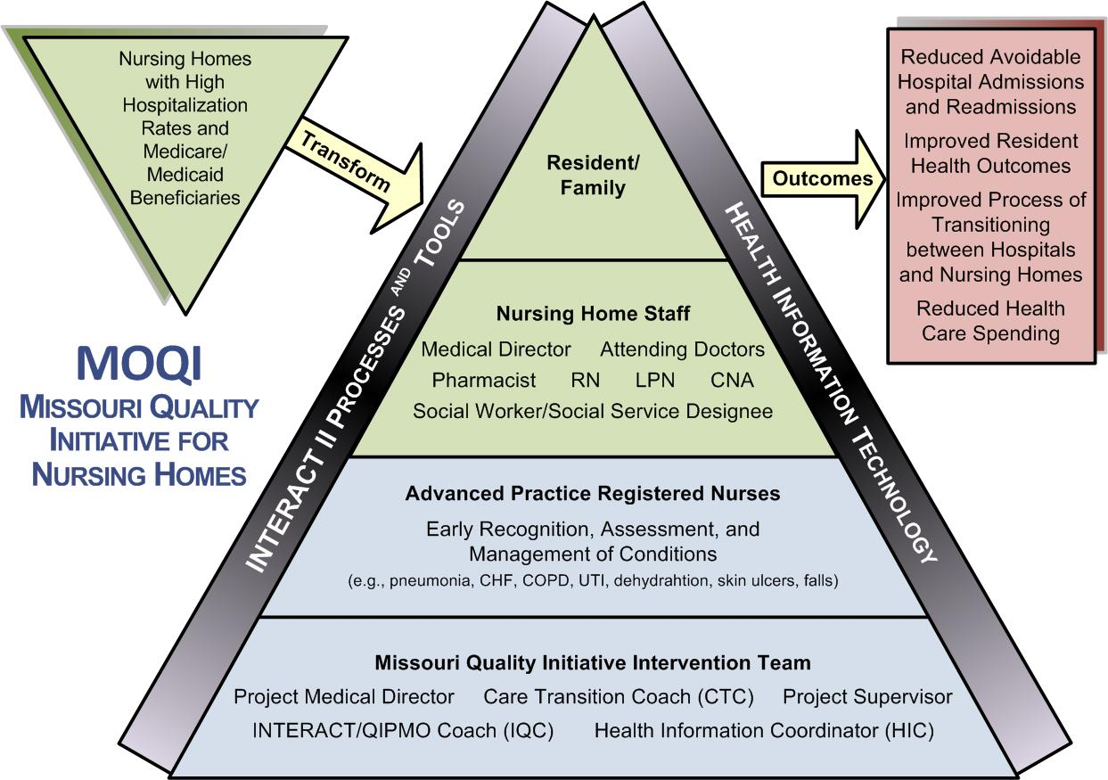
MOQI Model

Slide 3
MOQI Team

Slide 4
Theoretical Model: Complexity Science
Relationships
Communication
Cognitive diversity
Relationships
Communication
Cognitive diversity

Slide 5
Key Variables
Relationships - Personal relationships are essential in organizations for positive outcomes. Intact relationships lead to better information exchanges needed for decision-making.
Communication - Communication is a social act of collaboration. Being able to say what you mean without fear of retribution is communication openness.
Cognitive Diversity - Using organizational connections and relationships to exchange information in decision making. Influences decision outcomes and resident outcomes.

Slide 6
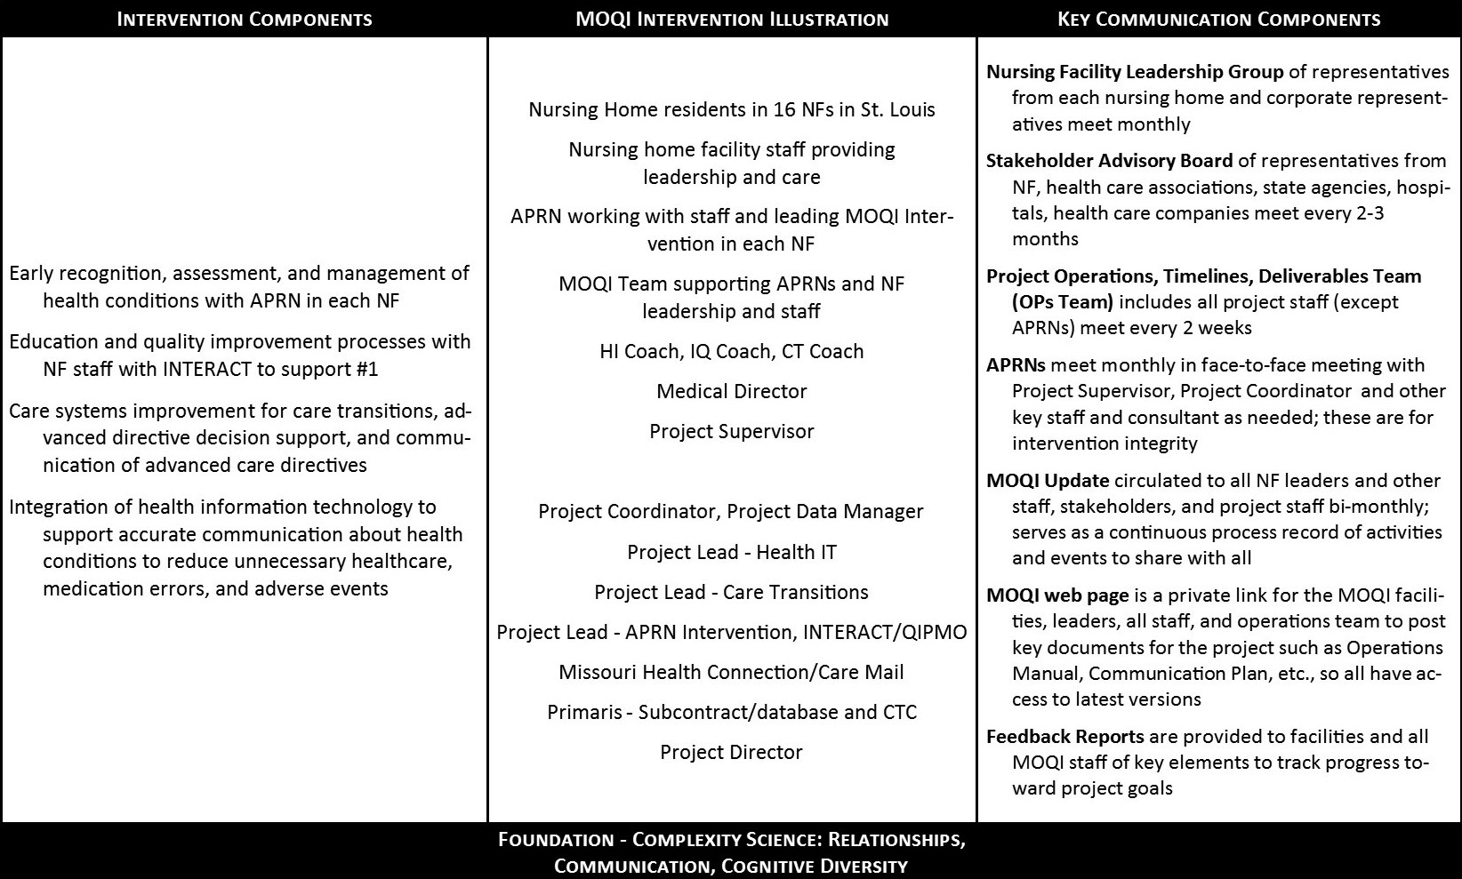
MOQI Intervention

Slide 7
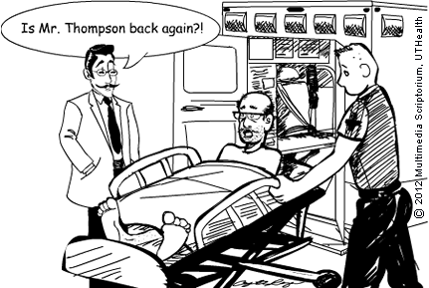
Preliminary Findings
Resident enrollment
Hospitalizations
Monthly management

Slide 8
Preliminary ECCP Aggregate Metrics for Total Initiative Updated April 2014 Calendar Quarter1-Demographics
Demographic | Total Initiative | Total -Missouri
Eligibles | 18,993 | 1,724
Medicare only | 23% | 28%
Medicaid only | 16% | 8%
Dually eligible | 59% | 63%
VA only | .28% | .64%
Hospice | 2% | 5%

Slide 9
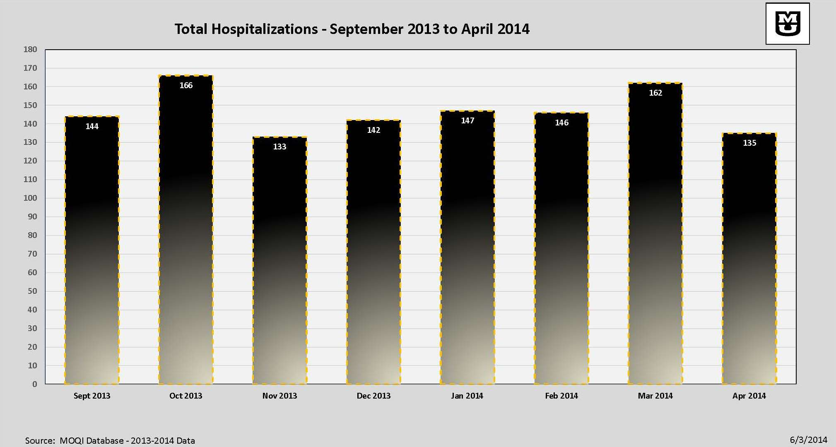

Slide 10
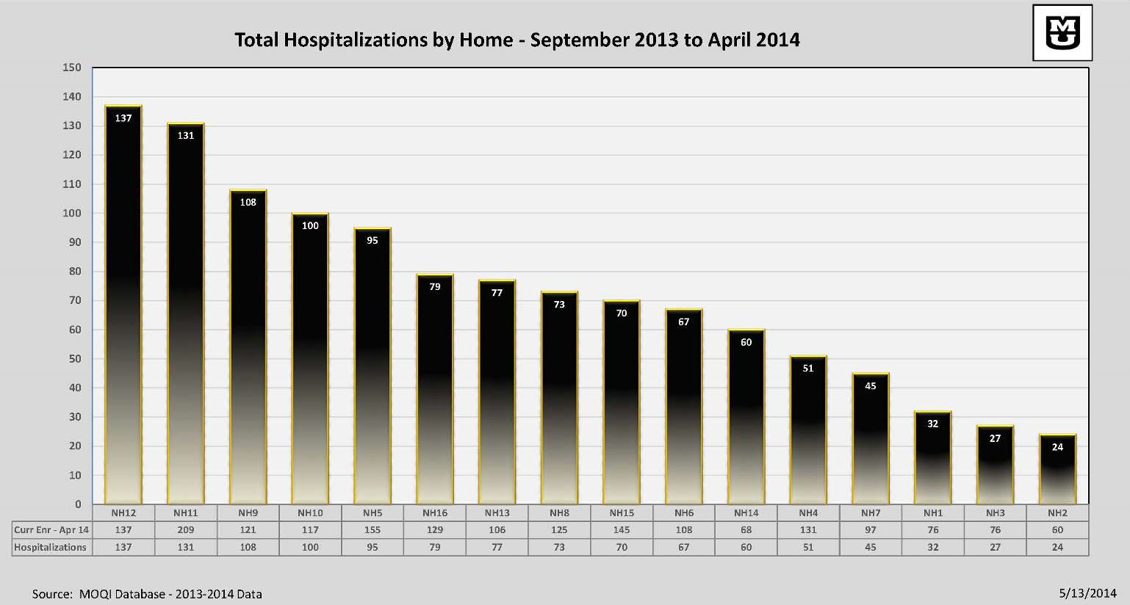

Slide 12
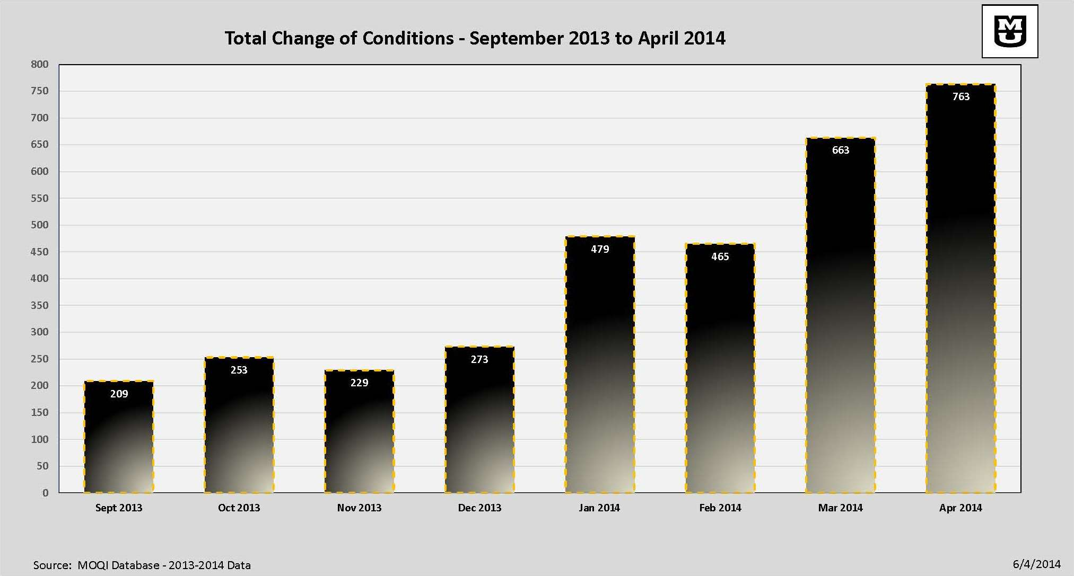

Slide 14
Health Information Technology
CareMail
Preliminary Workflow Analysis
Technology Use

Slide 15
Care Mail Use
Messages Sent
Messages Received
Discipline or Role | Number of Messages
APRN/Medical Director | 119
Social Work/Social Services | 53
System Administrator | 47
Nursing Staff | 41
Total | 260
Discipline or Role | Number of Messages
APRN/Medical Director | 78
Social Work/Social Services | 60
System Administrator | 43
Total | 181

Slide 16
Care Transitions Advance Directives
Improved Communication in Transitions
Support Quality Improvement Processes Between SNF’s and Hospitals
Education about Advance Directives and Advance Care Planning
Provide Opportunities for Enactment of Advance Directives
Improve psychosocial support and care in facilities

Slide 19
APRN Intervention ^{in} Skilled Nursing Facilities

Slide 20
Preliminary ECCP Aggregate Metrics for Total Initiative Updated April 2014 Calendar Quarter 1- Outcomes
Outcomes | Total Initiative | Total Missouri
Hospital Admission Rate | 1.57 | 1.99
Transfer rate to ED | .32 | .71
Transfer rate for observation | .09 | .06
Change of condition | 4.22% | 4.57%
Change of condition/ Hospitalization | 20.03% | 27.45%
Change of condition/structured tool | 61.33% | 70.62%
Medication Reviews | 32.80% | 55.05%
# Residents AD Discussions | 8154 | 1323

Slide 21
Disclaimer
Please note that the data contained in this presentation are preliminary findings only. The Nursing Facility Initiative has an independent contractor that will be performing the official evaluation.

Slide 22
QUESTIONS ??

