Slide 1
Teaching Students how to Transform Power and Privilege Into a Resource to Assist those who lack the same Privilege Virtually
Dr. Ebonnie Vazquez, MSW
Dr. Brie Radis, LCSW, MSS, MLSP

Slide 2
Who are we?
Ebonnie has extensive experience in macro social work practice. She has worked in both the public in private sectors advocating for, creating, and implementing policies that enhance the quality of life for Pennsylvania’s most vulnerable citizens.
Brie has extensive clinical and supervisory experience working with individuals experiencing trauma in the mental health, substance use, and homelessness fields. She has focused on trauma informed educational practice in her teaching and scholarship. She is currently co-director of the Anti-Racism Working Group, which is an action-oriented collaborative group of staff, students, and faculty across West Chester University.
Commonalities
Social work professors
Committed to anti-racism trauma informed educational practice
Teach at both the Philadelphia and West Chester campuses

Slide 3
Goals
Goal 1:
Learn how to identify your individual power to better advocate for those who are lacking similar power and privilege.
Goal 2:
Learn how to transform your power and privilege into a resource that can be used to empower those who lack similar power
Goal 3:
Learn how to utilize your power of privilege as a tool to advance social justice causes in your agency and community and empower future social workers

Slide 4
When you think about Power and Privilege, reflect on these statements:
When thinking of my power and privilege, I think__________
But then I learned _________
So now I think of my power and privilege as__________
Dr. Beverly Daniel Tatum
*We are going to revisit these questions at the end*

Slide 5
Methodology
1. Introduce undergraduate social work students to the concept of privilege (race, gender, gender identity, class, sexuality etc.). Suggested: Identity and Social Location Wheel
2. Students complete a point scale adaptation of Peggy McIntosh’s “Privilege Walk” to establish a baseline related to privilege as an accessible way for them to comprehend the idea of privilege in the context of their own positionality (McIntosh, 1989).
3. Introduce key concepts from Empowerment theory (Joseph, 2020; Laging & Heidenreich, 2019) and Critical Race Theory (Daftary, 2018; Nakaoka & Ortiz, 2018; Pulliam, 2017) to raise student's consciousness.
4. Train students on the transforming technique of EACE
Evaluate: Evaluate the situation
Assess: Assess where and how you can be a transformative resource
Create: Create a situation that reestablishes balance
Execute: Put your plan in action
Notes:
Show vignettes from ABC special “What would you Do?” Have students apply EACE
The privilege scale has been modified to ask students a total of 10 related to privilege. Each question has been assessed a point value. The instructor will read each question aloud to students and they will respond with the appropriate point value. At the conclusion of the scale student will total up their points. A point scale has been created that assesses privilege based upon final point totals.
The instructor will read out the privilege scale and ask students to identify where they fall. After the exercise students and the professor will debrief on the experience.

Slide 6
What is Privilege?
Webster defines Privilege as: “a special right, advantage, or immunity granted or available only to a particular person or group.”
Privilege manifests itself in a multitude of different ways…instinctively, when we think of power, we think of wealth, status, and prestige..
Privilege manifests itself in:
Gender Identity
Race
Age
Education
Language
Class
Sexuality
Ethnicity
Age

Slide 7
How we learn about privilege?
Often a deficit-based narrative
Privilege is taught as something which puts others at a disadvantage, but has not been taught as something with corollary aspects, which puts some at an advantage. (McIntosh, 1989)
We often vilify power or privilege.
We want to transform power and privilege into a resource.
We want to embrace the beneficial qualities that come with power and privilege.

Slide 8
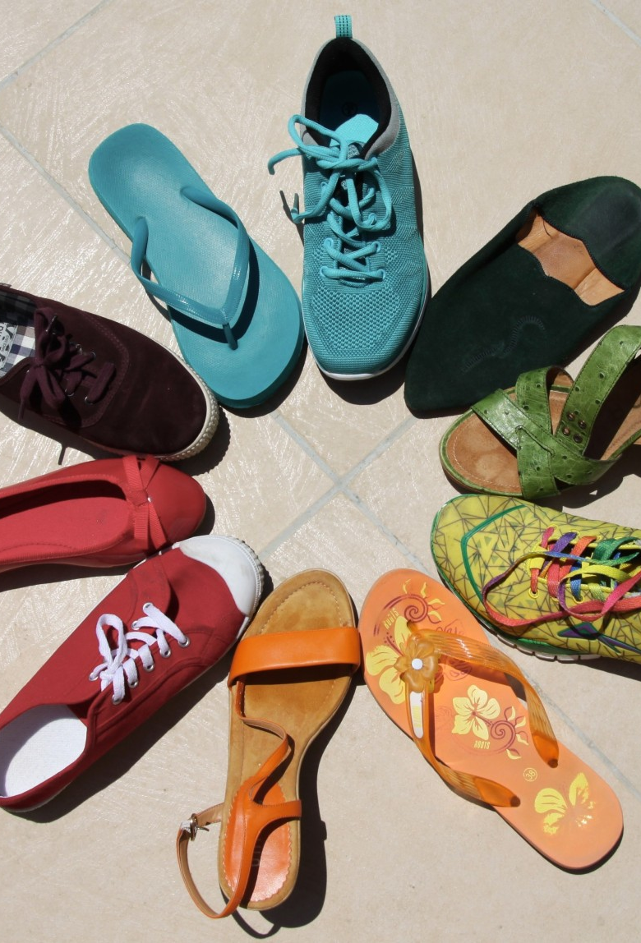
Virtual Privilege Walk
As we look to transform our privilege, we first want to establish a baseline related to privilege as an accessible way to comprehend the idea of privilege in the context of student's own positionality.​
This activity was adapted for use for an introductory social policy class with students and also for a training for social work field instructors.

Slide 9
How do we train students virtually about power and privilege?
We use Zoom as our virtual teaching platform.
Through a synchronous classroom design, we created an interactive PowerPoint for students that includes worksheet activities designed to establish a privilege baseline:
Identity and Social Location Wheel
Privilege Scale
After completion of the worksheet activities, students are placed in small breakout groups to assist with processing.
Then, students will come back to the large room to share what they learned with each other.
Notes:
Talk about the virtual process….How you are reading questions with students thru the screen share

Slide 10
Privilege Walk Sample Statements See attached list for more statements
1. Add three points if you can do well in a situation and not be called a credit to your race. If that could very well happen to you, add one point.
2. Add one if your ancestors were forced to come to the U.S. or forced to relocate from their historical lands in the U.S.; add three if that did not happen to your ancestors.
3. Add three if, in most cases when you ask to speak with the person in charge, you will be facing a person of your race; add one if in most cases you would not be facing a person of your race.
4. Add three points if when you learned about the history of this country and of civilization in general your racial group was primarily represented; if not, add one.
5. Add one point if English is not your first language; add three points if it is.
Notes:
Here are a few example questions. Via Zoom we use the screen share option feature to make it interactive and to provide a visual.
We read the questions outloud to students and assume the role as a facilitator through out the process

Slide 11
Break-out Discussion
An example of what we would discuss in a Break-Out room:
Your total points
Your perceived privilege
Your actual privilege
Were you where you thought you would be?
How are you feeling?
How comfortable are you with your position?
Were there certain statements that were more impactful than others?
Notes:
Next we have the students go to small breakout sessions...students always have the option to pass.
We sometimes share the whiteboard (and make it anonymous for students/or have it --- to have students place their number on a scale to create a visual)

Slide 12
Why does this virtual design work?
Fosters Collaborative Learning (CL)
Builds diversity understanding among students
Student-centered instruction (Laal & Ghodsi, 2011)
Emerging Best Simulation Practices (Kourgiantakis et al., 2020)
Notes:
This student centered virtual adaption fosters both collaborative learning and individualized learning about diversity-privilege white supremacy
Scoping review on simulations focused on advanced practice simulations and reviewed 52 articles about social work simulation and reviewed 14 best emerging best practices some of which we have incorporated into this introductory level social work level simulation at the BSW level students are doing this in activity in their sophomore year. Examples of the emerging best practices are to 1. Describe the theoretical framework or conceptual model. 2. Identify clear and concise competencies. 3. Prepare students adequately for simulated learning activities. 4. Design simulation with realistic scenarios that provide opportunities for students to demonstrate competencies 5. debrief simulation with students.
Table 5. Emerging Best Practices for Simulation-Based Learning. Emerging Best Practices 1. Describe the theoretical framework or conceptual model. 2. Identify clear and concise competencies. 3. Prepare students adequately for simulated learning activities. 4. Design simulation with realistic scenarios that provide opportunities for students to demonstrate competencies. 5. Train actors on the structure and objectives of the learning activity, role and scenario, level of affect in that role, and the expectations around giving feedback to students at the end of the simulation. 6. Develop teaching and assessment instruments that can be used pre-, during, and postsimulation. 7. Integrate culture and diversity components explicitly in the competencies, scenario, instruments, facilitation, feedback, reflection exercises, and debrief. 8. Train facilitator or instructor on teaching using simulation. 9. Provide practice opportunities to ensure students’ practice is observed. 10. Actively engage students who are not in the interviewing roledirected observation. 11. Provide focused feedback on practice for students. 12. Guide student reflections on practice and elicit oral and written student reflections. 13. Debrief simulation with students. 14. Evaluate simulation-based learning activity.

Slide 13
Strengths and Challenges
Strengths
Interactive design
Putting theory to practice
Introspective analysis of both power and privilege
Virtually, students can have a more TIEP individualized experience and share only as much as they feel comfortable sharing
Challenges/Lessons Learned
Virtually, it is difficult to gage student reactions to a charged topic.
A modified scale that includes various dimensions of intersectional privilege including education, sexuality, and age would enhance the experience
Privilege walks often center privilege and has the potential to generate internalized shame

Slide 14
Purpose of the Activity
This activity has been designed to provide participants (BSW students or field instructors) with an opportunity to understand the intricacies of privilege and to explore the ways that we enjoy privileges based on being members of social identity groups in the United States.
Please note that this exercise is not meant to make anyone feel guilty or ashamed of their privilege or lack of privilege related to any social identity categories. Rather, the exercise seeks to highlight the fact that everyone has SOME privilege, even as some people have more privilege than others. By illuminating our various privileges as individuals, we can recognize ways that we can use our privileges individually and collectively to work for social justice. The purpose is not to blame anyone for having more power or privilege or for receiving more help in achieving goals, but to have an opportunity to identify both obstacles and benefits experienced in our life.

Slide 15
Privilege Walk Directions for Participants
As we look to transform our privilege, we first want to establish a baseline related to privilege as an accessible way to comprehend the idea of privilege in the context of their own positionality.
This exercise that can create certain emotions such as discomfort and vulnerability. Check in with yourself.
To do this virtually, please use a blank piece of paper to score yourself based on the points (points represent steps) gains or losses.
Let’s prepare to walk (in the virtual sense). Envision everyone starting at one end of a soccer field or a large room together.

Slide 16
Virtual Privilege Walk Instructions for Instructors
1) Review the purpose, then provide a content warning that some statements may cause discomfort and/or vulnerability. Thus, this activity should be introduced after students/participants have developed some level of trust and safety with one another. Participation should be encouraged, but optional.
2) State the following: Listen to the following statements, and follow the instructions given. I will read each statement out loud that is also shown on the PowerPoint. For example, if I read, “If you have blue eyes, add two points, and if you have another eye color, add zero points,” only people with blue eyes will add points to their scoresheet. Each point represents a step.
3) This activity should be done in silence, and if anyone feels uncomfortable taking points on any statement I read, then you do not need to use this statement, but remember the statement read. This is an introspective exercise and it’s important for you to understand how privilege affects your life, but it is not designed to make you share things which you don’t wish to share.

Slide 17
Privilege Walk Scoring
10-15: In U. S. society, many obstacles will be put in place that will interfere with you getting the things required to have what the society considers a good life, simply because of your identity.
16-20: In U. S. society, some obstacles will be put in place that will interfere with you getting the things required to have what the society considers a good life, simply because of your identity.
21-25: In U. S. society, some resources will be offered to you that support you to get the things required to have what the society considers a good life, simply because of your identity.
26-30: In U. S. society, many resources will be offered to you, whether or not you want them or ask for them, that will support you to get the things required to have what the society considers a good life, simply because of your identity.
Notes:
Optional processing have everyone in the room say one word as you go around the word about how they are feeling/doing post the activity. Participants can pass if they would like to do for this activity.

Slide 18
Individual Reflection
Let’s take 10 minutes to discuss and process our thoughts on:
Your total points
Your perceived privilege
Your actual privilege
Were you where you thought you would be?
How comfortable are you with your position?

Slide 19
How do we transform our power and privilege into a resource?
Recognize your power and privilege
Embrace your power and privilege
Don’t vilify your privilege
Minimize privilege shaming
Execute our Power of One
This Photo by Unknown Author is licensed under CC BY-NC-ND

Slide 20
Break Out Discussion
Privilege manifests itself in a multitude of different ways. Instinctively when we think of power, we think of wealth, power, and prestige.
Privilege of Language
Privilege of Gender
Privilege of Race
Privilege of Sexuality
Privilege of Education
Take 10 minutes and identify your privilege.
This Photo by Unknown Author is licensed under CC BY-NC

Slide 21
Wrap Up
As you continue to work on transforming your Privilege and Power, reflect on these statements:
When thinking of my power and privilege, I think__________
But then I learned _________
So now I think of my power and privilege as__________
*Dr. Beverly Daniel Tatum

Slide 22
References
Abrams, L. S., & Gibson, P. (2007). Teaching notes: Reframing multicultural education: Teaching white privilege in the social work curriculum. Journal of Social Work Education, 43(1), 147-160.
Daftary, A. M. H. (2018). Critical race theory: An effective framework for social work research. Journal of Ethnic & Cultural Diversity in Social Work, 1-16.
Davis, A., & Gentlewarrior, S. (2015). White privilege and clinical social work practice: Reflections and recommendations. Journal of Progressive Human Services, 26(3), 191-208.
Joseph, R. (2020). The theory of empowerment: A critical analysis with the theory evaluation scale. Journal of Human Behavior in the Social Environment, 30(2), 138-157.
Kourgiantakis, T., Sewell, K. M., Hu, R., Logan, J., & Bogo, M. (2020). Simulation in social work education: A scoping review. Research on Social Work Practice, 30(4), 433-450.
Laal, M.., & Ghodsi, S. M. (2011). Benefits of Collaborative Learning. Procedia - Social and Behavioral Sciences 31(2012), 486 – 430.
Laging, M., & Heidenreich, T. (2019). Towards a Conceptual Framework of Service User Involvement in Social Work Education: Empowerment and Educational Perspectives. Journal of Social Work Education, 55(1), 11-22.
McIntosh, P. (2016). Privilege Walk Lesson Plan. Peace Learner.
White Privilege Unpacking the Invisible Knapsack
McIntosh, P. (2007). White privilege: Unpacking the invisible knapsack. Race, class, and gender in the United States: An integrated study, 177-182.
Nakaoka, S., & Ortiz, L. (2018). Examining racial microaggressions as a tool for transforming social work education: The case for critical race pedagogy. Journal of Ethnic & Cultural Diversity in Social Work, 27(1), 72-85.
Pulliam, R. M. (2017). Practical application of critical race theory: A social justice course design. Journal of Social Work Education, 53(3), 414-423.
Tatum, B. D. (2000). The complexity of identity:“ Who am I?”. Readings for diversity and social justice, 2, 5-8.
Vazquez, E., Radis, B., (2020, October). Teaching Students how to Transform Power and Privilege Into a Resource to Assist Those who Lack the Same Privilege Virtually, New York State Social Work Education Association Symposia

Slide 23
Contact Information:
Ebonnie L. Vazquez, Ph.D., MSW
Assistant Professor, Undergraduate Social Work Department
evazquez@wcupa.edu
Brie Radis, DSW, LCSW, MSS, MLSP
Assistant Professor, Undergraduate Social Work Department
bradis@wcupa.edu
B

