Slide 1


Mental and Behavioral Health Programs

Slide 2
Mental Health of Older Adults
Focus on Depression, Dementias and
EBHP Programs in Mental Health

Slide 3
Late Life Depression is Common
About 20% of older adults suffer from clinically significant depressive symptoms
About 3% of older adults have “major” depression
Depression is more common in women
Prevalence varies by setting
Notes:
Women more commonly suffer from depression, altho by age 85+, men (22.5%) and women (23%) depression occurs equally
Variance by setting: Community: 1-3%; Primary care offices: 5-9%; Nursing homes: 12-30%
Depression frequently accompanies common diseases of the elderly: heart disease, stroke, cancer and diabetes. When is co-exists with other med problems, it makes it difficult to diagnose AND it jeopardizes health recovery by impairing the patient’s ability to seek treatment and adhere to medical advice.

Slide 4
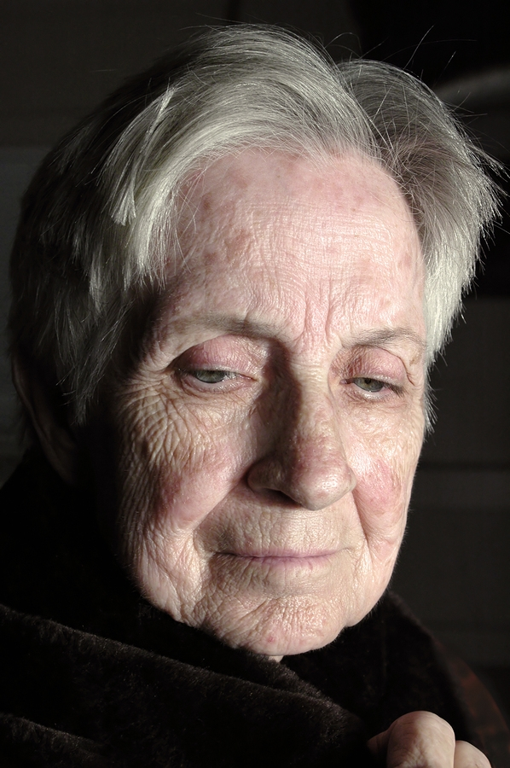
Depression Symptoms
Sadness
Inactivity
Cognitive deficits
Inability to be attentive

Slide 5
Impact of Depression
Late life depression has a profound impact on:
  Functioning
  Quality of life
  Health care costs

Slide 6
Quality of Life (Q of L)
Linked to age and typically shows declines across the life span
Defined as “the value assigned to the duration of life as modified by impairment”
Useful measurement tool
Linked to concepts of healthy life expectancy and healthy-year equivalents

Slide 7
Treatment for Depression
Older adults rarely receive specialty mental health services
Behavioral therapy and drug regimens are effective treatments
Collaborative care models

Slide 8
IMPACT Study (www.impact-uw.edu)
Study sample
Design and methodologies
Project intervention
Results
Implications
Notes:
Go to study info document
Improving Mood and Promoting Access to Care and Treatment
Impact now has an Implementation Center that provides technical support and training to organizations that wish to implement the program. Currently there are programs operating in 28 states (separate from the AoA funded programs).

Slide 9
Healthy IDEAS
Hybrid of IMPACT and PEARLS programs
Community-based program delivered by care managers
Designed to reduce depression symptoms of older people with CI & functional limitations
Notes:
Healthy IDEAS = Identifying Depression, Empowering Activities for Seniors
Employed 4 evidence-based intervention components:
Screening and assessment
Education
Linkage to health and mental health professionals
Behavioral activation

Slide 10
Healthy Ideas Methods
Trained care managers in two community agencies and one social service agency
Screened all clients age 60+
  Geriatric depression scale
  Functional status
  Number and type of co-morbid conditions
  Cognitive status
  General health status

Slide 11
Healthy Ideas Intervention
Six month intervention
In-person and telephone contacts
Baseline, 3-month and 6-month assessments
Notes:
Go through flow chart on page 6 and discuss

Slide 12
Healthy Ideas Baseline Characteristics
Average age = 72.5 years
Female
Hispanic
Widowed and living alone
Poor/fair self-rated health
3-4 co-morbidities
~30% with 3+ limitations in function

Slide 13
Client Outcomes
Improved scores on depression scale (GDS-15)
Higher % of clients who:
  Could make an appointment to get help with depression
  Identify depression symptoms
  Knew what to do if their depression increased
  Believed that increasing their activity level would help
  Reported less health interference in social activities
Less pain
Regression analyses showed number of behavioral activation contacts predicted less depression
Notes:
Results compared baseline to 6-month

Slide 14
Client Outcomes (continued)
Less pain
Regression analyses showed number of behavioral activation contacts predicted less depression
Notes:
Results compared baseline to 6-month

Slide 15
Healthy IDEAS “Translational” Value
Proved feasible and effective in reaching frail, diverse, depressed older adults
Agency staff trained effectively and provided appropriate services
Integration of objective measures into daily practice and data collection by agency
Effective in reaching low-income Hispanics
Notes:
LIMITATIONS: Bias caused by attrition and lack of a control group (did comparison and saw no notable differences)

Slide 16
Dementia
Credit to Kami Chin, MSG and Zaldy Tan, MD
UCLA School of Medicine

Slide 17
Normal Changes with Age
Physical changes
Sensory decline
Slower thinking
Difficulty paying attention

Slide 18
Dementia: Definition
Clinical syndrome of persistent intellectual deterioration that is severe enough to interfere with social or occupational functioning in an alert person
  1. Syndrome
  2. Persistent
  3. Functional impairment
  4. Alert person
Notes:
18

Slide 19
The Dementia Syndrome
Memory deficit is the main feature
Other cognitive deficits
  Attention - Abstract thinking
  Executive function - Calculation
Personality disturbances
Behavioral disorders
Notes:
19

Slide 20
Dementia and Cognition
Perception
Abstraction
Reasoning
Memory
Thought or Cognition
Attention
Language
Judgment
Organization
Notes:
Loss of cognitive functioning serious enough to interfere with daily functioning
Depression, delirium
Emotional disorders
Metabolic disorders (e.g., hypothyroidism)
Eye and ear impairments
Nutritional (e.g., B12 deficiency)
Tumors
Infections
Alcohol, drugs, medication interactions

Slide 21
Types of Dementia
Dementia
Frontotemporal dementia
Reversible
dementias
Lewy Body dementia
Vascular dementia
Alzheimer’s disease
Notes:
Vascular-2nd most common type of dementia, due to strokes
Lewy-pattern of decline similar to AD, visual hallucinations, muscle rigidity and tremors, wide variations in attention and alertness, sleep disorder
Pick’s disease is a type of FTD-affects front and side regions of brain, changes in personality and behavior, language difficulty, begins earlier and progresses more quickly than Alzheimer’s disease
Creutzfeldt-Jakob disease (CJD) is another rare form of dementia and is rapidly fatal. It impairs memory and coordination, and causes behavioral changes.
Parkinson’s disease affects control of movement, resulting in tremors, stiffness and impaired speech. Many individuals with Parkinson’s also develop dementia in later stages of the disease.
Huntington’s disease is an inherited progressive disorder that causes irregular movements of the arms, legs and facial muscles, personality changes and a decline in the ability to think clearly. This disease has a very clear genetic link.
Normal pressure hydrocephalus is cause by a buildup of fluid in the brain. The cause of most cases is unknown. Symptoms include difficult walking, memory loss and inability to control urine.
Wernicke-Korsakoff syndrome is a two-stage disorder caused by a deficiency of thiamine (vitamin B-1). The most common cause is alcoholism.

Slide 22
Dementia: Classification
Cortical Dementia
  Alzheimer’s disease
  Frontotemporal dementia
Subcortical Dementia
  Vascular dementia
  Dementia with Lewy bodies
  Parkinson’s disease
  Progressive supranuclear palsy
  Normal pressure hydrocephalus
Notes:
22

Slide 23
The Gray Plague:
Prevalence of Dementia
Age range % Affected
65-74 5%
75-84 15-25%
85 and older 36-50%

Slide 24
Dementia: Etiology
Alzheimer’s Disease: 70%
Vascular Dementia 20%
Lewy Body and Parkinson’s Disease 5%
Others 5%
Notes:
24

Slide 25
Alzheimer’s disease (AD)
60-70% cases of dementia
5.4 million Americans living with AD
Every 69 seconds, someone develops AD
5th leading cause of death (65+)
Notes:
Amyloid beta plaques are sticky clumps of protein fragments that start to build up in the brain between the nerve cells
Neurofibillary tangles are clumps of altered proteins inside the brain cells
2009 Alzheimer’s Disease Facts and Figures
16 million by 2050
People with AD live 8 – 20 years

Slide 26
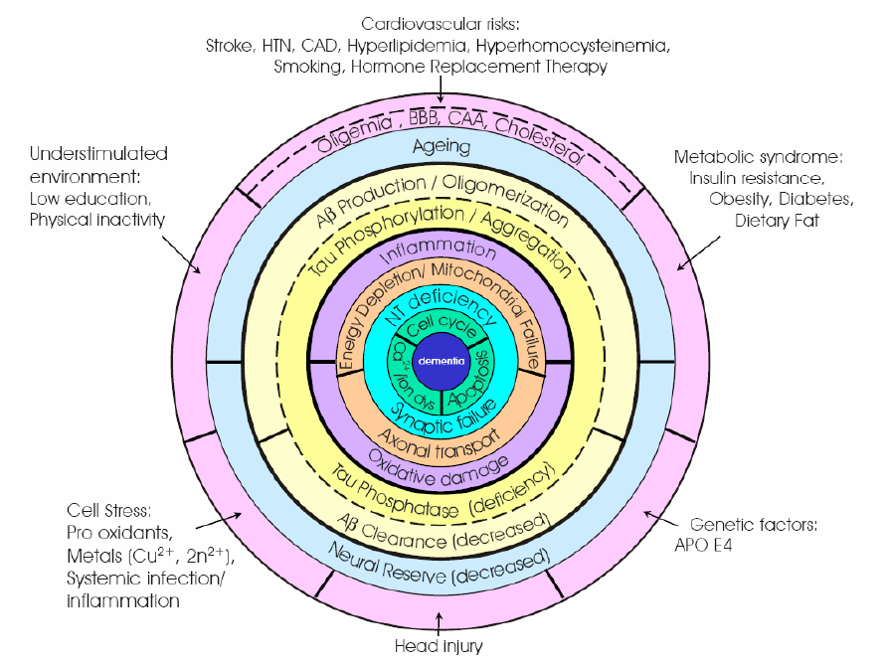
Querfurth & LaFerla, NEJM 2010;362
Notes:
26

Slide 27
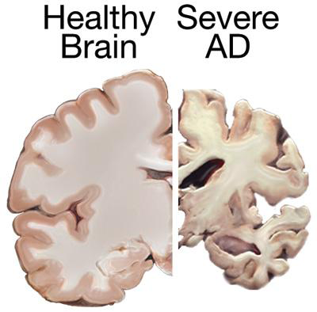
Brain Comparison
Ventricles enlarge
Cortex shrivels, especially near hippocampus
Notes:
cortex shrinks and shrivels up as the result of damage to the neurons, damaging areas involved in thinking, planning and remembering
Shrinkage is especially severe in the hippocampus, an area of the brain that plays a key role in formation of new memories sometimes known as the “memory bank”
ventricles are fluid-filled spaces within the brain, grow larger as the disease progresses, resulting in loss of cognitive function

Slide 28
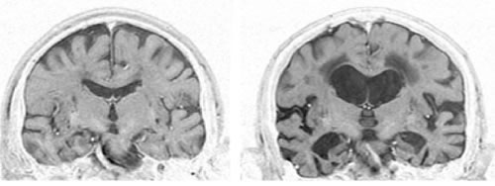
92-year-old male
cognitively intact
92-year-old male
severe AD
Notes:
28

Slide 29
Evidence-based Programs for Persons With Dementia and Their Caregivers

Slide 30
Evidence-based Programs
Saavy caregiver
Powerful Tools for caregiving
Reducing disabilities in AD (RDAD)
Practice improvement programs using collaborative care models

Slide 31
RDAD Citation
Teri L, Gibbons LE, McCurry SM, Logsdon RG, Buchner DM, Barlow WE, Kukull WA, LaCroix AZ, McCormick W, Larson EB. Exercise plus behavioral management in patients with Alzheimer disease. Journal of American Medicine. 2003. 290(15), 2015-2022. Retrieved at http://jama.ama-assn.org/cgi/reprint/290/15/2015.

Slide 32
RDAD Study Highlights
RCT with 153 Alzheimer’s patients and their caregivers
Intervention Group: Caregiver support and exercise training
Control Group: Caregiver support only
Notes:
In the RDAD study, 153 community-dwelling AD patients and their caregivers were randomly assigned to an exercise and caregiver training program (RDAD), or to routine medical care (RMC). The RDAD program was conducted in the participants’ homes for three months.

Slide 33
RDAD Study Results
Three Months:
  More likely to exercise 60 min+ each week
  Less depression
  Higher functioning
  Fewer restricted activity days
Two Years:
  Higher functioning
  Less likely to be placed in NH due to behavioral disturbances
  Less depression maintained
Notes:
After three months, the RDAD group was significantly more likely to exercise at least 60 minutes a week, and had fewer days of restricted activity, compared to the RMC group. RDAD participants also had improved physical role functioning and fewer symptoms of depression, while those in RMC were worse in both areas. At two years, RDAD participants continued to have better physical role functioning than RMC participants, and were less likely to have been placed in a nursing home due to behavioral disturbance. For participants with higher depression scores at baseline, those in RDAD improved significantly more than those in RMC and maintained their improvement at two years. The study concluded that exercise training combined with teaching caregivers behavioral management techniques improved physical health and depression in participants with Alzheimer’s disease.

Slide 34
Savvy Caregiver History
Developed in Minnesota in the late 1990s
Caregiving is an unexpected role
Benefits to caregivers:
  Increased skills, knowledge and confidence
  Improved beliefs about caregiving, reaction to behavioral symptoms and feelings of stress and burden

Slide 35
Savvy Caregiver Structure
6 classes, 2 hours each, meets weekly
Format: lecture, discussions, exercises, video clips, and homework
AV equipment
Non-scripted

Slide 36
Savvy Eligibility
Informal caregivers-family members and friends
An active caregiver
PWD lives at home or plans to return home
PWD moderate stage of the disease
Importance of pre-registration

Slide 37
Savvy Objectives
Appreciate scope and impact of work
Increase skills and knowledge
Adopt a more strategic outlook
Develop more effective strategies
Improve self-care skills
Improve the quality of life of care recipients
Increase involvement of families and other resources

Slide 38
Savvy Caregiver in CA
3-year statewide implementation project
5 Alzheimer’s Association Chapters
Over 1,200 caregivers participated
Free program
Funds for respite/transportation

Slide 39
Savvy Caregiver in CA Results
1/3 ethnically diverse: 149 Hispanic; 91 African-American; 79 Asian/Pacific Islander caregivers
Female
Under age 75
Higher levels of formal education
Higher income levels
Notes:
1/3 from ethnically diverse community

Slide 40
Savvy Caregiver in CA Results
Statistically significant improvements on:
  competence
  depression
  reaction to care recipient’s problems
  management of situation
Effective program with ethnically diverse caregivers

Slide 41
The Dementia Quality Care Problem
Poor quality of care: 38-44% of ACOVE met
  Conducting a cog evaluation if pos screen (25%)
  Checking medication to see if contributors (9%)
  Providing caregiver support (29%)
  Monitoring for Behavioral/Psychological sx (45%)
Poor linkages to community-based Resources

Slide 42
The Consequences
$130 billion in health care (2011)
3 times as many hospital stays
Higher medical provider, nursing home, home health, and prescription drug costs
15 million caregivers provided 17 billion hours of care worth $203 billion (2010)

Slide 43
Collaborative Care for Dementia
Randomized controlled trial
153 patients with Alzheimer’s disease
  84 collaborative care/ 69 usual care
Intervention: care management by APN in collaboration with primary care
Standard protocols for behavioral symptoms of dementia
Callahan CM, et al. JAMA 2006
Notes:
Measures: NPI, Cornell, ADL, resource use and caregiver depression survey

Slide 44
Collaborative Care for Dementia
Intervention patients
  More likely to be dementia meds and antidepressant
  Fewer behavioral symptoms
  Caregiver distress improved
  Caregiver depression improved
Callahan CM, et al. JAMA 2006

Slide 45
Program Translation at UCLA
Based on Indiana University dementia program based at urban health system serving indigent population that :
  reduced behavioral symptoms and caregiver stress by half at 12 months
  reduced ED visits, hospitalizations, and 30-day readmission by almost half
Lynchpin is Dementia Care Manager (NP) whose role is to tailor and facilitate the delivery components

Slide 46
UCLA Alzheimer’s & Dementia Care
Social
-Family
-Paid Caregivers
-Adult day care
-Support groups
-Financial planners
-Legal
-Spiritual
Medical
-PCP
-Neurologist
-Psychiatrist
-Specialists
UCLA
A&DC

Slide 47
What Patients Get
Management of dementia and behaviors
Counseling and education and linkage to UCLA programs (e.g., support groups, education, research)
Linkage to community-based services
All patients have ongoing follow-up at intervals determined by the care plan
  Usually first follow-up is within 1-2 weeks

Slide 48
What Physicians Get
E-mail with specific recommendations
  Medical (physician can accept or decline)
  Behavioral
  Education and social services (DCM does)
Detailed note in clinical record
Phone call if there is a safety concern
Periodic follow-up e-mail correspondence

Slide 49
Prevention of Dementia
Framingham Study
  Lifetime risk of Alzheimer’s
    1 in 5 women
    1 in 10 men
  5-year delay in Alzheimer’s onset
    Equivalent to lifetime risk reduction from
    14% to 7%!
Seshadri S et al. Stroke 2006;37:344
Notes:
49

Slide 50
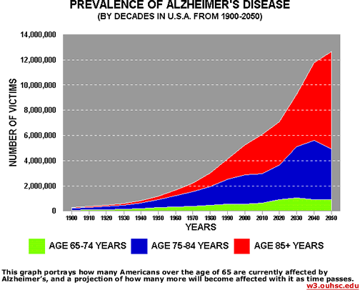
Why Should We Care?
Notes:
50

Slide 51
CDC Healthy Brain Initiative
Established in 2005, the overall intent of the Healthy Brain Initiative is to
  better understand the public health burden of cognitive impairment through surveillance;
  build a strong evidence base for policy, communication, and programmatic interventions for improving cognitive health;
  and translate that foundation into effective public health practice in states and communities

Slide 52
Healthy Brain Initiative Partners
CDC partnered with the Alzheimer’s Association and together they engaged other groups, including
    the National Institute on Aging at the National Institutes of Health (NIH),
    Administration on Aging (now within the Administration for Community Living),
    AARP, and other public and private sector organizations

Slide 53
CDC Healthy Brain Initiative: Objectives
To increase the proportion of persons with diagnosed Alzheimer’s disease and other dementias, or their caregiver, who are aware of the diagnosis.
To reduce the proportion of preventable hospitalizations in persons with diagnosed Alzheimer’s disease and other dementias (USDHHS, 2013a).
Developmental objectives currently do not have national baseline data and, therefore, have abbreviated or no operational definitions.

Slide 54
CDC Healthy Brain Initiative Objectives (continued)
To reduce the proportion of older adults who have moderate to severe functional limitations.
To increase the proportion of older adults with reduced physical or cognitive function who engage in light, moderate, or vigorous leisure-time physical activities.
To reduce the proportion of unpaid caregivers of older adults who report an unmet need for caregiver support services (developmental).

Slide 55
Healthy Brain Initiative Roadmap
Offers a “synergistic” model for
  moving science into practice based on several principles: a firm grounding in science, an emphasis on primary prevention, a community and population approach,
  and a commitment to eliminating disparities (CDC & Alzheimer’s Association, 2007).

Slide 56
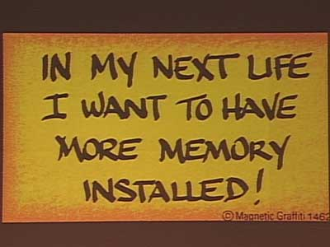
Notes:
56

